Slide 1
Sabbath Questions
Social Media Advertising Campaign – Fall 2018
A Case Study in Data-Driven Decision Making
Project Manager: Heidi Baumgartner, Washington Conference communication director

Slide 2
Rationale
Washington Conference is seeking to become a data-driven organization for decision making
Test images & messages with targeted audiences
Winning results inform future ad investments
Data-driven decisions
Low Initial Investment
Strategic Planning
Better Higher Investment
SabbathQuestions.com Social Advertising

Slide 3
Executive Summary
Our audience has specific preferences that are different from our expectations
Our current ads trend toward an older female audience appeal
Test new concepts and variables & BLITZ best results
Social ad results should inform larger ad buys for effective investment
Our two commercial spots performed well—just with different genders!
We reached nearly 40,000 people in 10 geo-targeted Washington communities for $875
SabbathQuestions.com Social Advertising
Summary Updated December 19, 2018

Slide 4
Campaign Introduction
North Pacific Union Conference asked Washington Conference to pilot a “Sabbath Questions” TV commercial
NPUC provided two videos, basic Wordpress website, and funding partnership for TV commercials (value: $15,000)
WAC provided website updates, content review, social testing, commercial ad placement contact, partial funding, and campaign management
SabbathQuestions.com Social Advertising
Conversations started in June 2018

Slide 5
Challenges
Commercials pre-developed for different market
Commercials purchased before social campaign developed
Website provided too much information
Quick website revamp needed more attention
Analytics access and availability: three people had different sets of information making it difficult to effectively track results – some results are still unknown
SabbathQuestions.com Social Advertising

Slide 6
5-Part Social Campaign Plan
Image Campaign
What images resonate best?
Message Campaign
What message resonates best?
Video Campaign
Which commercial resonates best?
Retargeting Campaign
How can we engage an interested audience?
Holiday Wildcard Campaign
What if we mix up everything we know?
SabbathQuestions.com Social Advertising

Slide 7
Image Campaign
1
SabbathQuestions.com
What does the Bible say about the Sabbath? Find out here!
1st Image
2nd Image
3rd Image
4th Image
5th Image
6th Image
Predicted Winner
Actual Winner
SabbathQuestions.com Social Advertising
Began Campaign: Monday, September 10, 2018

Slide 8
Image Campaign Content
6 Images, 1 Message
Text: What does the Bible say about the Sabbath? Find out here!
Website URL: SabbathQuestions.com
Headline: What is the Biblical Sabbath?
CTA: Learn More
No Overlay
Display Link: SabbathQuestions.com
News Feed Link Description: The Biblical Sabbath gives a life-changing day of rest
SabbathQuestions.com Social Advertising
Monday, September 10, 2018

Slide 9
Audience, Timeframe & Budget
2 week geo-targeted campaign
$75 Initial investment
Refine based on relevancy
Add budget as needed up to $150
Fall 2018 Targeted Areas
Demographic Info
Maple Valley
Tacoma Central
Oak Harbor
Centralia
Yelm
Port Orchard
Bremerton
Seattle Fil-Am (White Center)
Port Angeles
Lynnwood
Ages 18-65+
Men & Women
English Language
10 Mile Radius For Each City
People who don’t like our Facebook page
Campaign Hours: 6 pm to Midnight
SabbathQuestions.com Social Advertising
Monday, September 10, 2018

Slide 10
Week 1 Results
Results After One Week Invested $47.08 of $75 Budget
74 unique link clicks / 77 total link clicks
5 Link Clicks
395 Reach
425 Impressions
Relevance: NA
AD TURNED OFF AFTER ONE WEEK
9 Link Clicks
417 Reach
498 Impressions
Relevance: NA
AD TURNED OFF AFTER ONE WEEK
12 Link Clicks
518 Reach
558 Impressions
Relevance: 6
37 Link Clicks
1,416 Reach
1,540 Impressions
Relevance: 5
11 Link Clicks
629 Reach
744 Impressions
Relevance: 7
3 Link Clicks
265 Reach
306 Impressions
Relevance: NA
AD TURNED OFF AFTER ONE WEEK
*
*
*
SabbathQuestions.com Social Advertising
Monday, September 17, 2018

Slide 11
Week 1 Evaluation
74 Unique Link Clicks from Facebook Ads
0 Free Book Requests on Website
Landing Page Not Converting
Plan of Action
Revise landing page based on industry best practices (plus top performing image)
Test & verify book request contact form
Continue running Top 3 ads
Prepare for the start of commercials (begins 9/17/18)
Monitor web conversions
Extend and reinvest in Top Ads for 2 weeks (if it is converting)
SabbathQuestions.com Social Advertising
Monday, September 17, 2018
Notes:
20 e-book landing page case studies: https://instapage.com/amp/ebook-landing-page-examples

Slide 12
Week 2 Results
Results After Two Week Campaign Invested $75 Budget
112 unique link clicks / 120 total link clicks
5 Link Clicks
395 Reach
425 Impressions
Relevance: NA
AD TURNED OFF AFTER ONE WEEK
9 Link Clicks
417 Reach
498 Impressions
Relevance: NA
AD TURNED OFF AFTER ONE WEEK
15 Link Clicks
937 Reach
1,125 Impressions
Relevance: 6
64 Link Clicks
2,790 Reach
3,238 Impressions
Relevance: 6
24 Link Clicks
1,522 Reach
1,918 Impressions
Relevance: 7
3 Link Clicks
265 Reach
306 Impressions
Relevance: NA
AD TURNED OFF AFTER ONE WEEK
*
*
*
SabbathQuestions.com Social Advertising
Monday, September 24, 2018

Slide 13
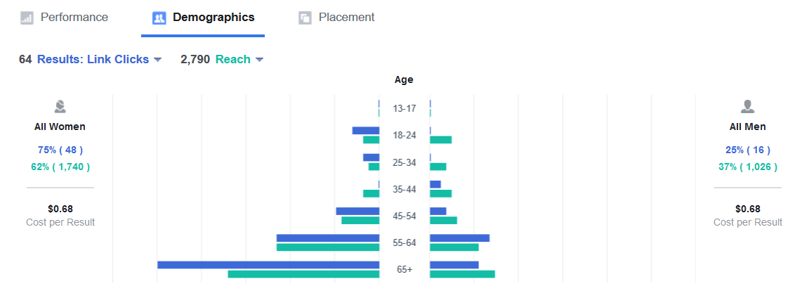
Facebook Charts
Top Image Demographic Appeal
Some interest with younger audience!
Higher appeal to older audiences
Campaign Results Chart
SabbathQuestions.com Social Advertising
September 23, 2018

Slide 14
Campaign Check-In
Google Analytics user reports 160 website hits
120 Total Clicks / 112 Unique Clicks
5,512 Reach
7,511 Impressions
$0.63 per link click
1.36 Frequency
4 Books Requested (2 from FB, 2 from TV)
TV Commercial Ran During Second FB Ad Week
Commercials Suspended After 1 Week for Internal Strategic Review
*Confirmation book offer is functioning; Needs more ad exposure before changes made.
SabbathQuestions.com Social Advertising
Monday, September 24, 2018

Slide 15
Time to Change?
At this point in the campaign, there was lots of conversation to change “everything” including graphics, the offer, forms, and more.
We decided to keep the offer as-is, tweak website components, install Facebook Pixel, and re-engage the campaign.
SabbathQuestions.com Social Advertising

Slide 16
Facebook Pixel
Why Pixel
96 page views from 36 unique visitors
Viewed all web pages
Viewed on desktop + mobile
Max time: 3 minutes
61% bounce rate (industry standard range)
No currently running advertisements! (FB or TV)
Pixel Report for Sept. 26-Oct 1
Allows us to create custom audiences for retargeting social campaigns. Options include:
All web visitors
People who visited specific pages
Visitors by time spent
By date
Visitors who did not request a free book
SabbathQuestions.com Social Advertising
Installed Wednesday, September 26, 2018

Slide 17
Message Campaign
2
Test A-B-C Messages
Messages to Test Later
A Day of Rest? Yes, Please! Learn why God said, “Remember the Sabbath,” the fourth commandment God wrote using His own finger!
A Day of Rest? Yes, Please! Guess what? A day of rest is Biblical! It's mentioned 175 times in scripture!
A Day of Rest? Yes, Please! In this busy, fast-paced 24/7 world of deadlines and stress, a day off. A Sabbath rest. Sound appealing? It is!
SabbathQuestions.com Headline Study scripture for yourself to see what God’s word has to say about a Sabbath day of rest!
SabbathQuestions.com Headline More than 100 languages translate the seventh day of the week as “Sabbath.” Find out why!
SabbathQuestions.com Headline Discover 30 Biblical reasons for keeping a seventh-day Sabbath of rest!
A
X
Predicted Winner
* Facebook fan suggestion!
B
X
C
Actual Winner
X
Message on Target!
SabbathQuestions.com Social Advertising
Campaign Began Monday, October 1, 2018

Slide 18
Message Campaign Specs
Marketing objective: Traffic to website
Split test A/B/C messages for creative
Audience: Evangelism Geo-Targets Fall 2018
Campaign optimized for Link Clicks
Lifetime budget: $150 (split 3-ways)
7-day campaign, no schedule limits
Pixel enabled
Conversational Tone
Required Minimum Budget $35 Each
SabbathQuestions.com Social Advertising
Monday, October 1, 2018

Slide 19
Message Campaign Content
1 Image, 3 Messages
Text 1: Learn why God said, “Remember the Sabbath,” the fourth commandment God wrote using His own finger!
Text 2: Did you know? The Biblical Sabbath is referenced 175 times in scripture. Explore more!
Text 3: In this busy, fast-paced 24/7 world of deadlines and stress, a day off. A Sabbath rest. Sound appealing? It is!
Website URL: SabbathQuestions.com
Headline: A Day of Rest? Yes, Please!
CTA: Learn More
No Overlay
Display Link: SabbathQuestions.com
News Feed Link Description: The Biblical Sabbath gives a life-changing day of rest
SabbathQuestions.com Social Advertising
Monday, October 1, 2018

Slide 20
Message Results
475 Pixel “Events” (page views) between October 1-8
Test A-B-C Messages
A Day of Rest? Yes, Please! Learn why God said, “Remember the Sabbath,” the fourth commandment God wrote using His own finger!
A Day of Rest? Yes, Please! Guess what? A day of rest is Biblical! It's mentioned 175 times in scripture!
A Day of Rest? Yes, Please! In this busy, fast-paced 24/7 world of deadlines and stress, a day off. A Sabbath rest. Sound appealing? It is!
A
Ad A
56 clicks
3,700 reach
5,729 impressions
1.55 frequency
5 relevancy
$0.87 per link click
Ad B
62 clicks
4,801 reach
7,183 impressions
1.5 frequency
5 relevancy
$0.79 per link click
Ad C
67 clicks
5,170 reach
8,193 impressions
1.58 frequency
5 relevancy
$0.75 per link click
* Facebook fan suggestion!
B
* Website content
C
*
* Commercial message
SabbathQuestions.com Social Advertising
End Campaign: Monday, October 8, 2018

Slide 21
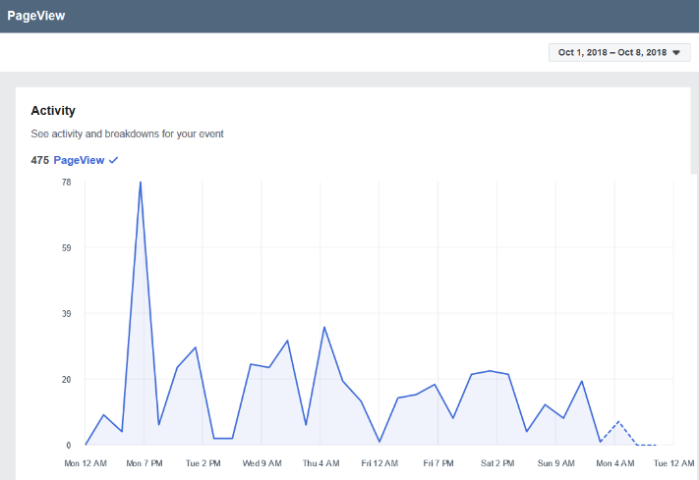
Facebook Charts
Pixel Activity
Message Campaign Highlights
185 clicks in one week
13,486 reach
21,103 impressions
Confirmation that commercial message is well-targeted
475 website page views
Top Message Demographic Appeal
Campaign Results Chart
SabbathQuestions.com Social Advertising
Monday, October 8, 2018

Slide 22
Website Stats
SabbathQuestions.com Social Advertising
Monday, October 8, 2018

Slide 23
Web Referrals & Top Pages
← Matches with Mobile Views →
Top 3 Beyond Home Page:
Spots (not directly linked on site)
Locate a Church
Was It Changed?
SabbathQuestions.com Social Advertising
Monday, October 8, 2018

Slide 24
Website Overview Report, v. 1
TV Commercial Begins
Pixel Installed
TV Paused
Image Testing Week 1, Response Form Update Needed
Website Updates
Image Testing Week 2
No Ads Running
Message Testing
1 Session = 1 Visit
SabbathQuestions.com Social Advertising
Monday, October 8, 2018

Slide 25
New Web Header
Challenge: Still low numbers on “web conversions” to request a free book.
Additional Web Tweaks
Text Over Image | Arrow Graphic | Button-Like Graphic
Whole Image Links to Request Page | Free Book! Added to Navigation
Multiple Points of Entry for “Free Book” Offer
SabbathQuestions.com Social Advertising
Added: Monday, October 8, 2018

Slide 26
Video Ad Campaign
3
Two video spots
Winning message
Identical geo-targeted audience
Additional web tweaks to emphasize free book offer
10-day blitz with a $500 budget
FOLLOW-UP RETARGETING MESSAGE
http://sabbathquestions.com/book-request/
Request your FREE BOOK on Biblical Sabbath-keeping and discover a sacred retreat in a frantic world!
SabbathQuestions.com Social Advertising
Campaign Begins Monday, October 8, 2018

Slide 27
Video Campaign Content
Video 1: Slow Down
Text: In this busy, fast-paced 24/7 world of deadlines and stress, a day off. A Sabbath rest. Sound appealing? It is! Find answers to commonly asked questions, plus request a FREE book on the Biblical Sabbath!
Website URL: SabbathQuestions.com
Headline: A Day of Rest? Yes, Please!
CTA: Learn More
No Overlay
Display Link: SabbathQuestions.org
News Feed Link Description: In this busy, fast-paced 24/7 world of deadlines and stress, a day off. A Sabbath rest. Sound appealing? It is!
Video 2: Remember
Text: Remember the Sabbath day to keep it holy. What does that mean for our lives today? Explore the concept of the Biblical Sabbath, find answers to commonly asked questions, and request a FREE book on the Biblical Sabbath!
Website URL: SabbathQuestions.com
Headline: Discover the life-changing gift of the Biblical Sabbath!
CTA: Learn More
No Overlay
Display Link: SabbathQuestions.org
News Feed Link Description: Remember the Sabbath day to keep it holy. What does that mean for our lives today?
SabbathQuestions.com Social Advertising
Monday, October 1, 2018

Slide 28
Video Campaign Content
Video 1: Slow Down Transcript
In this busy, fast-paced 24-7 world of deadlines and stress a day off. The Sabbath rest. Saturday, the seventh day Sabbath, was created for our benefit. A day of rest and worship to slow down and reconnect with God. What does that mean for our lives today? To find a church that worships on Saturday or to find answers to your questions about the Sabbath, visit www.sabbathquestions.org
Video 2: Remember Transcript
Remember the Sabbath day to keep it holy. What does that mean for our lives today? Many people are surprised to learn that the Bible Sabbath is really Saturday and not Sunday. Does it make a difference? Is there something special about the seventh day? Well, yes! The scriptures say God rested, blessed, and made holy the Sabbath day. To find a church that worships on Saturday or to find answers to your questions about the Sabbath, visit www.sabbathquestions.org
SabbathQuestions.com Social Advertising
Monday, October 1, 2018

Slide 29
Ad Set Details
Objectives & Results
Objective: Traffic to Website
No additional offers
Identical Geo-Targeted Audience
Edited Placement: FB Feed, Right Column, Audience Network
Optimized/Charged for: Link Clicks
Lifetime Budget: $500 for 10 days
SabbathQuestions.com Social Advertising
Updated Monday, October 22, 2018

Slide 30
Video Campaign Results
Both video ads performed well!
“Slow Down” Script
Budget: $250
Timeframe: 10-day Blitz
233 Link Clicks
205 Unique Link Clicks
10,026 Reach
15,479 Impressions
Relevancy Score 4
“Remember” Script
Budget: $250
261 Link Clicks
230 Unique Link Clicks
10,348 Reach
16,054 Impressions
Relevancy Score 5
TOTAL
Budget: $500
Timeframe: 10-day Blitz
494 Link Clicks
418 Unique Link Clicks
17,360 Reach
31,532 Impressions
Timeframe: 10-day Blitz
Reach = Number of people who saw ad. Impressions = Number of times ad seen on screen.
SabbathQuestions.com Social Advertising
Monday, October 22, 2018

Slide 31
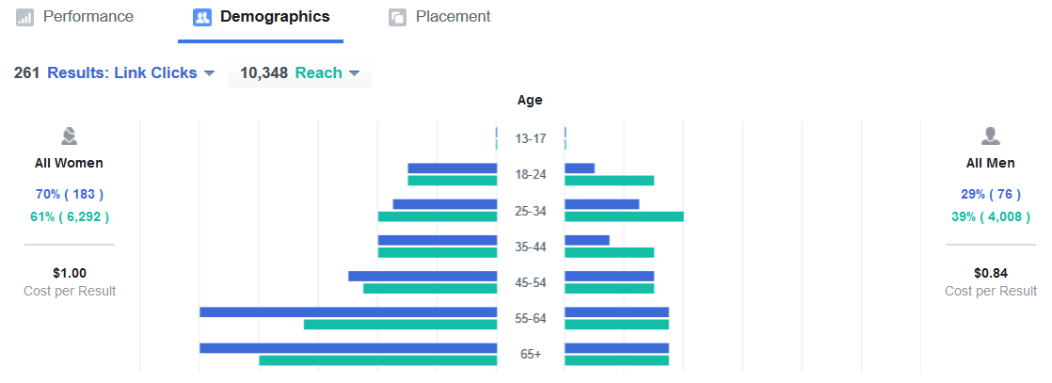
Video Demographics
Both video ads performed well!
Slow Down
Higher appeal to men
Remember
Higher appeal to women
Higher appeal to older audiences
SabbathQuestions.com Social Advertising
Monday, October 22, 2018

Slide 32
Website Overview Report, v. 2
Pixel Installed
TV Paused
Active Social Campaigns Conclude
Image Testing Week 2
No Ads Running
Message Testing
Video Ad Blitz
Unknown # of Book Requests
Remained the Same %
Mobile Increased
SabbathQuestions.com Social Advertising
Monday, October 22, 2018

Slide 33
Retargeting Campaign 1.0
4
Engagement Focus
FOLLOW-UP RETARGETING ENGAGEMENT MESSAGE
http://sabbathquestions.com/book-request/
Request your FREE BOOK on Biblical Sabbath-keeping and discover a sacred retreat in a frantic world!
SabbathQuestions.com Social Advertising
Campaign Began November 5, 2018

Slide 34
Retargeting Results
Engagement Focus
Clutched Bible Ad
15 Post Engagements (13 women, 2 men)
2 Link Clicks
274 Reach
2.42 Frequency
Relevancy 3
Father Son Ad
42 Post Engagements (36 women, 6 men)
4 Link Clicks
381 Reach
3.59 Frequency
Relevancy 3
SabbathQuestions.com Social Advertising
November 12, 2018

Slide 35
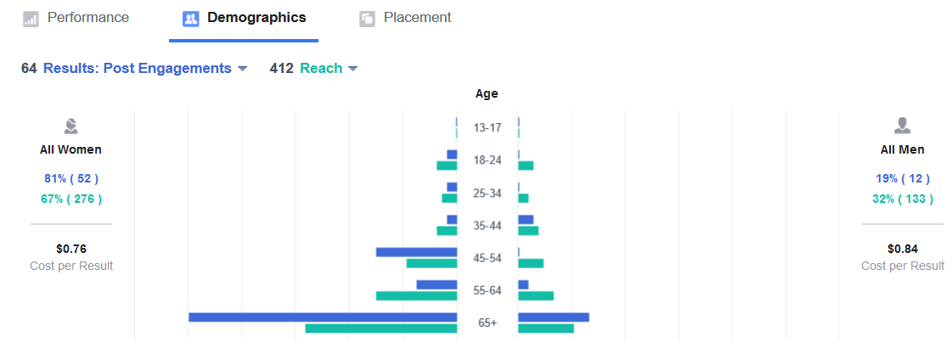
Engagement Results
Engagement Focus
TARGET
Smaller overall audience
Viewers of 50% of video
Previous website visitors
RESULTS
64 Engagements (predicted: 6-30)
412 Reach (predicted: 100-500)
Still higher appeal to older women
One week investment: $50
DETAILS
6 images, 1 message
Top 3 tested images + 3 video screenshots
Turned off 4 images
SabbathQuestions.com Social Advertising
November 12, 2018

Slide 36
Retargeting Campaign 2.0
4
Traffic Focus
FOLLOW-UP RETARGETING TRAFFIC MESSAGE
http://sabbathquestions.com/book-request/
Request your FREE BOOK on Biblical Sabbath-keeping and discover a sacred retreat in a frantic world!
SabbathQuestions.com Social Advertising
Campaign Begins Monday, November 19, 2018

Slide 37
Traffic Predictions
Same $50 Budget
Same Audience
Same Images (top 3)
Refined Message
Different Objective (Traffic vs. Engagement)
Thanksgiving Week Timeline
Campaign Specs
Reach: 270-710
Landing Page Views: 4-20
Pre-Campaign Predictions
SabbathQuestions.com Social Advertising
Monday, November 19, 2018

Slide 38
Traffic Campaign Content
3 Images, 1 Message
Text: Request your FREE BOOK on Biblical Sabbath-keeping and discover a sacred retreat in a frantic world! A gift from SabbathQuestions.com!
Website URL: http://sabbathquestions.com/book-request/
Headline: FREE BOOK on Biblical Sabbath-keeping!
CTA: Learn More
No Overlay
Display Link: SabbathQuestions.com
News Feed Link Description: Read about the gift of a life-changing day of rest!
SabbathQuestions.com Social Advertising
Monday, November 19, 2018

Slide 39
Retargeted Results
Ad Sets Targeted to Previous Website Visitors As Identified by Facebook Pixel
Engagement Overall Results
64 Post Engagements
412 Reach
2,449 Impressions
$50 Budget
17 Landing Page Views
399 Reach
2,143 Impressions
$50 Budget
Age Appeal: 65+, 45-54
Traffic Results
Gender Appeal: 52 Women, 12 Men
Age Appeal: 65+, 45-54, 55-64
Gender: 15 Women, 2 Men
SabbathQuestions.com Social Advertising
Reported December 13, 2018

Slide 40
Engagement vs. Traffic Results
Image 1
15 Post Engagements
275 Reach (187 Women, 86 Men)
Image 3
42 Post Engagements
396 Reach (265 Women, 128 Men)
4 Additional Images
1-2 Post Engagements
Turned Off Early
Image 1
8 Landing Page Views
279 Reach (181 Women, 97 Men)
5 Relevancy
Image 2
4 Landing Page Views
258 Reach (172 Women, 85 Men)
4 Relevancy
Image 3
5 Landing Page Views
319 Reach (210 Women, 106 Men)
4 Relevancy
SabbathQuestions.com Social Advertising
Reported December 13, 2018

Slide 41
Holiday Wildcard Campaign
5
Thanksgiving Week
New Message
Similar Images
Washington Audience
Traffic Objective / Prediction
1,300-8,100 Reach
33-200 Landing Page Views
Widened Audience to Washington
Tie to Thanksgiving Holiday
4 New, 2 Tested
Went Beyond 10 Initial Geo-Targeted Zip Codes
1
2
3
4
5
6
SabbathQuestions.com Social Advertising
Campaign Begins Wednesday, November 21, 2018

Slide 42
Wildcard Campaign Content
6 Images, 1 Message
Text: A day of Thanksgiving once a year? Or a day of Thanksgiving every week? Your choice!
Website URL: http://sabbathquestions.com/
Headline: FREE BOOK on Biblical Sabbath-keeping!
CTA: Learn More
No Overlay
Display Link: SabbathQuestions.com
News Feed Link Description: Discover the benefits of the Biblical Sabbath!
SabbathQuestions.com Social Advertising
Monday, November 19, 2018

Slide 43
Wildcard Results
Image 1
6 Landing Page Views
Image 2
0 Landing Page Views (Inactive)
Image 3
17 Landing Page Views
Image 4
1 Landing Page View (Inactive)
Image 5
0 Landing Page Views (Inactive; Previous Front Runner)
Image 6
11 Landing Page Views
885 Reach (418 Women, 460 Men)
7 Relevancy
245 Reach (118 Women, 123 Men)
-- Relevancy
1,141 Reach (703 Women, 427 Men)
6 Relevancy
139 Reach (76 Women, 63 Men)
87 Reach (50 Women, 36 Men)
-- Relevancy
793 Reach (471 Women, 307 Men)
7 Relevancy
TURNED OFF
TURNED OFF
TURNED OFF
*
*
*
Campaign Totals: 35 Landing Page Views | 2,590 Reach | 3,910 Impressions | $50 Budget
SabbathQuestions.com Social Advertising
Reported December 13, 2018

Slide 44
Website Overview Report, v. 3
Top 3 Pages:
Home Page 94
Free Book 32
Locate a Church 8
Dual Campaigns Running
Pixel Retargeting Begins
Wildcard Begins
Campaigns conclude
SabbathQuestions.com Social Advertising
Reported December 13, 2018

Slide 45
Total Social Investment
Nearly 40,000 People Reached!
Image Campaign
$75 Investment
5,512 Reach
Message Campaign
$150 Investment
13,486 Reach
Video Campaign
$500 Investment
17,360 Reach
Retargeting Campaign x2
$100 Investment
412 Clicks (Engage)
Totals:
$875 Investment*
39,759 Reach
399 Clicks (Traffic)
Holiday Wildcard
$50 Investment
2,590 Reach
*Budget Designation
$375 Communication Budget
$500 Evangelism Budget
SabbathQuestions.com Social Advertising
Updated December 13, 2018

Slide 46
Recommended Next Steps
FOLLOW-UP Timeframe still to be determined
FOLLOW-UP Test each new campaign element added to gauge audience appeal
Resume commercials (pre-paid)
Establish a better web presence, platform, & analytics access
Run more “Retarget” ads over time to encourage Free Book requests
Test additional campaign concepts
Use a variety of demographic voices for content creation
Invest in more Facebook ads (photo and/or video)
IDEA Seek to appeal to different age groups, genders
SUGGESTION Transition from SabbathQuestions individually-themed website to “Adventist Neighbors” campaign website (already owned) with full-access to analytics and integrated social media
SabbathQuestions.com Social Advertising
Updated December 13, 2018
Notes:
Future Testing Cycle To Test:
1 Week Images
1 Week Message
2 Week Video Campaign

