Slide 1
Beyond the Basics
Session 1 – Web Tracking + introduction to Google analytics
Notes:
Thank you for coming to the first session of our advanced social media course!

Slide 2
Four sessions
Session 1: Web Tracking + Introduction to Google Analytics
Session 2: Basics of Placing Targeted, Paid Social Media Ads
Session 3: Basics of Social Media Insights & Reporting
Session 4: Event Campaigns, Goals, Strategy, Budget, and Results
Notes:
Feel free to grab an outline to follow along with for this series.

Slide 3
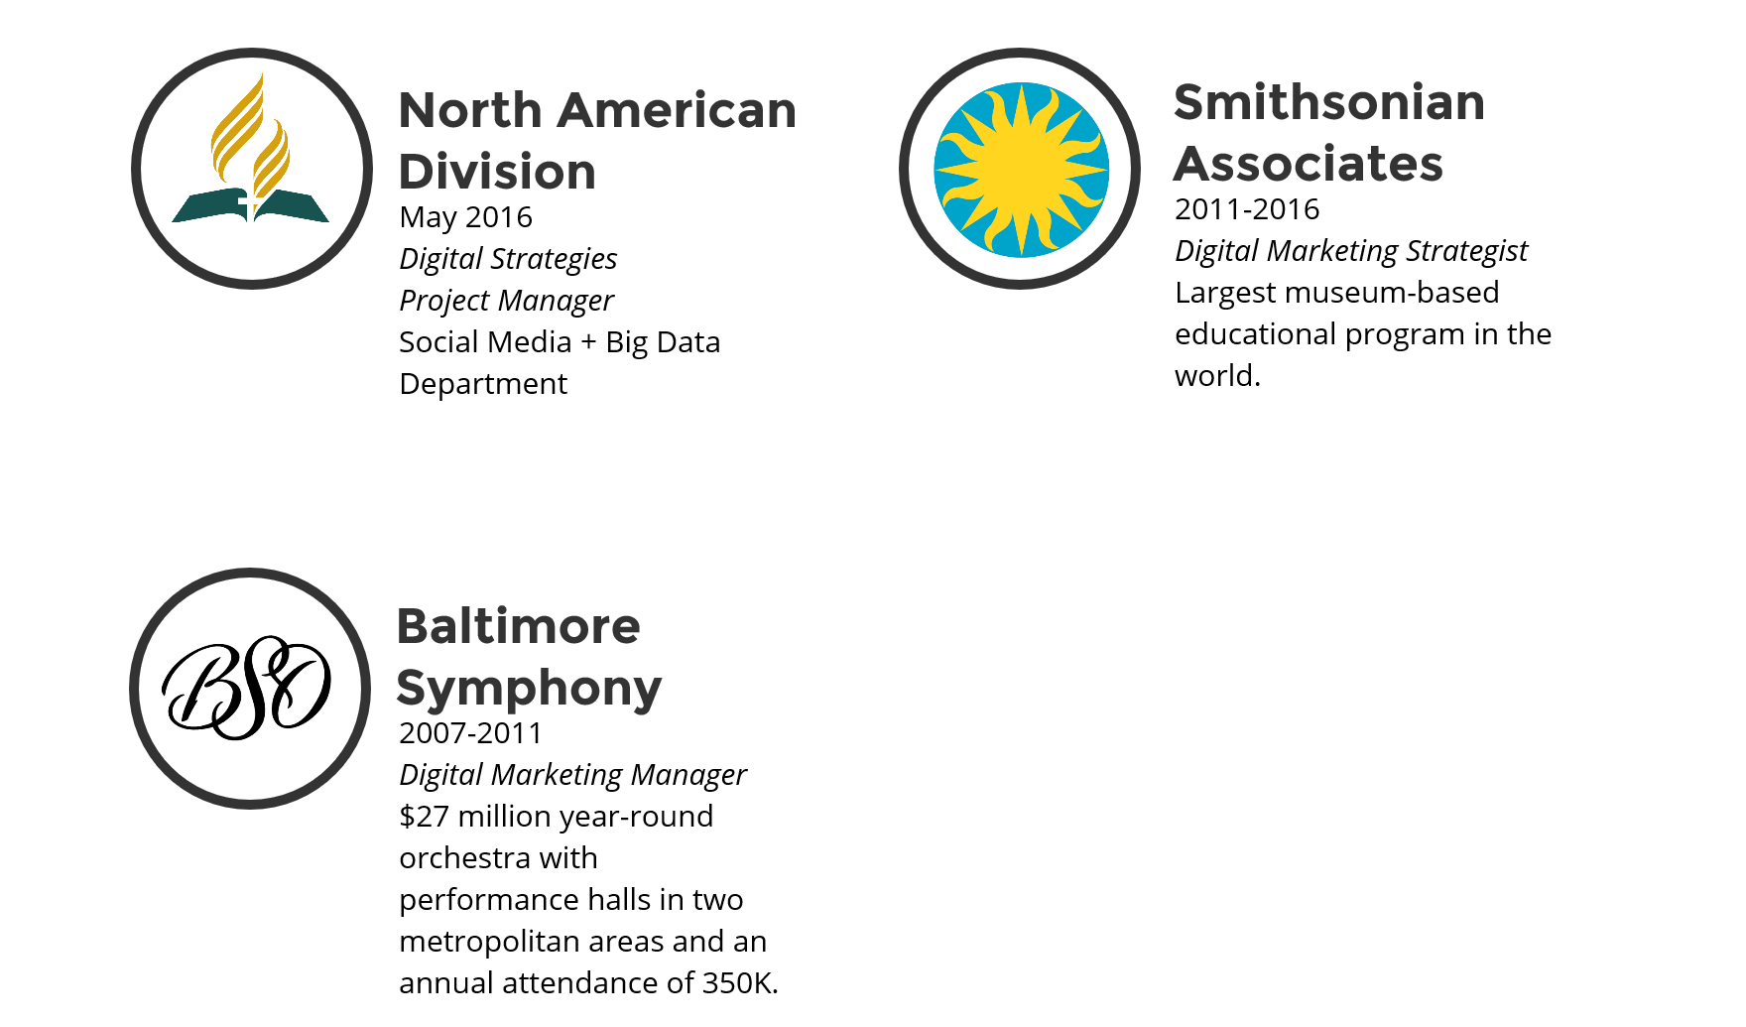
Who am I?
Notes:
For those of you who haven’t attended one of my classes before, a little bit about who I am. With 10 years experience, my specialty is building multi-channel, multi-platform digital strategies from the ground up with limited budget and resources. I am part of a new department at NAD called Social Media & Big Data that serves to connect members & mission through technology.

Slide 4
Why is tracking important?
Learning and adapting our strategies

Slide 5
If you can track it, you can measure it.
Notes:
As a result, you can better understand your audience, and their behavior in order to adapt your strategies to more effectively reach them. Saving both time and money

Slide 6
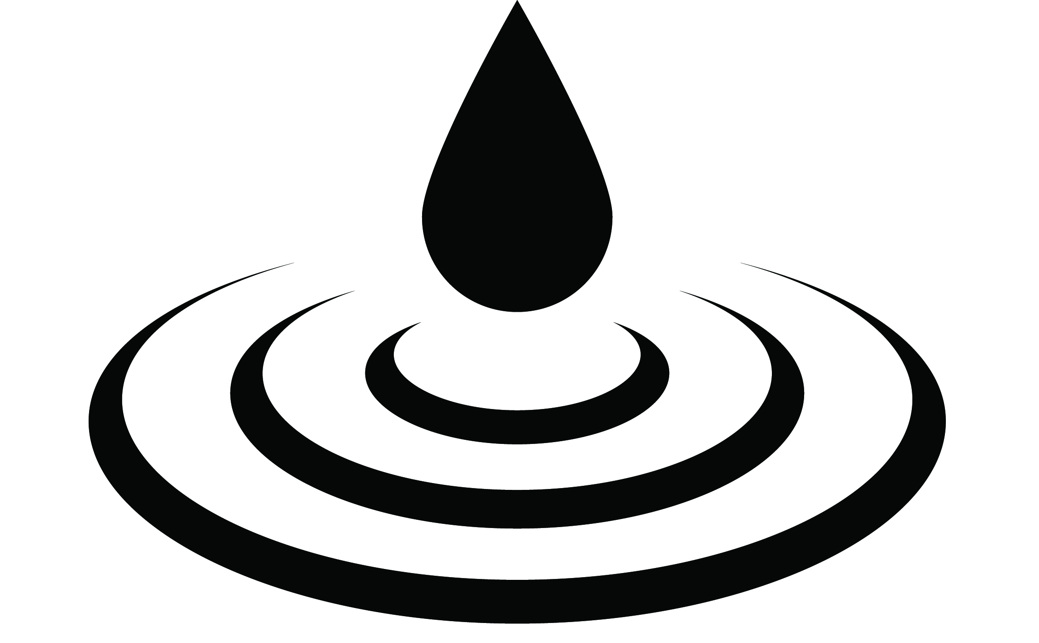
Notes:
while maximizing impact.

Slide 7
UTM Codes
A Guide to creating your own
Notes:
This is surprising very easy to do, which actually makes it difficult to teach because people feel like they are missing something. I assure you, it really is this straight forward.

Slide 8
What is a UTM code?
UTM = Urchin Tracking Module
https://www.ittoshow.com/?&utm_campaign=NADnow-2017&utm_source=Social-Media
Helps you measure & prove social media success!
Notes:
UTM = Urchin Tracking Module. UTM codes are segments appended to the end of a URL that enables data platforms like Google Analytics to record information about website visitors and traffic sources.

Slide 9
Where can they be used?
Social Media
Email
Online Ads
Website Links
In any link that drives traffic to your website

Slide 10
Creating Your Own Tracking Links
https://www.ittoshow.com/?&utm_campaign=NADnow-2017&utm_source=Social-Media
Regular link + ? + Campaign (what event, month, where, etc.) + Source (channel/platform)
Notes:
Explain the building blocks

Slide 11
Demonstration
Url = https://www.adventistlearningcommunity.com/faith-reason-earth-history
Campaign = FaithReasonEarth-2017
Source = Social-Media
Put it all together using this formula: Regular link + ? + Campaign (what event, month, where, etc.) + Source (channel/platform) https://www.adventistlearningcommunity.com/faith-reason-earth-history?&utm_campaign=FaithReasonEarth-2017&utm_source=Social-Media
Notes:
Talk through process & demonstrate

Slide 12
Be sure to always test your links!
Notes:
After you create your trackable link, always test your link before using it to make sure it works. There is nothing worse than sending out a bunch of digital content with a broken link.

Slide 13
Your turn!
Notes:
Now that it’s been explained. I want you to partner with the person next to you and create a trackable link using this formula. You have five minutes. Then I’ll walk around and check your work.

Slide 14
URL Shorteners
Why, how, & benefits

Slide 15
Why shorten your links?
Saves valuable space in your social media posts
Hides/masks UTM codes (trackable links)
Looks cleaner for marketing messages
Easy to share
Built in tracking

Slide 16
THIS: https://www.adventistlearningcommunity.com/faith-reason-earth-history?&utm_campaign=FaithReasonEarth-2017&utm_source=Social-Media
BECOMES: https://goo.gl/ZaBXgL
Notes:
URL shortening allows you to tighten up a long trackable URL to something short and easy to copy for social media posts.

Slide 17
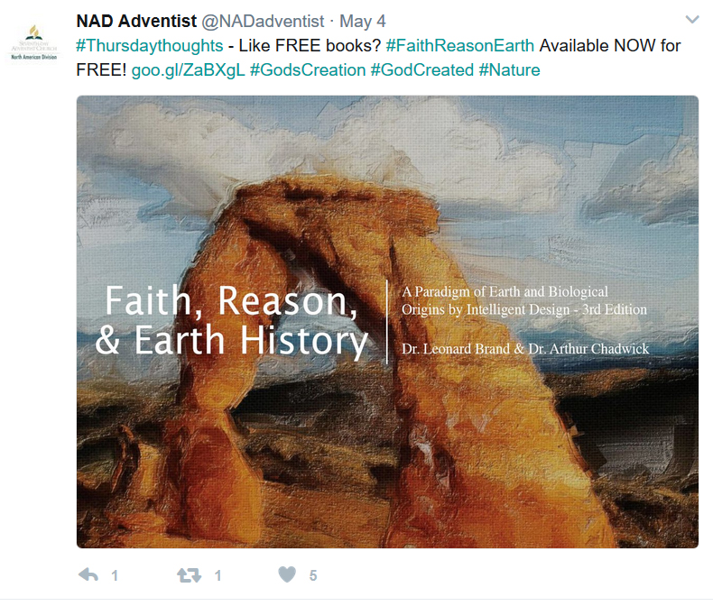
Notes:
This shortened url then fits much better in social media posts, especially Twitter.

Slide 18
They track too!
Notes:
As I mentioned before, many link shortening tools also track click-throughs. Here you can see that this particular link is actually performing quite well. Now because we used UTM codes, we can actually get more in-depth data. But more on that in a moment.

Slide 19
The Short List of URL Shorteners
Goo.gl – Provided by Google with built-in individual link analytics
Rebrandly.com – Create & share short links with your domain name
Bit.ly – Shorten, brand, & optimize links while tracking individual link analytics
Ow.ly – Provided by Hootsuite with built in analytics
Hiveam.com – Link management dashboard
Tr.im – Link management dashboard
There’s more….
Notes:
These are a few of the top options. Many are available for your phone and iPad as well.

Slide 20
Your turn! Remember, keep it short.
Notes:
Demonstrate and then have them shorten the trackable link they created in their groups. Walk around and check.

Slide 21
Google Analytics
OVERVIEW & SET UP
Connecting the Dots
Notes:
Now we know how to append UTM codes to our links, and then shorten them. Let’s see how that information then connects to the data in Google Analytics.

Slide 22
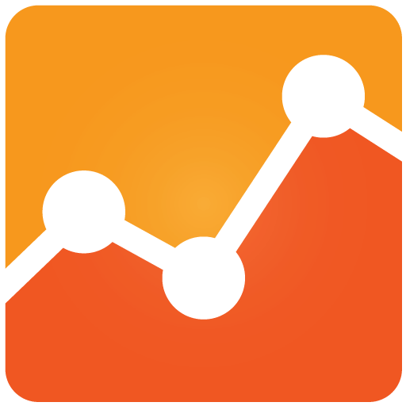
What is it & why do you need it?
Google Analytics is a free and essential tool for monitoring and understanding how visitors interact with your website and where they come from.

Slide 23
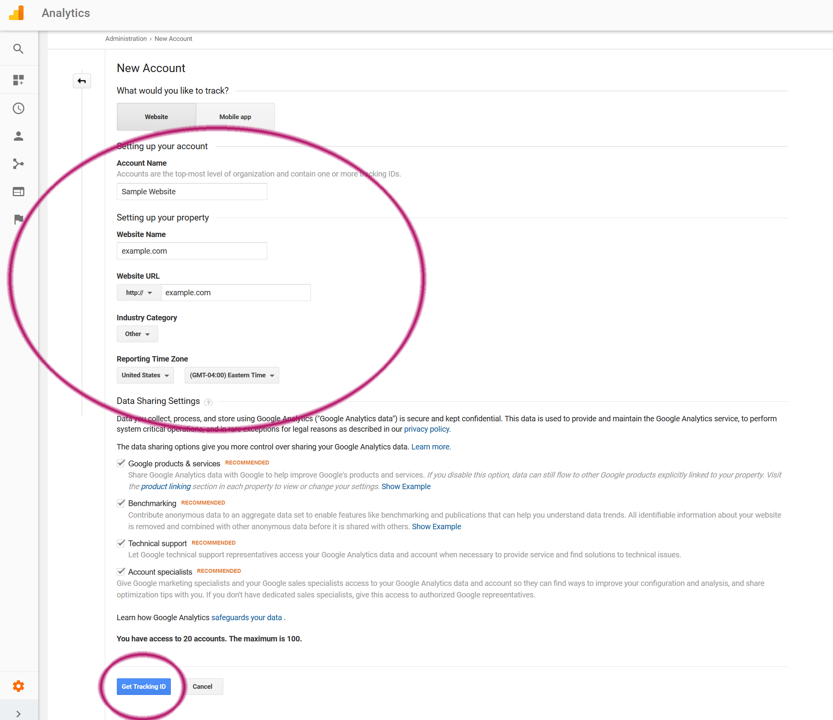
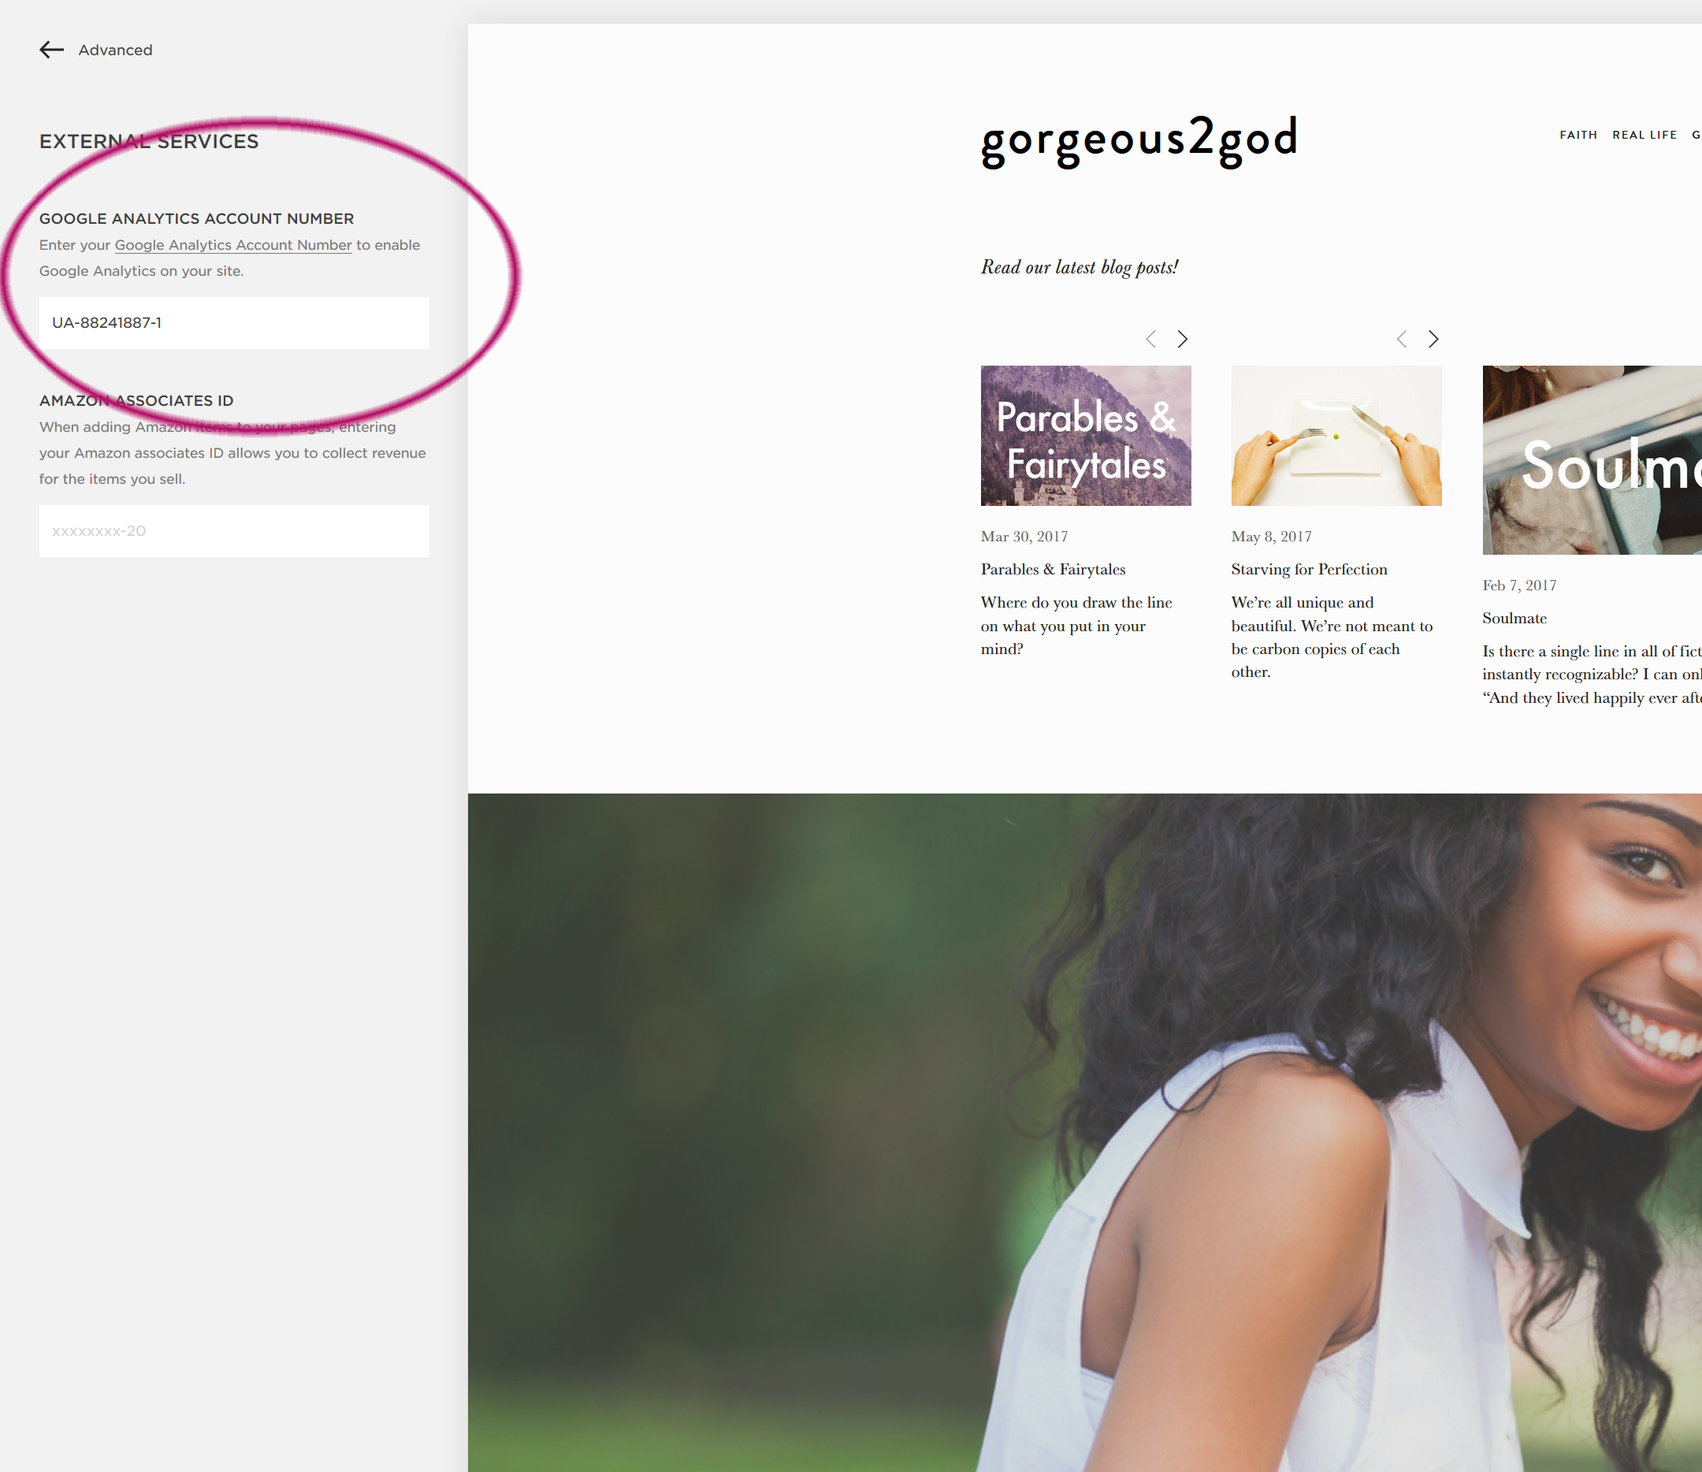
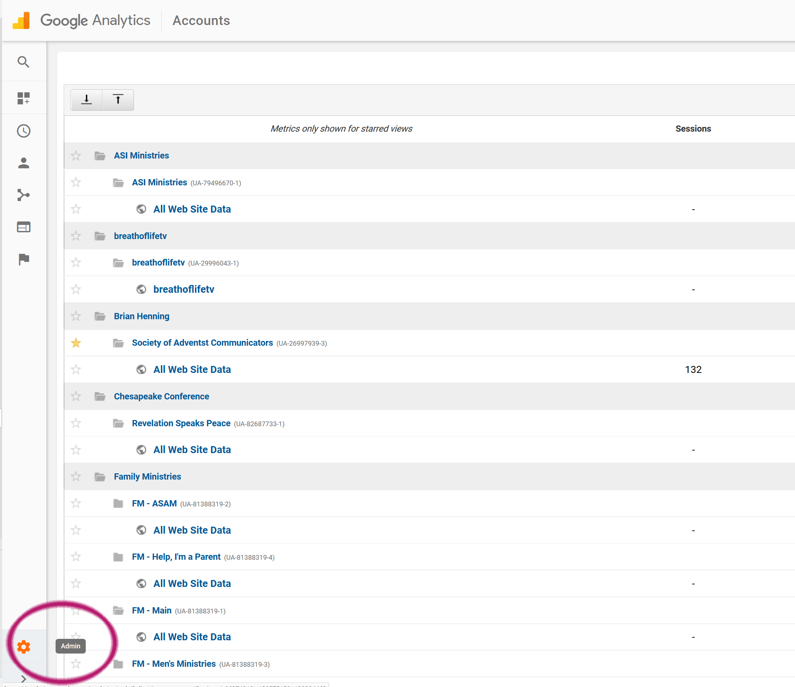
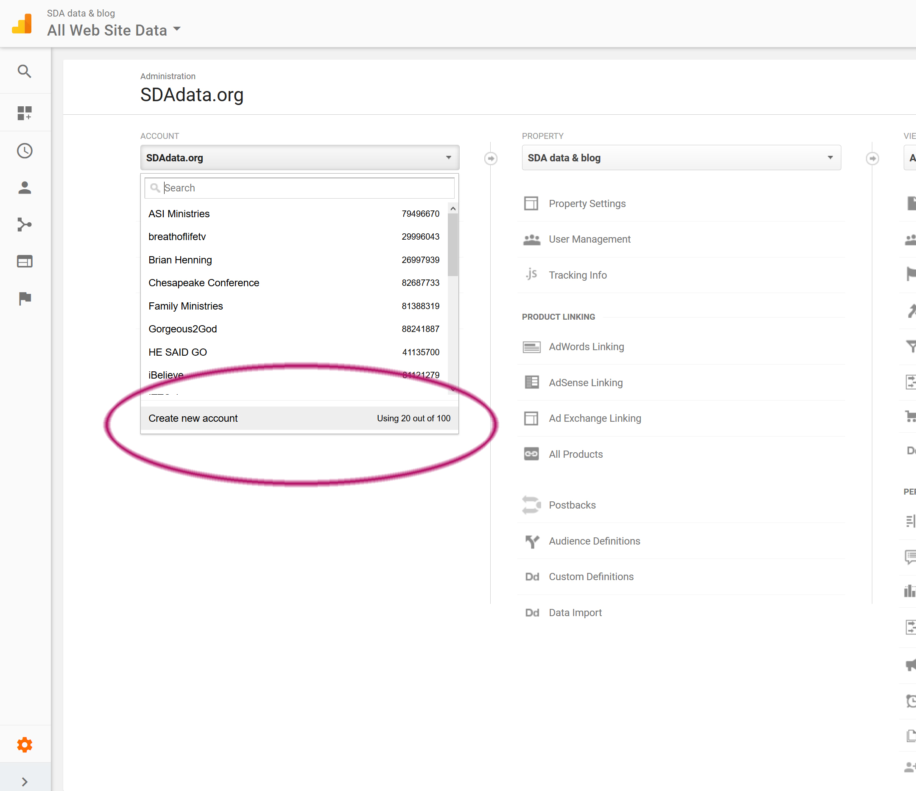
Squarespace Example
Set up:
Go to google.com/analytics
If you have a google account, sign in. If not, create an account.
Set up your website in Admin that will serve as a data collection point.
Add the Analytics tracking code to your website. Will be slightly different for each website platform.
Wait 24 hours for data to begin to appear.

Slide 24
Key terms/metrics
Session: a visit to the website during which the user is active
Users: number of unique people who have visited your website during a specific timeframe
Pageviews: total number of pages viewed. Repeated views of a page by a single user are counted
Page/Session: average number of pages viewed during a session
Average Session Duration: average length of a session
Bounce Rate: the percentage of single-page sessions in which there was no interaction with the page
% New Sessions: estimated percentage of first-time visitors

Slide 25
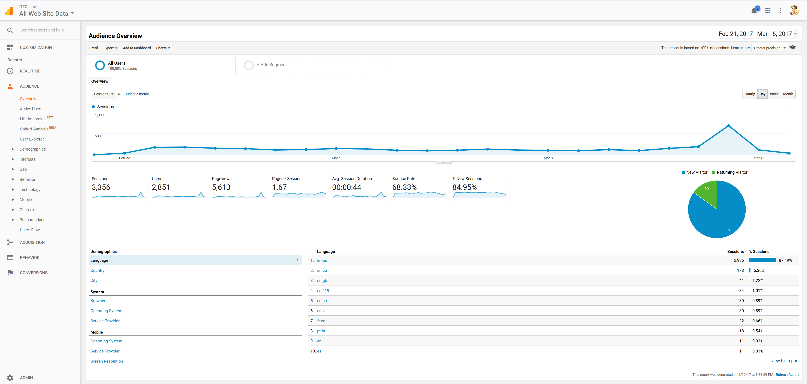
Dashboard & Navigation
Notes:
When you open your Google analytics account, you’ll see your homepage or dashboard. In the top right you can change the data range. In the center you can see the data for the various terms we just discussed. On the left-hand side is the main navigation.

Slide 26
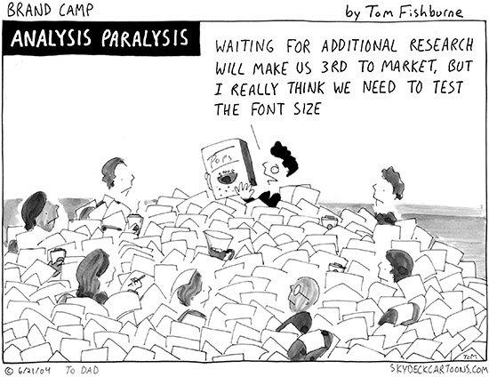
Avoid Data Paralysis
Time is valuable. Don’t get so caught in the details or data that you never move forward, or respond too late and miss an important opportunity.
Notes:
Most non-profits do not have the luxury of a dedicated analytics team. But you don’t need to dive too deep to get valuable information about how your website and campaigns are performing. I’m going to highlight the key metrics that won’t overwhelm you, but will maximize your data-driven decision making.

Slide 27
Other key metrics to monitor
Prioritize: You don’t have time to track everything!
Age & Gender
Location
Site Content – Pages
Engagement
Acquisition & Traffic Sources
Campaign Performance
Notes:
Here are some key metrics that you should consider tracking in Google Analytics

Slide 28
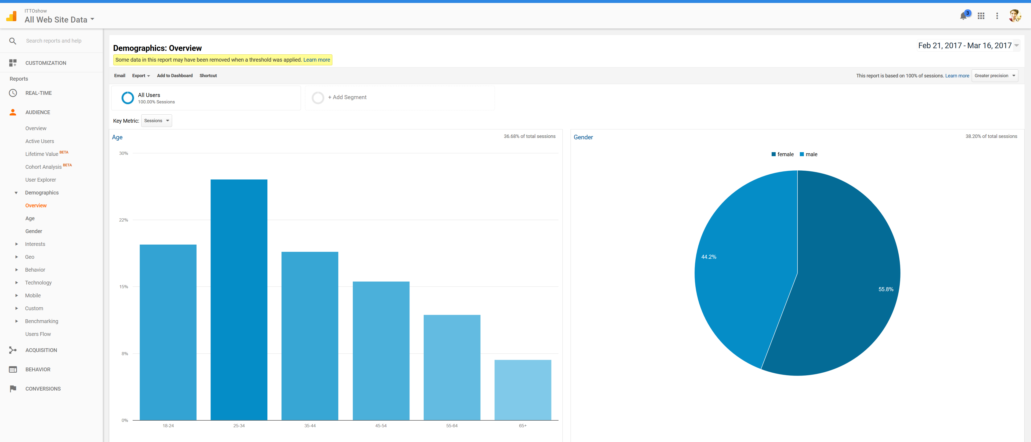
Age & Gender
Notes:
Under demographics you can view known age & gender. In this case only 36.68% of total sessions have corresponding demographic data. Even though the data is incomplete, it does give a pretty good cross-section of who is visiting your website.

Slide 29
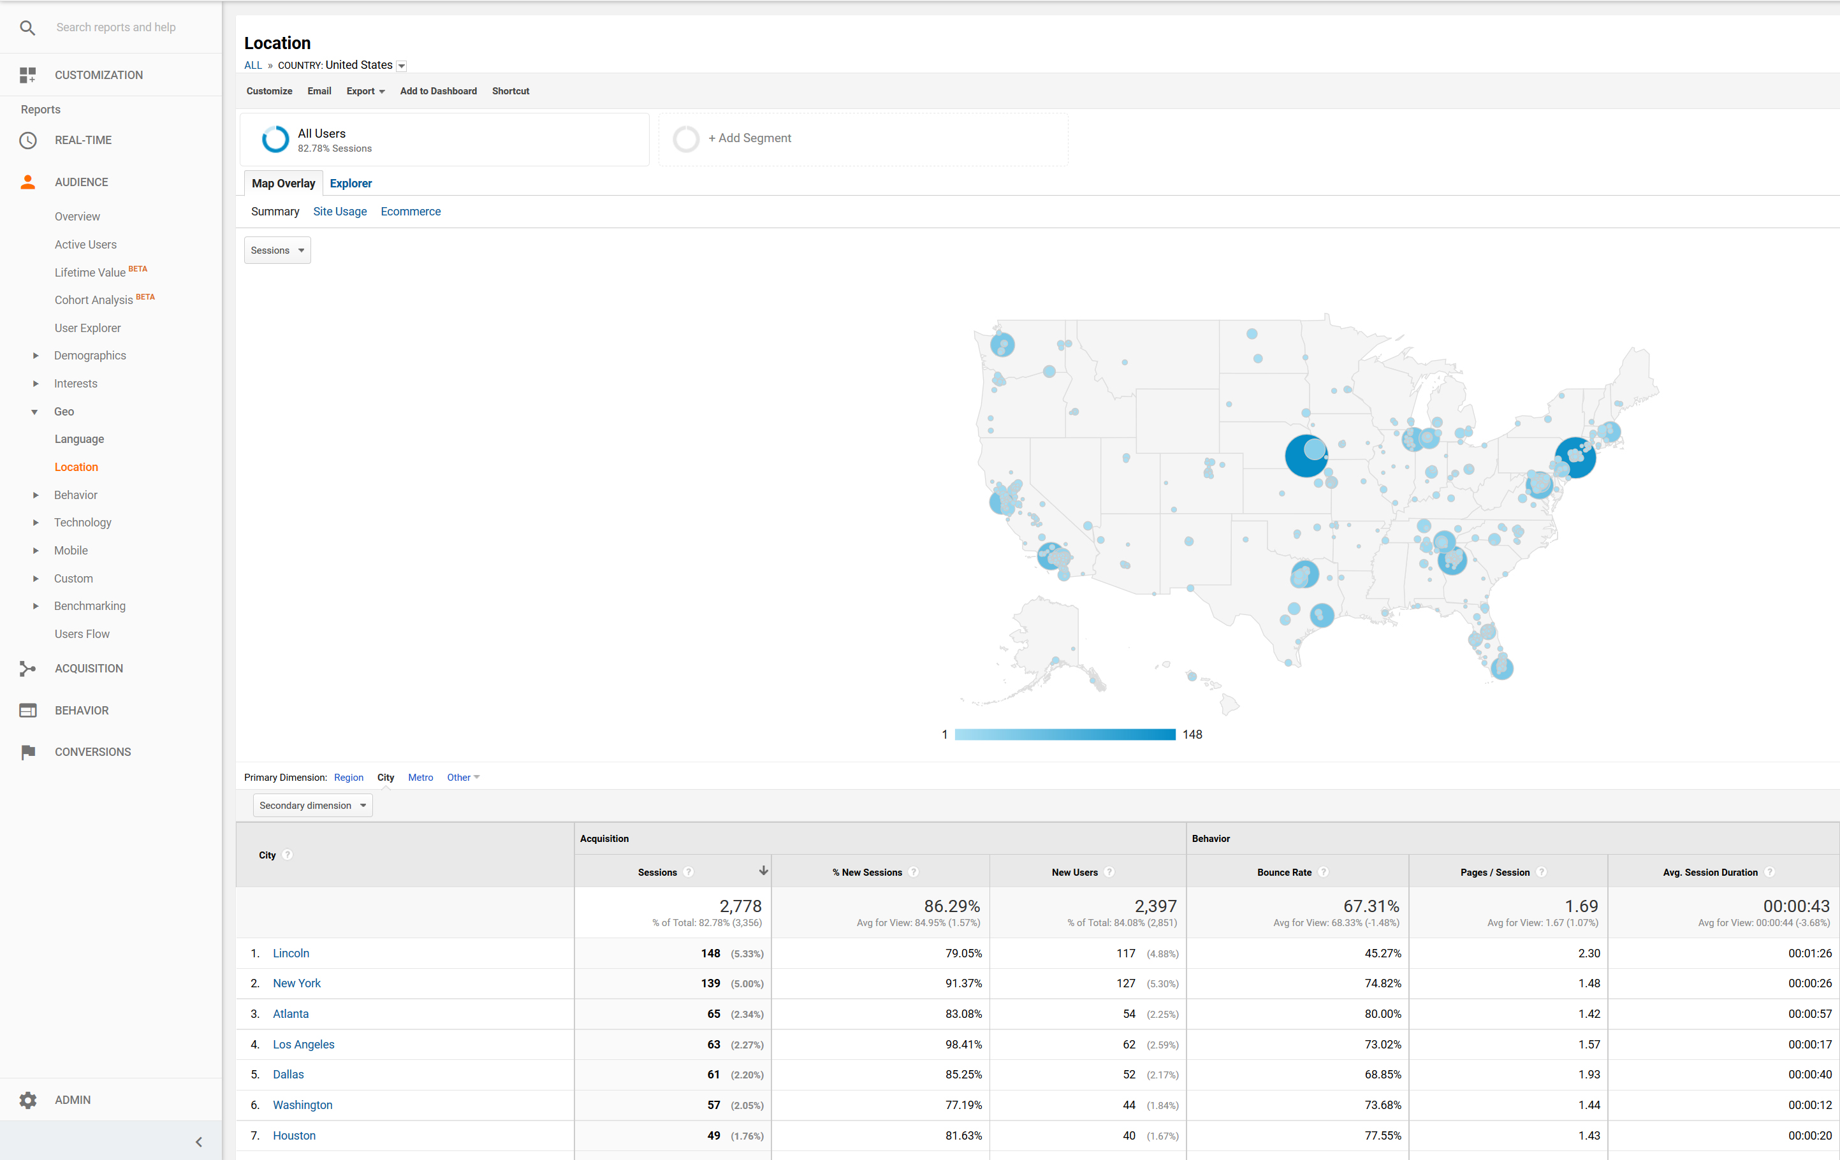
Location
Country
State
City
Metro Area
Language
Notes:
You can see location by country, city, state and metro area. You can also look at language if that is relevant to your ministry. You can look at the number of sessions and users as well as their behavior such as bounce-rate, pagers per session or depth-of-session and average session length.

Slide 30
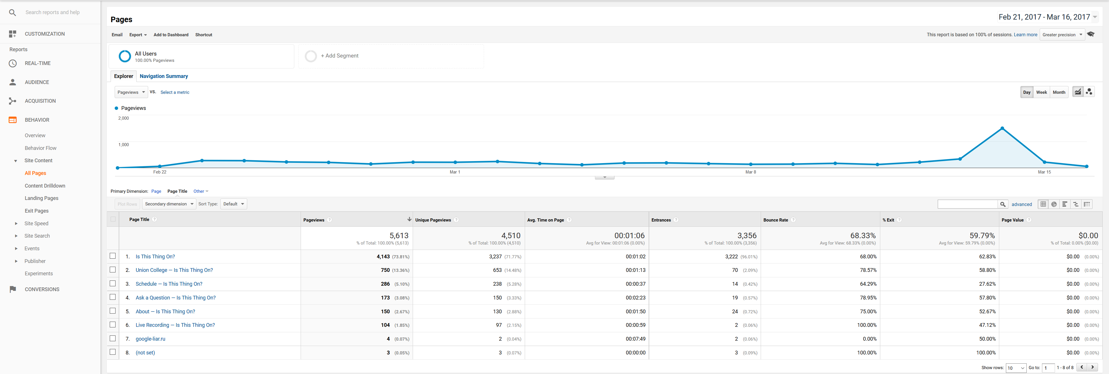
Behavior – Site Content
Here you can determine your most popular and least popular pages.

Slide 31
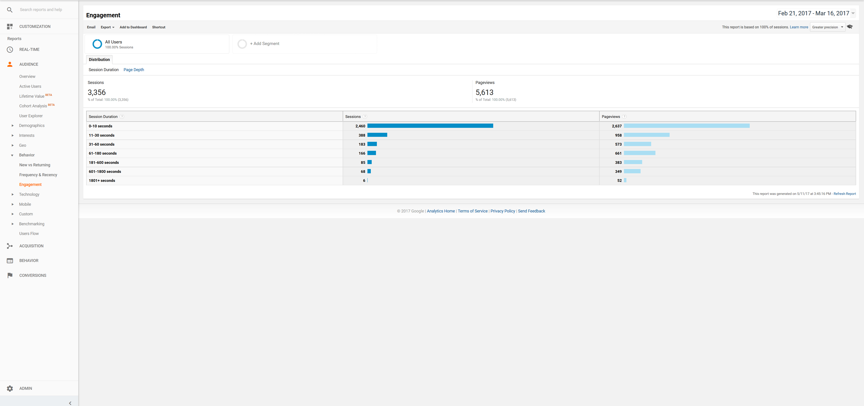
Engagement
Length of visit/depth of visit

Slide 32
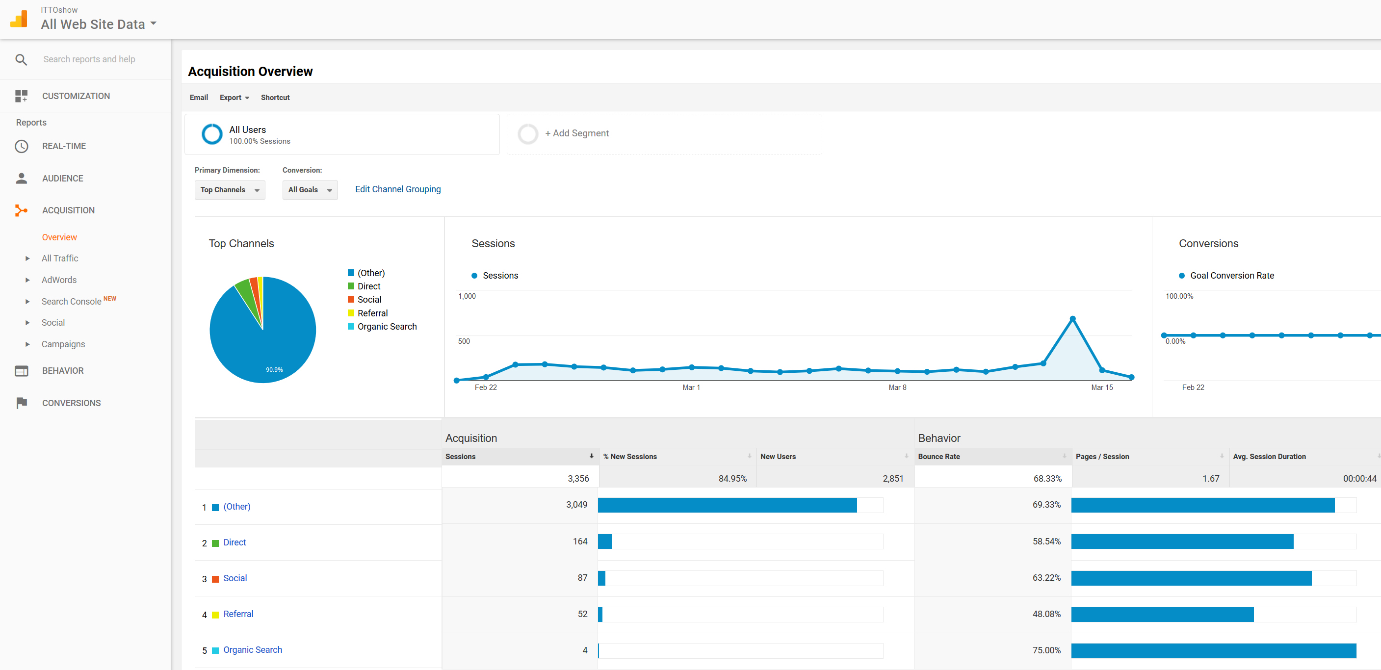
Acquisition Overview
This is where those UTM codes (trackable links) come in! Here we can see that trackable links accounted for 90.9% of the traffic to the website, meaning that our campaign was a huge driving factor behind awareness and traffic.
Other = UTM Codes or Campaigns
Direct
Social Media (no tracking code)
Referral from another website
Search engine
Notes:
As communicators, we want to know what is working and what is not working to drive people to your website. Here is where you can determine that. Keep in mind that OTHER is links with tracking codes or campaigns.

Slide 33
Campaign Performance
Google Analytics automatically picks up the campaign name and source from the links. No need to do anything in Google Analytics to make this work!
Notes:
We can then drill down deeper to learn more about what aspects of the campaign performed the best. You can create as many campaigns and sources as you want.

Slide 34
In summary:
If you can track it, you can measure it.
Use data to make better strategic decisions—saving both time and money.
Use UTM codes to track the performance of digital campaigns.
Always test your links before you post.
Use a url shortener to mask tracking codes and to track clicks.
Set up a free Google Analytics account for your website to better understand your visitors.
Avoid data paralysis, pick a few metrics to keep track of and determine goals.
Monitor the performance of your UTM codes in Google Analytics and optimize accordingly.

Slide 35
Questions?
Follow @DigiEvangelism on Facebook, Twitter, and Instagram for more digital marketing tips and tricks.
Visit SDAdata.org for more resources, blogs, and upcoming videos.
The next class will focus on: Basics of Placing Targeted, Paid Social Media Ads
Notes:
I know this is a lot of information. So I wanted to allow for plenty of question and answer time. I’m also happy to live-demo anything else you want to see.
For those of you who want to receive a copy of this presentation, see me afterwards to give me your email address.

