Slide 1
Social Media + Big Data
A Conference-Level Model
Heidi Baumgartner
Washington Conference
Communication director
Jamie Jean Schneider Domm
North American Division
Digital strategist
Notes:
Greeting
Good afternoon! Thank for choosing this session to discover how you can grow your social media efforts. We are Heidi Baumgartner, communication director for Washington Conference, and Jamie Jean Schneider Domm, digital strategist for the North American Division.
Today’s Plan
Our plan today is to share with you a snapshot of what’s happening with Washington Conference’s communication growth, and provide you with a model of what you can do in your conference, school, or ministry.

Slide 2
Growth Mindset
Notes:
Biggest Growth
Heidi: With all of our growing activities, the biggest area of growth is our mindset. We are thinking differently now. Our conversations and planning sessions are becoming more strategic.
One of my favorite stories happened in September during a walking meeting with our ministerial director. He just couldn’t wrap his head around the concept of big data and why he should be sharing ministry updates on social media.
I’ve known our ministerial director for many years, and he’s been my pastor and friend through most of those years. “Bill,” I started, “you know how you go and visit with pastors. You ask them questions and interact with them. And you come back with information. This is data for one person. Then you go and talk with the next pastor or leader and find out more information. Soon, you’ve talked with enough pastors and leaders that you can start seeing trends in your conversations. Now imagine if you multiplied this by 100, or 1,000, or 1 million. That’s big data.”
The light bulb moment was immediate! And then halted: “But I’m not sure what to share on Facebook. Much of what I do involves confidential conversations.”
“Well, you are on the editorial schedule for October. That’s pastor appreciation month. We can ask our followers to pray for our pastors.” Bill’s face lit up: “Yes, we can do that!”
“And then,” I continued, “Men’s ministry is on the schedule for February right before your men’s day retreat. We can ask our conference family to pray for men to be good spiritual leaders in their homes.”
Bill is my new ally in social media! He may not “get” all of it yet, but he is willing to cooperate with the process.

Slide 3
Pilot Partnership
Authorization + Permission + Education + Coaching
Notes:
Piloting a Partnership
Heidi: Right about a year ago, the North American Division reached out to Washington Conference to see if we would be interested in a pilot program with their Social Media & Big Data department. NAD representatives came and talked with our executive team who authorized the partnership and gave permission for us to move forward. Big data was a relatively new concept for our leaders and Executive Committee, so we had to do a little education to help our team understand what we would be doing. A simple presentation explaining key terms was helpful.

Slide 4
Why We Exist
The mission (purpose) of the department is to help ministries, conferences, unions, and the division better understand, connect with, and provide relevant, cost effective initiatives and services to church members through social media outreach and big data analytics, as well as give voices to member needs and thoughts.
Notes:
Jamie presents

Slide 5
Blueprint for success
goals/dreams
equipping your team
creativity/innovation
passion
integrated communications
digital strategy
member care
positive results
Notes:
Jamie: What that means is that we’re here to help you determine your goals and dreams, build the foundations of a digital strategy around these objectives, help you create an integrated communications strategy that works together across traditional and digital promotions, train your team and church leaders to embrace these techniques, help you cultivate an atmosphere of creativity, innovation and passion for our shared mission, guide you on path to building meaningful connections with members and community online, and ultimately help you measure and achieve results.

Slide 6
Initial Actions
Account Access: Social Media + eAdventist
Google Analytics
Social Media Audit
Defined Growth Areas
Leadership Buy-in
Coaching Sessions
Strategy Development + Editorial Calendar
Notes:
Initial Actions
Heidi: Several initial actions happened: we gave the NAD access to our social media accounts for an audit, access to eAdventist data, and fully enabled Google Analytics. We started defining our areas of needed growth: education enrollment, church planting, young adult engagement, and member retention. I had a month’s worth of weekly meetings with my new conference president to discuss a shared strategic vision for communication. This gave me leadership support. About this same time, I also began my coaching sessions with Jamie. With this process and partnership, I essentially did a hard restart of my department. Everything was evaluated and re-evaluated.

Slide 7
I Wish I Had Created Audience Vignettes
Who are you serving?
What are their needs?
Where do they get their info?
Who do they trust?
A married mother of four in Centralia that is a stay-at-home parent and has a total family income of less than $40,000 per year
A couple in their thirties with no children, living in Tacoma, coping with unemployment
A retired couple in their seventies in Burlington with fourteen grandchildren and fixed retirement incomes
Notes:
Heidi: I wish early on that I had spent more time creating audience vignettes and having a better understanding of my audience personas. It would have made this process easier as I envisioned the people who comes through our doors and who we would like to come through our doors. With so many moving parts and so many changes, this area of development became a victim of the process and now I am having to go back and recreate better personas. I “know” these people in my head, but I don’t “know” them on paper so I can more strategically communicate with them.
Four basic questions. Examples of audience vignettes. It doesn’t have to be complicated.
More details: https://www.forbes.com/sites/jaysondemers/2013/08/27/6-steps-to-decoding-your-target-audience/#1077f4f915cf

Slide 8
Figuring Out Big Data
Digital Cookie Crumbs
Patterns
Trends
Associations
Big Data
Individual Information → Force Multiplier
Community Survey → Big Data
Notes:
January 26, 2017
Heidi: I had to learn about and figure out what this industry phrase was all about: Big Data. Once I learned it, I could start explaining and educating. Do I have a firm grasp? No, but I have a basic working knowledge that I can grow. I am having to take the terms I know and the terms my team knows and help translate that over into the realm of big data.
Big Data Definition
With big data, you find digital cookie crumbs that can be analyzed for patterns, trends, and associations related to human behavior.

Slide 9
Growth Areas & Data to Examine
Church Planting
School Enrollment
Church Growth
Reconnecting with Members
Young Adult Engagement
Big Data Decision Making
Notes:
Big Data Themes - January 31, 2017Bi
Heidi: We defined five key areas of growth, but really there is a sixth area: applying big data to church/school/ministry growth.
Defining these key growth areas is helping us focus our ministry efforts, organize our thoughts, and have better overall strategic planning. We are looking for solutions, seeking to cultivate innovation, and inviting in local experts (members) to aid us.
Recently, one of our churches held a Hackathon to discuss with developers and non-developers alike how we could accelerate ministry through technology. Bringing these six growth areas to the table helped focus the conversation.

Slide 10
Social Media Goals
Increase fan base
Increase event attendance
Create a content strategy
Encourage social media ambassadors
Set a budget (range: $2,000-5,000)
Study demographic cluster
Analyze data
Make organic changes over time
Notes:
January 26, 2017
Jamie: Often when we approach SM, we don’t approach it with goals in mind. What are we trying to achieve? We then came up with a strategy and budget. Evaluate effective.

Slide 11
Google Analytics
Enabled demographics
Location bubbles
Acquisition – link back from social
Behavior flow – website
Examine non-bounce sessions
41 percent of web traffic is mobile
Notes:
March 9, 2017
Jamie: Connected to website. Looked at who was coming, what they were doing, impact of social media. Needed to provide more links in social media posts. Discovered most of web traffic is mobile. Need to be mobile first. This is a work in process.

Slide 12
Value of Coaching
Find reassurance
Dialogue through details
Learn new concepts
Accountability
Ask questions
Notes:
Value of Coaching
Heidi: My administrators advised me going into this process to make sure I understood and felt comfortable with every topic and action that Jamie and I discussed. If I didn’t understand something, I asked Jamie lots of questions until it was clear in my mind. She patiently answered my questions, and sometimes the same question for a couple weeks in a row! This is the value of a good coaching relationship!
Jamie and I teleconference usually once a week and sometimes once a month depending on the needs. It’s been a positive coaching experience to ask questions, find reassurance, and dialogue through the details. I thought I knew a lot already—and I learned even more! Some days were discouraging, and Jamie told me to keep posting, keep interacting, and keep adapting.
Jamie: I have found time and time again that the best way to teach digital strategies is through allowing the “student” to learn as they go and build upon every milestone. In an environment that is constantly changing, it’s too disconnected to try and teach social media in theory, in a classroom. Just like you can optimize social media communication in real time, the best way to learn is in real time, and in response to how the particular client’s audience is responding. Every organization has different needs and different audiences, therefore a mentorship role allows the client to become an expert on their situation and their audience in a way that has meaningful impact for their mission.
We meet via telephone or GoTo Meetings to share screens and talk through various aspects of the communication strategy and tools.

Slide 13
Coach’s Perspective
Post reach and interaction will ebb and flow based on personal preferences, that day’s attitude, that evening’s supper, or just the busy-ness of life. Keep posting. Keep interacting. Keep adapting.
Notes:
March 22, 2017
Heidi: Early on, the changes in post engagement showed immediate and positive results. And then things dipped a bit. Jamie kept encouraging and reassuring me to keep moving forward. This is the advice she gave me.

Slide 14
Auditing Process
Account Access
Analyze Data
Audience Reach?
Effective Strategy?
Metrics for Future
Advice for Future
Share Feedback
Notes:
Auditing Process
Jamie
So what I did after gaining access to all their social media profiles is simply go through and look at their data to determine who they were reaching, how effective their strategy was, and identified best practices that they should incorporate. At this state, I wanted to identify the biggest issues in their foundation, and help the team start thinking about their social media goals, target audiences, and key metrics. I also wanted them to recognize social media as an extension of their brand and voice online.
Heidi
Receiving the first social media audit was HARD, but good. It was a wake-up call that we had fallen into the reactive trap versus taking proactive steps forward. All of our social media handles were different. We did not have a strong content plan. We had an interested but not overly engaged audience. Our social posts were present but not particularly consistent or frequent. And then there was the challenge of time and how to integrate more social activities into an already full work load. We definitely had room to grow!

Slide 15
Audit Summary
Good Social Media Foundation
Ready for Optimized Growth
Suggested Content Tweaks
Need for Branding Consistency
Facebook
Instagram
Twitter
Live & Produced Videos
Tagged Posts
Currently Dissimilar:
Account Images
@Handles
Editorial Calendar
Scheduled Times
Trackable Links
Behind-the-Scenes Stories
Resolved!
Notes:
Heidi: This is the audit summary I shared with my team. The social media audit was three core pages with 14 additional pages of data charts.
The audit and a follow-up conversation noted how we have a good social media foundation with the social media trinity of Facebook, Instagram and Twitter. All accounts are ready for optimized growth with suggested content tweaks that will improve our engagement.
The biggest insight was actually right in front of our eyes the whole time: All of our account handles are different!

Slide 16
Our Dissimilar @Handles
Facebook: @washingtonconference
Instagram: @waadventist
Twitter: @washconf
Notes:
Social Handle Buy-In
Heidi: In one of our early steps, I led our Executive Committee team through a creative session to define if they wanted to see our social handle represent our organizational name, a campaign theme, or a hybrid approach. I showed them my initial brainstorming, research and Knowem.com results, and then let them vote for a desired social handle. They chose something different than what I would have chosen, but they had buy-in. We also asked our Executive Committee and office staff to start following and interacting with our social accounts. Sometimes they remember, and sometimes they forget! Friendly reminders every so often help re-engage our core leadership team.

Slide 17
Keep the same name and look
Make sure all your social media profiles look consistent and use the same name.
Reserve your name on all platforms
Use a consistent name (15 characters or less; short/simple; stands test of time; no numbers, symbols or punctuation)
Use the same profile photo & a consistent design look
Use the same headline, blurb or bio
Notes:
Jamie: Keeping a consistent profile helps others find you easily, and it helps cement a picture of you in their mind. It helps you stand out as memorable, and professional. This was why it was important for the Washington Conference to develop their online brand look.

Slide 18
How do we want to be known?
[PATH OF CREATIVITY]
Marketing
[KEYWORD THEME]
Public Relations
[ORG NAME]
Corp. Communication
@washconf
@washingtonconference
@waadventists
@adventistneighbors
@livinggenerously
@wholehope
@hopeneighbors
@waneighbors
@waconference
@adventneighbors
@livinghope
@hopewholeness
@sdaneighbors
@hellowashington
@waconf
@adventistlive
@waadventist
Notes:
Heidi: Redeveloping your department and/or your strategy takes a lot of behind-the-scenes homework. I wanted to involve my team in part of the process so they could join in ownership. This is an example of my brainstorming that I took to our Executive Committee team.
What Heidi Shared With Her Team
Let me take you through my brainstorming session:
I have the following initial suggestions grouped into three categories. Yes—some of the suggestions are too long for Twitter. That’s OK for now.
The Marketing category represents a path of creativity for handles. These are creative concepts that connect back with our mission and name.
The Public Relations category represents keywords & themes. It’s a blending of marketing and corporate communication.
The Corporate Communication category represents our organizational name in various iterations.

Slide 19
Evaluating @Handle Options
[PATH OF CREATIVITY]
Marketing
[KEYWORD THEME]
Public Relations
[ORG NAME]
Corp. Communication
@washconf
@washingtonconference
@waadventist
@adventistfriend
@livinggenerously
@wholehope
@hopeneighbors
@waneighbors
@waconference
@adventneighbors
@livinghope
@hopewholeness
@sdaneighbors
@waconf
@adventistlive
@hellowashington
We asked Executive Committee: “What direction would you like the @handles to go?”
Notes:
What Heidi Shared With Her Team
We have little success in the Marketing category!
@livinggenerous was claimed in 2009 by a blogger with a small following
@wholehope was also claimed in 2009 by a blogger with a micro following
@hellowashington was claimed in 2009 and has a micro following of 1.
@livinghope is a social media brand used by Mark Finley’s church and many, many other denominations (with various iterations)
We have better success in the Public Relations category.
We already claimed “adventneighbors” in 2014 for a campaign we didn’t launch.
The rest of the options are relatively available.
In the Corporate Communication category, we have several options.
Our current Twitter handle is @washconf.
We think @waconference may belong to one of our contract workers. We may or may not be able to obtain access to this account.
QUESTION FOR EXECUTIVE COMMITTEE: So….what direction would you like the handles to go? What alternatives would you like me to research? (Added note: A 60-second brainstorming session yielded about 40 options; only 3 were available.)

Slide 20
The other side of strategy!
Mission + Messages + Audience + Publications + Events + Budget + Time + Work Structure
Notes:
Additional Audits
Heidi: The social media audit also prompted an evaluation of ALL our communication activities: our mission, our messages, our publications, our events, our work structure. I used lots of sticky note brainstorming on my office door and window. The visual process highly fascinated my colleagues and led into some great strategic conversations!
Everything we were doing had areas of improvement. This last year represents a lot of department rebuilding and repurposing. Where the communication department had mainly had a service-oriented function to aid ministries, it is now becoming more of its own department with its own purposes in communicating effectively with our target audiences.
Jamie: Social media is designed for engagement and relationship building. For conferences, the communications department use of social media can be a valuable tool in breaking down the perceived barrier between the individual member and the corporate church. The most important thing you can do is be human. Find a voice that is inviting and welcoming to your community. Be real and give them something they can’t get elsewhere.

Slide 21
Spectrum of Communication
Marketing
Advertising & Promotion
Social Media & Big Data
Inbound Marketing > SEO
Community Building
Direct Marketing (Print/Online)
Mobile Marketing
Education & Evangelism Marketing
Public Relations
Content Development
Social Media
E-Marketing
Media Relations > News Releases
Thought Leadership > Responding to Social Issues
Webinars / Seminars / Tradeshows
Corporate Communication
Website
Newsletters (Print/Digital)
Statements, Policies & Letters
Editorials & Gleaner Stories
Crisis Communication
Employee Communication
Department Support
EXTERNAL
SOME OF BOTH
INTERNAL
Department Function
Administrative Function
Notes:
Heidi: The church doesn’t quite know what to do with the marketing. We are more comfortable in the public relations and corporate communications roles.
This graph was instrumental in working with administration to determine the future of my department. My president found a better grasp of what I do and what options are available. Where I had been squarely in Corporate Communication with a little Marketing and PR activity as time permitted, my president gave me permission to integrate more Marketing & PR and share Corporate Communication activities. This is a hard transition in thinking! This is how we are balancing out internal and external communication.
Challenge question: What if 25 percent of my week was devoted to external communication? In a four-day work week, that’s one full day.

Slide 22
Understanding Purpose
Start a Conversation
Make Connections
Breakdown Barriers
Influence Network
Advance the Gospel
Friendly
Human
Approachable
Connect to God
Connect with Others
Connect Others to Gospel
Open Communication
Listening
Restoring Relationships
Calls to Action
Get Involved
Connect/Follow
Grow God’s Kingdom
Encourage social media ambassadors
Notes:
Understanding Purpose - May 4, 2017
Jamie: The biggest problem I see with ministries using social media is that they have no clear goal or objectives. You must determine your purpose and shape your online communications accordingly.
Heidi: The auditing process helped us to evaluate our communication and led us to rebrand much of our activities. We had to define our communication purpose: to advance the gospel and influence our network.

Slide 23
Rebranding
New Weekly E-Cal
New Weekly E-Update
New Website
Updating Publications
Updated Adventist Identity
New Color Palette
Helpful Resources
identity.adventist.org
Notes:
Rebranding
Heidi: We retired our old e-newsletter and introduced two new options: an e-cal we call Out & About, and an e-update from ministry leaders we call Washington ACTS. Thanks to additional help from our new communication intern, we also about ready to launch a new website that seeks to follow Donald Miller’s hero-guide story structure. His book “Building a Story Brand” is newly available on Amazon and at other book retailers.
The introduction of the new Adventist identity system came at an ideal time last spring, and we were able to begin integrating the Adventist color palette and identity structure. Have we implemented this perfectly? No! It’s a learning and education process to encourage ministries to use the Creation Grid and branding structure. It’s a good habit to cultivate! You may explore more at identity.adventist.org.

Slide 24
What’s Appropriate to Spend?
It Depends
Washington Conference
$3,000 - 5,000 budget
$50/event
$250/camp meeting
$100-250/ quarterly ad campaign
Remainder: SMBD “What If? Experiments”
Notes:
Budgeting
Heidi: It’s turned out to be harder than expected to plan a social media budget. Jamie is used to investing more to reach a larger audience. The accounts she works with have 100,000 or so followers. We are just under 2,000. What’s the appropriate amount to spend? She’s challenged us to set aside $5,000 for a social media budget. In talking with my administrators, we’re setting aside $50 per event promotion, $250 for camp meeting promotion, and $150-250 per ad campaign (planned for at least once per quarter). The rest of the budget we have designated for social media big data “experiments.” What this looks like we will soon discover!
Jamie: a lot of time people will ask me, “how much does it cost to promote online.” But the beauty of social media ads is that it depends on what you can spend. Social media works very well for small budgets and non-profits. A little can go a long way, but it’s important to spend a little. As your confidence grows and your familiarity with reaching your target audiences grow, you can increase your budget as needed. Ultimately your budget depends on the size of your goals and your purpose. A small local ministry may only need to spend $300 a year where as a nationwide campaign would need $3,000 to create impact. What you can do: Go through my course power points online, and start with small ad budgets with a clear objective…this way you can learn and maximize your results as you grow.
Audience Question: How long will you have this budget amount?
Initially for one year, then we will evaluate! Right now we are seeking to grow our audience. When we reach a point of saturation, then we can determine new goals and budget needs.

Slide 25
Data Collection
Purchased data
Collected data
Print survey
Web survey
Initial survey
10 day reminder
5 day reminder
Discipleship survey results (3 years) – baseline for the future
Data needs to be put in the right people’s hands. This is where research meets reality. This is where reality becomes strategy.
Notes:
May 31, 2017
Jamie Presents
Data comes from a variety of sources. Collect it together. Analyze. Follow-up.

Slide 26
Email Appending
Process
Pulled member data from eAdventist (with permission)
Compared it against known marketplace data
Found 5,683 new emails for Washington
Results
Discovered high affinity
Only 148 people opted-out of invitation to connect
Plans
Import 500 emails each week
Avoid spikes in opt-out
Review list for unopened emails
FB campaign for identified emails
Notes:
Jamie: Explain email appending a bit more and where these companies get their data. Recommend TowerData. You can also set the terms of the arrangement so that the company does not keep any of the information you provide in order to append the desired data. Here’s how you can do this yourself….feel free to reach out to me if you have any questions.

Slide 27
Understanding Data Append Services
Purchased from companies like Amazon
Email addresses are matched with mailing addresses
You can set the terms of agreement
They don’t need or keep your data
They request permission from the people
Data is then handed over to you and your information is deleted per your terms of agreement
Recommended provider: towerdata.com
Notes:
Jamie: Feel free to reach out to me if you have any questions or need guidance. TowerData has a very positive reputation to maintain and works with Institutions like the Smithsonian. Very affordable.

Slide 28
E-Update Design Changes
Mobile Friendly
Bigger Pictures
Less Text
More Clickable
Content
Build Excitement
Buttons to Click
Font Size: 14 px
Design
Single Column
Images Across Width
Clean & Modern
Subject
Test types of subject lines
Test “From” names
Notes:
February 22, 2017
Heidi: These are the changes Washington Conference made in its e-update design. Good audience response with remarks of cleaner, modern design that is easier to read.
With From names, we found that people did not associate best with a personal name. They wanted to see the Out & About e-cal email coming from “Washington Conference” before they clicked into it.
With Washington ACTS, though, our readers best associated and clicked into our emails if it came from a key leader, especially the conference president. We now cycle through the president, vice presidents, and a few ministry directors. Each key leader contributes a short devotional every 6 weeks or so. For our YA director, he had a longer devotional, so I linked his PDF to a teaser. We had 144+ clicks to read the rest of the story!
Buttons were the other key factor. We have more clicks on buttons than links, but both are still needed.

Slide 29
Implementing Lessons
500 Emails Per Week
Excel File With Dated Tabs
MailChimp Groups by Intro Date
Friendly Welcome Message Template
Give One Week for Response
Integrate into Mailing List
Answer Questions & Concerns
Document Customer Service with MailChimp Notes
Responsive Customer Service
Notes:
Implementing Lessons
Heidi: We learned the hard way to not try and implement this email integration process during camp meeting! There is just too much going on! This summer, with the relaunch of our weekly e-updates, we started introducing 500 new emails each week in MailChimp. We send a friendly welcome message with a second option to opt-out. Relatively few people take this action. We’ve only had a handful of people who followed up with emails asking, “Why did you send this to me?” Or a couple wildcards like a gentleman in France receiving our emails. Each one was dealt with in a caring customer service way. One lady wrote back: “I have a new email address now!”
Jamie: While technology is highly sophisticated, you can expect a small margin of error. Just make sure you’re prepared to put your customer service hat on! Be sure to respond quickly and solve the problem.

Slide 30
Audience Growth
Sailing with Jesus E-News
1,043 subscribers
Out & About E-Cal
1,935 confirmed subscribers & growing
Washington ACTS E-Update
2,353 confirmed subscribers & growing
Retired e-news list
Baseline for growth
10 years of cultivation
Notes:
Audience Growth
Heidi: When we first started, Washington Conference had about 1,000 e-news subscribers that had been cultivated over the years. Now, we are at 4,000 on our master list and anticipating 5,000 on our master list before Thanksgiving. As a reference point, we have 23,000 members in about 8,800 households. That represents about 22% of our membership which is a huge improvement over 4% of our membership. Gathering these additional email will help us to better connect with our members and keep them informed. We will soon be reaching up to 57 percent of our member households.
In many ways, these new numbers are misleading, because many are in our “master list” and still waiting to be integrated. There also seems to be a connection problem with transferring confirmed names into our mailing list. I need to investigate this more next week.

Slide 31
Instagram
Most surprising growth!
Began with 68 followers in March
Started following 50 people a day for a couple weeks
Optimized profile pix, bio, @handle, lots of behind the scenes photos
“National Geographic” Cultivation
Now 509 engaged followers
Notes:
Instagram
Heidi: Instagram was mostly a back-burner project as time was available. With Jamie’s coaching, we started with more frequent posting of inspirational and behind-the-scenes images, a fresh profile update, and simplified branding elements. Jamie encouraged me to follow more Adventist accounts, and not just in my local area. Clicking into the follower list for key Adventist Instagrammers was helpful. For the first couple weeks of this strategy, we were following up to 50 new people per day.
Jamie: Instagram is highly visual, be creative and engaging. Tell your story and use it to connect people with in your community. Good results! Taking off! Not always one-size-fits-all model. What are your goals? Reach local audience, not the nation.
OBSERVATION
This is a “National Geographic” approach with curating photos, captions, and content from a variety of ministry voices.

Slide 32
Our #PewView Start
Adopted a hashtag
251 posts to #pewview and most are from Washington Conference
Conference president, VPs, ministry leaders text, email, post image reports
Busiest day of social media!
Gives voice to ministry leaders
Notes:
#PewView
Heidi: We had a small, but faithful Instagram audience. Instagram was a side project that we had never strongly promoted. My new conference president wanted more voice in social media. He started texting me photos from various places he visited on Sabbath morning. We started our #pewview hashtag almost by accident. It was a random, little used hashtag I selected to represent his viewpoint that first Sabbath. And it stuck! This has been a lot of fun! More churches and leaders are starting to use the hashtag with their posts! We often reshare their Sabbath #pewview and #waadventists posts. These are our two key hashtags.
Using Instagram led to another challenge: hashtags.

Slide 33
Hashtag Library
Develop 2-3 unique hashtags for your organization
Connect with Adventists & local community
Goal: 11 hashtags per post for best engagement
Refer to “Hashtag Library”
Standard hashtag collection
Creative hashtag collection
Keep in your Notes app
SDA
SDAChurch
NADAdventists
NWAdventists
WAAdventists
Adventista
SDAYouth
AdventistYouth
AdventistEducation
HappySabbath
SabbathSelfie
Bible
Bibleverse
Biblequote
Inspiration
Christianity
Service
Seattle
WashingtonState
Full Hashtag Library
www.sdadata.org/resources
Notes:
Hashtag Library – February 22 & March 9, 2017
Heidi: I have a love-hate relationship with hashtags and groaned when Jamie told me I need to use 11 hashtags per post on Instagram. I can easily get to 6-8 hashtags, and then my creativity runs out. In desperation, I set out to learn and discover what I could about hashtags! Out of this came a Hashtag Library with tagging ideas for organizations, ministries, nature, holiday, and life stages. You can pick up a copy of the Hashtag Library at www.sdadata.org/resources. The easiest way to store these hashtags is in a Notes app entry. You can copy+paste from your Notes into your social post.

Slide 34
Why use them?
Hashtags are a way for people and brands to create conversations, interact, and promote their message to interested audiences. Use a combination of:
Popular (widely used or trending)
Branded (unique to you/tells your story)
Niche (less used but reaches a targeted audience)
Create your own unique hashtag to:
Brand your message/product
Guide the conversation
Create a curated stock of content that tells your story
Enable your audience to engage with you, contribute to the conversation, and become part of your story
Notes:
Jamie: Large brands and celebrities don’t need to make much use of hashtags because they already have a strong following who will see their content anyway.

Slide 35
Start a conversation
Make connections
Breakdown barriers
Facebook is the new website
Website | Facebook | Instagram | Twitter
Notes:
Tweaking Facebook Content
Heidi: We began our Facebook revamp by updating our page images and writing specifically for Facebook. Now we start with an image, add our message, and include a shortened link. We use Bit.ly. Other short code options are available. Most of our content is still natively posted in real time, but some elements are scheduled natively for key audience engagement times or will soon be scheduled through Buffer.
We adopted a more news-heavy versus inspiration-heavy content calendar for now. Our audience likes seeing what’s happening in ministry with social reports. Anecdotally, this translates into better conversations in person and better connections in committees and teams.
Jamie: Keep in mind Facebook suppresses certain 3rd Party links such as YouTube and MailChimp. Therefore you should upload videos directly to increase engagement and upload an image first for MailChimp and then add in copy and a link.

Slide 36
Types of Content
Happy Sabbath
Local beauty shots
Galleries
Upcoming events
Registration
Mission
Stories
Follow us
Ideas We are Nurturing
Nature photo challenge
Happy Sabbath posts
Ask Me Anything (topical)
Behind-the-Scenes
Ministry Reports
Holiday & Special Event Invites
Notes:
February 22, 2017
Heidi: I follow Visual Church Media and Church Social Media Managers Facebook groups. These are highly active groups that make you feel like you are doing NOTHING in comparison but INSPIRE you just the same. One of the posts quoted Thom Rainer who said 82 percent of people would attend an Easter service if asked. The discussion had all sorts of ideas for inviting people to a holiday church service. Someone suggested that in your social copy you include the line: “Please commit to inviting one person.”
Sphere of digital influence to get people into church. Content Calendar. Strategic approach to content. Thinking ahead. Early planners vs. late minute committers. Last minute jump depends on how you’ve planted seeds all along. Create buzz all along for last minute jump

Slide 37
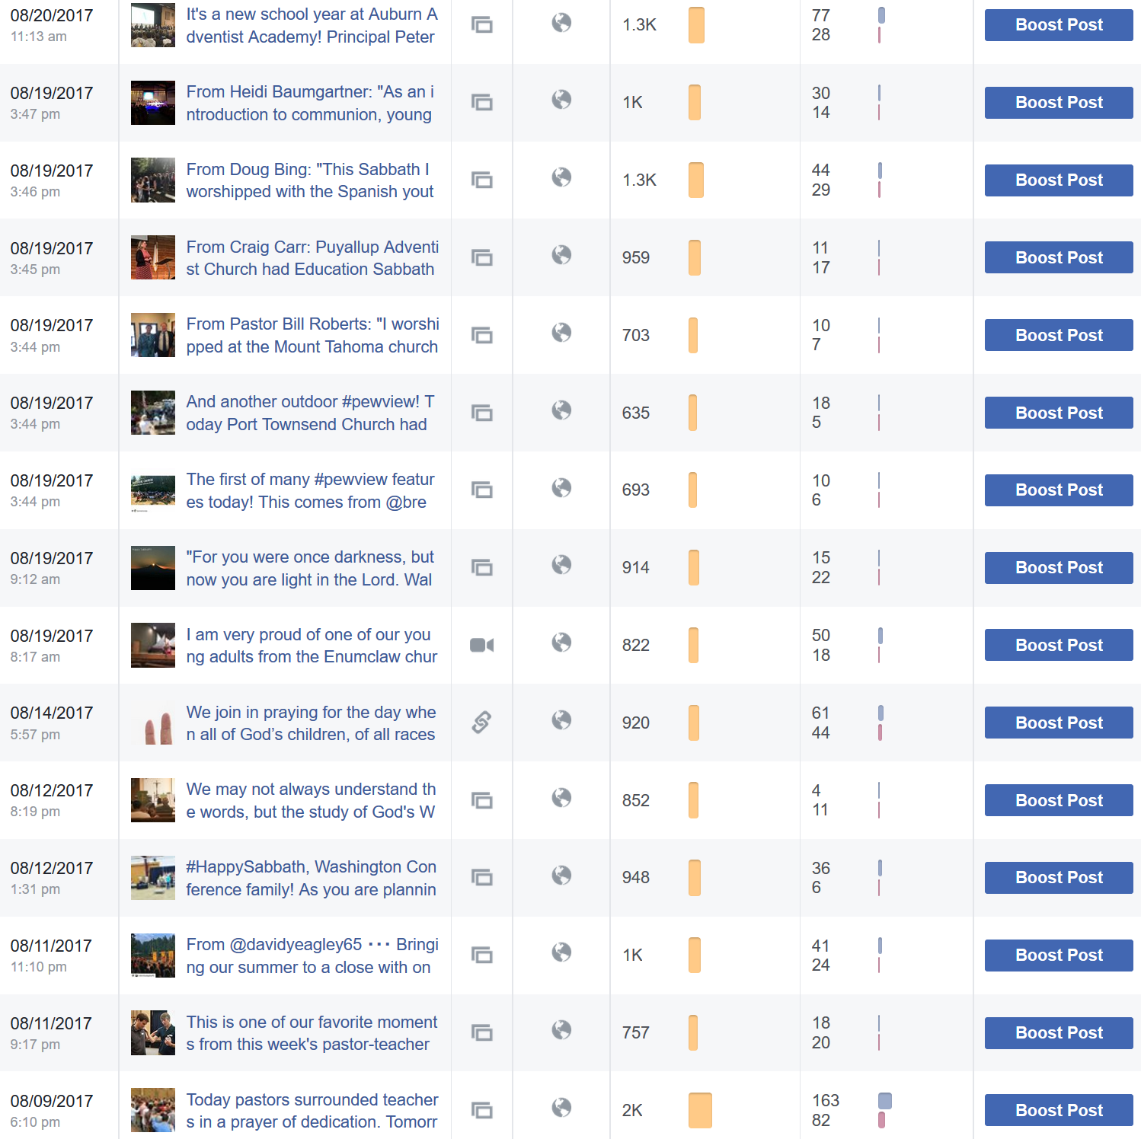
Anatomy of a Good Facebook Post
Illustrative Image (Creative Commons)
Creative Action Copy
1-2 Hashtags
Call to Action
Shortened Link
Notes:
Heidi: This structure has greatly helped with our audience engagement. Where we used to have a reach of 300 or less on a consistent basis for our Facebook page of 1,000 or so followers, we now have engagement in the 700-1000-plus range. The algorithm seems to favor self-generated content over shared content, so we rarely direct repost. If we share a post from other pages, we will often download the image, copy the text, create a new post, and then tag the source. But not always…we try to mix it up and make it human.
Posts still require a balance of emotion and logic!

Slide 38
A Week on Social Media
Before Featured Week
Sunday
Monday
Tuesday
Content developed & scheduled
Webpage ready
Out & About event
Totally Involved action item
Prayer focus
Did You Know feature
Link to website
Wednesday
Thursday
Friday
Sabbath
Washington ACTS mission feature
Thought essay
Get Involved Feature
Link to sign up form
Shop talk
Link to email
Sabbath greeting, message, or favorite Bible verse
Sabbath illustration
Sabbath video
Link to resource PDF or video
Sharing ideas
Discussion item
Talk with a leader
Notes:
Editorial Content Calendar
Heidi: In Washington Conference, we’ve chosen to develop a ministry approach to our content calendar. Other conferences are using an inspiration approach with Bible verses and evergreen quotes on spiritual growth. Both approaches have merit.
We are choosing to feature ministries at least once each year and other times as needed. The goal is to give ministry leaders a “voice” and help them connect with a broader audience. In our editorial schedule, the ministry of the week begins on Sunday with a prayer focus. Mondays feature a “Did You Know” snackable. Tuesdays highlight a way for members to be “Totally Involved.” Wednesdays are discussion days. Thursdays are for a mission feature, thought essay, or a practical resource. Fridays are for a “Get Involved” appeal or feature. Sabbaths are for a special greeting, message, or favorite Bible verse for featured ministry.
Additionally, our editorial calendar integrates Happy Sabbath greetings, local beauty shots, photo galleries, upcoming events, registration reminders, mission posts, stories, follow us invitations, and more. This year we’ve used a soft calendar approach to help introduce our team and audience to what we are trying to do. We are still a work-in-progress.
Talk about how the community is responding…

Slide 39
Publication Strategy 2018
Editorial Themes
Website
Social Media
E-Updates
Publications
Editorial Deadlines:
E-Cal: Each Tuesday
E-News: Each Thursday
Social Media: Daily/Weekly
Magazine: Third Thursday
Magazine Insert:
First month of quarter
First Quarter | Second Quarter | Third Quarter | Fourth Quarter
January WA Youth: Education 1 Prayer Ministry 2 Evangelism/Begin Cycle 3 Risk Management 4 Religious Liberty 5 Men’s Ministries Magazine Deadline: Jan. 25 +A | April WA Youth: Education 1 Evangelism/Cultivating 2 Financial Ministry 3 Youth/Pathfinders 4 Prison Ministry 5 Discipleship Magazine Deadline: Apr 26 +A | July WA Youth: Sunset Lake 1 Vacation Bible School 2 Major Centers 3 Communication/Social Media 4 Russian Ministries 5 Leadership Development Magazine Deadline: July 26 +A | October WA Youth: Education 1 Evangelism/Harvesting 2 Thrift Store Ministry 3 Pastor Appreciation 4 Disaster Response 5 SAGE Magazine Deadline: Oct 25 +A
February WA Youth: Education 1 Regional/Black History 2 Marriage & Family 3 Urban Development 4 Education/Music Magazine Deadline: Feb 22 | May WA Youth: Sunset Lake 1 Youth/Adventurers 2 Sunset Lake Camp 3 Regional/Convocation 4 Education/Graduation Magazine Deadline: May 24 | August WA Youth: Education 1 Native Ministries 2 PF/Adv – New Year 3 Edu/School Starting 4 Children’s Ministries Magazine Deadline: Aug 30 | November WA Youth: Sunset Lake 1 H.O.P.E. House 2 Health Ministries 3 Thanksgiving 4 Trust Services Magazine Deadline: Nov 27
March WA Youth: Young Adults Anticipate: Coaching/CM 1 Singles Ministry 2 Women’s Ministry 3 Literature Ministry 4 Young Adult Ministry Magazine Deadline: Mar 29 | June WA Youth: Education Anticipate: Education 1 Hispanic Ministries 2 Camp Meeting 3 Totally Involved 4 Deaf Ministries Magazine Deadline: Jun 28 | September WA Youth: PF/Adv Anticipate: Totally Involved 1 Human Resources 2 Personal Ministries 3 Adult Sabbath School 4 Prayer Ministries Magazine Deadline: Sept 28 | December WA Youth: Children/Youth Anticipate: Spiritual Growth 1 Community Services/ACS 2 Family Ministries 3 Christmas 4 Stewardship Magazine Deadline: Jan 2
Notes:
Heidi: This is my content schedule for 2018! Every ministry is featured at least once in the year. Sure: they can share other ministry announcements and features throughout the year.

Slide 40
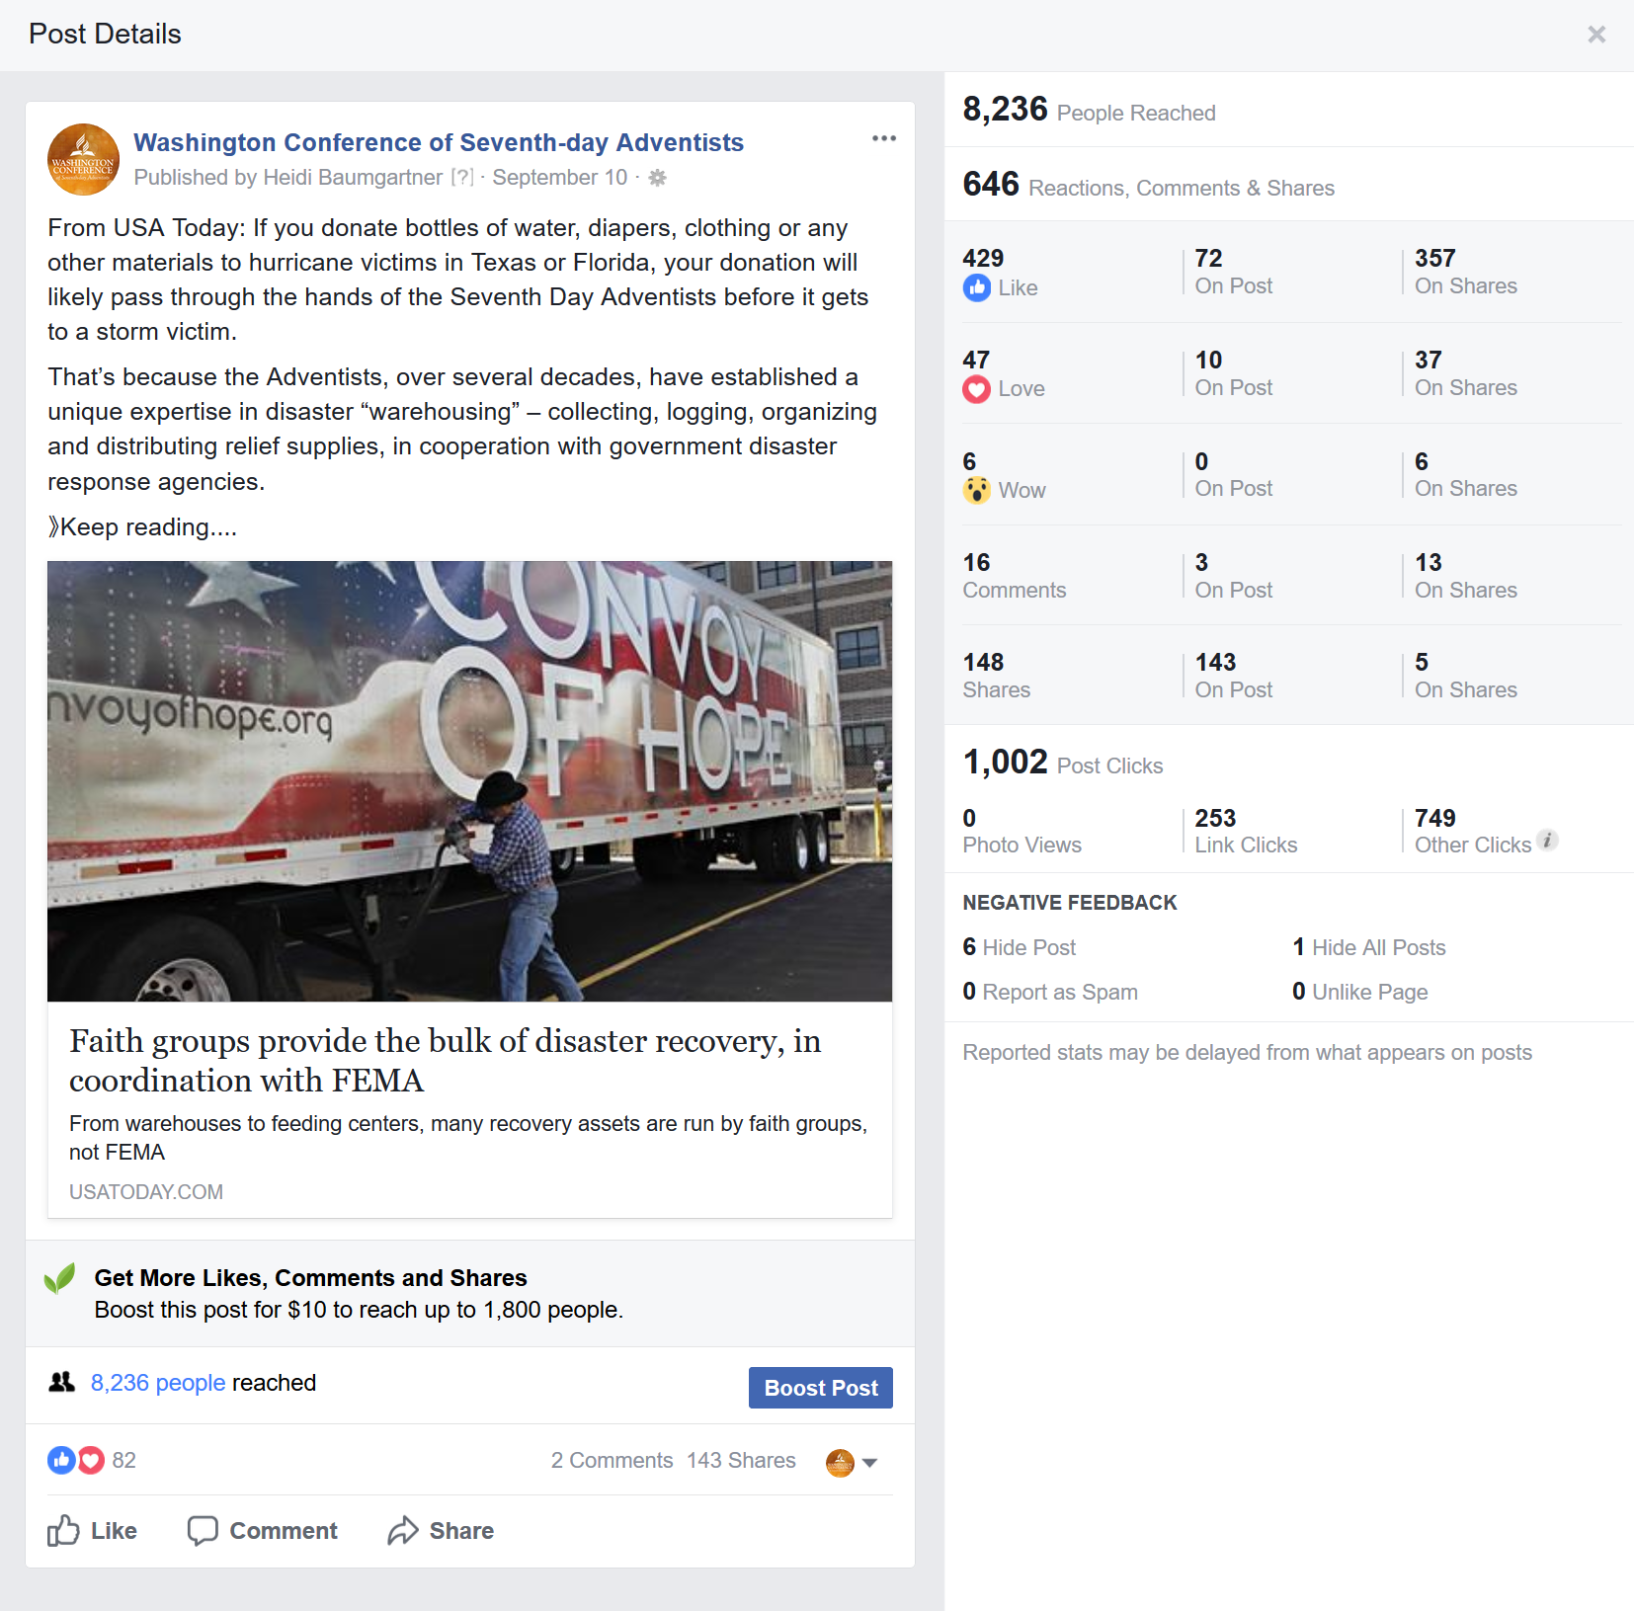
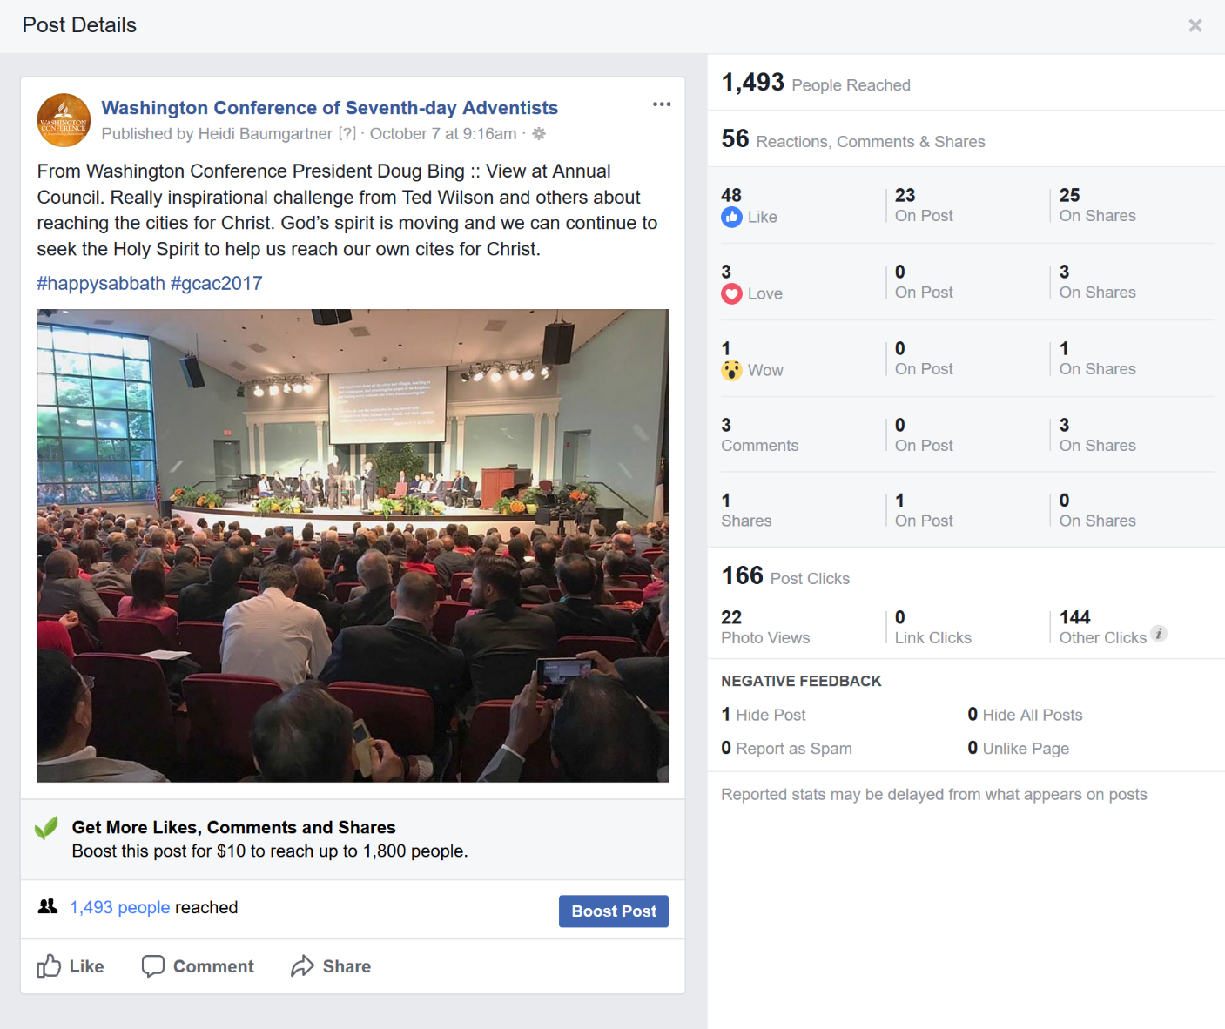
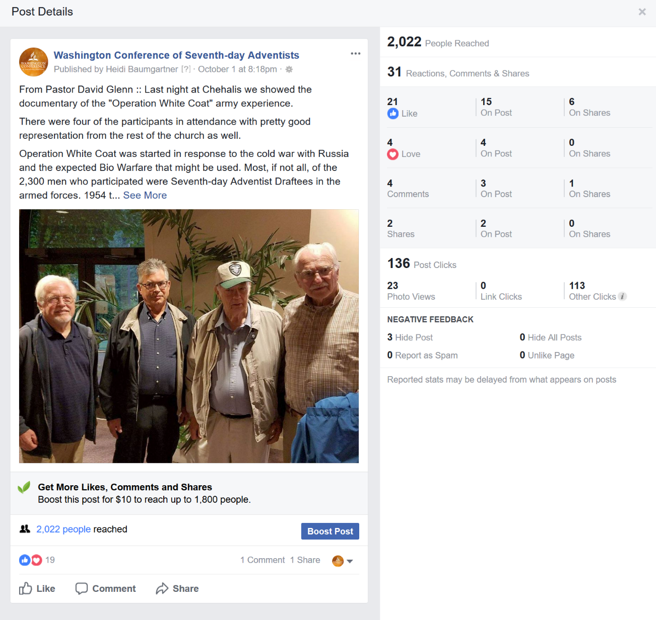
Notes:
Heidi: Several examples of posts and results. Not everything is this good. We still make mistakes and don’t time things just right or hit our audience’s needs. So we try again until we get results like this!

Slide 41
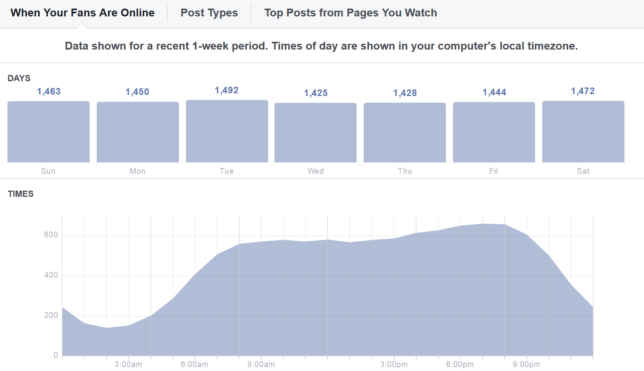
Key Times
Key Lessons
Knowing When Audience Online
Evening Audience Helps Morning Audience
Post an Item
Pray
Walk Away!
Watch Results
Notes:
Heidi: Jamie challenged me to dig into key times when my audience was online and then having something “ready” for them to see. For Washington Conference’s audiences, we have connection points before work hours, during lunch, and in the evenings. We have our best successes in the evenings, and then often spills over to the next morning.

Slide 42
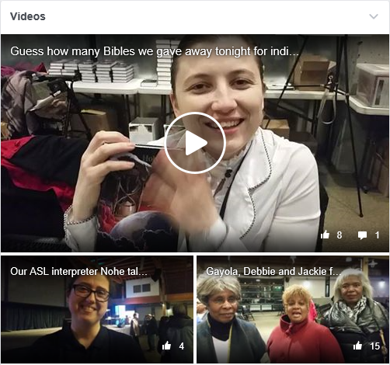
Social Video
20-40 second “Man on the Street” nightly cell phone video interviews
Volunteers, staff, pastors, guests
Posted to Instagram & Facebook
5,434 total Facebook video views (up 90,467%)
Appeal of real, live video
Live vs. produced video
Link back to website
Give subtle calls to action
Track analytics
Notes:
March 9, 2017
Heidi: I am not a strong “video creator”. I should have taken more production classes in college! However, I ventured into social video responses during a city evangelism series. Explain process. Fun experiment! I wanted to do more with camp meeting and other event responses, but it just didn’t happen this year. We definitely want to experiment with more social videos in the future!
We gave the media team at camp meeting access to our Facebook page through a “ghost” account to live stream camp meeting programs — this had pluses and minuses. One of our speakers had not signed a release form for the presentation to be “broadcasted” and we ended up removing the archived links. This was our first year with Facebook Live. It works well if you have a competent operator and solid 4G internet connection.

Slide 43
Live Streaming
People spend 3x more time watching Facebook live videos on average compared to a video that is no longer live.
Makes you more human
Expands reach of message
Can engage with people in real-time
High engagement
Facebook is prioritizing and promoting live video right now (sorry Periscope)
Grants you advantages for traffic flow on Facebook’s algorithm, increasing the reach of regular content.
Sends out notifications that you are live
Notes:
Jamie: There are a lot of advantages to making use of live-streaming on Facebook. …

Slide 44
Why Social Video? The good news
Social video generates 1200% more shares than text & images combined – Brightcove
Videos drive a 157% increase in organic traffic from search engines – Brightcove
70% of marketers claim video produces more conversions than any other content – Vidyard
4x as many people would rather watch a video about something than read about it. – eMarketer
Notes:
Jamie: If you are not currently using video in your social media, you should and here’s why:

Slide 45
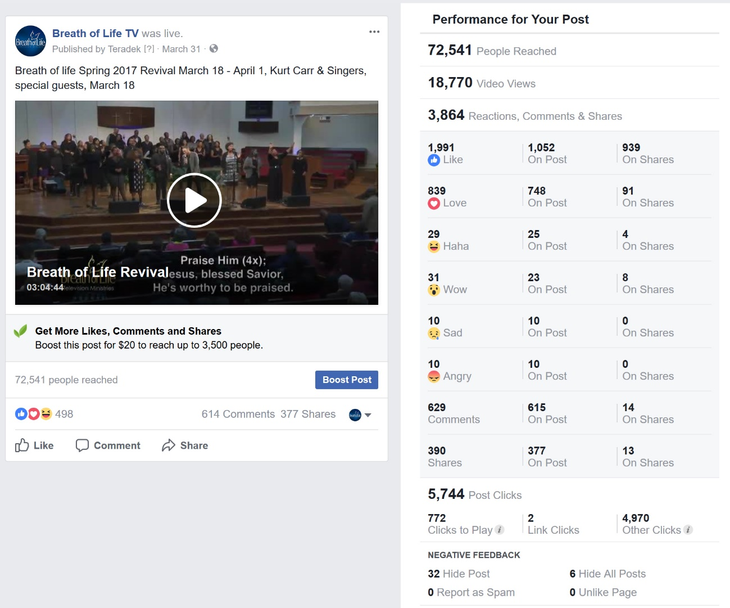
Case Study: Breath of Life Series
Highlights
10,000 viewers per night
Aired 5 pm Pacific/8 pm Eastern
Short video links
Livestreamed (not archived)
Notes:
May 4, 2017
Jamie Presents

Slide 46
Growing Facebook with Page Ads
Goals
Aim for 7+ relevancy (indicates how well I am targeting)
CTR – 2-3% (indicates clicks/impressions)
Ideal cost less than 50 cents/click
Paid always enhances organic
Growth
Grew to 1,571 – nice distribution of age & gender
60+ new likes
Message
Thank you for being part of our community. Feel free to invite your church friends to connect and join our community.
Washington Results From First Campaign:
Notes:
May 18, 2017
Growing Facebook with Page Ads
Heidi: A Facebook “page like” advertising campaign just before camp meeting helped our likes to greatly increase. We invested $100 as a proof of concept, and ended up paying a little less than a dollar a like. A second Facebook campaign this fall is just wrapping up after investing $175. For this campaign, we targeted the Facebook campaign to our growing email list so subscribers can connect with us beyond e-updates. And we did an A-B test with the same images and different copy.

Slide 47
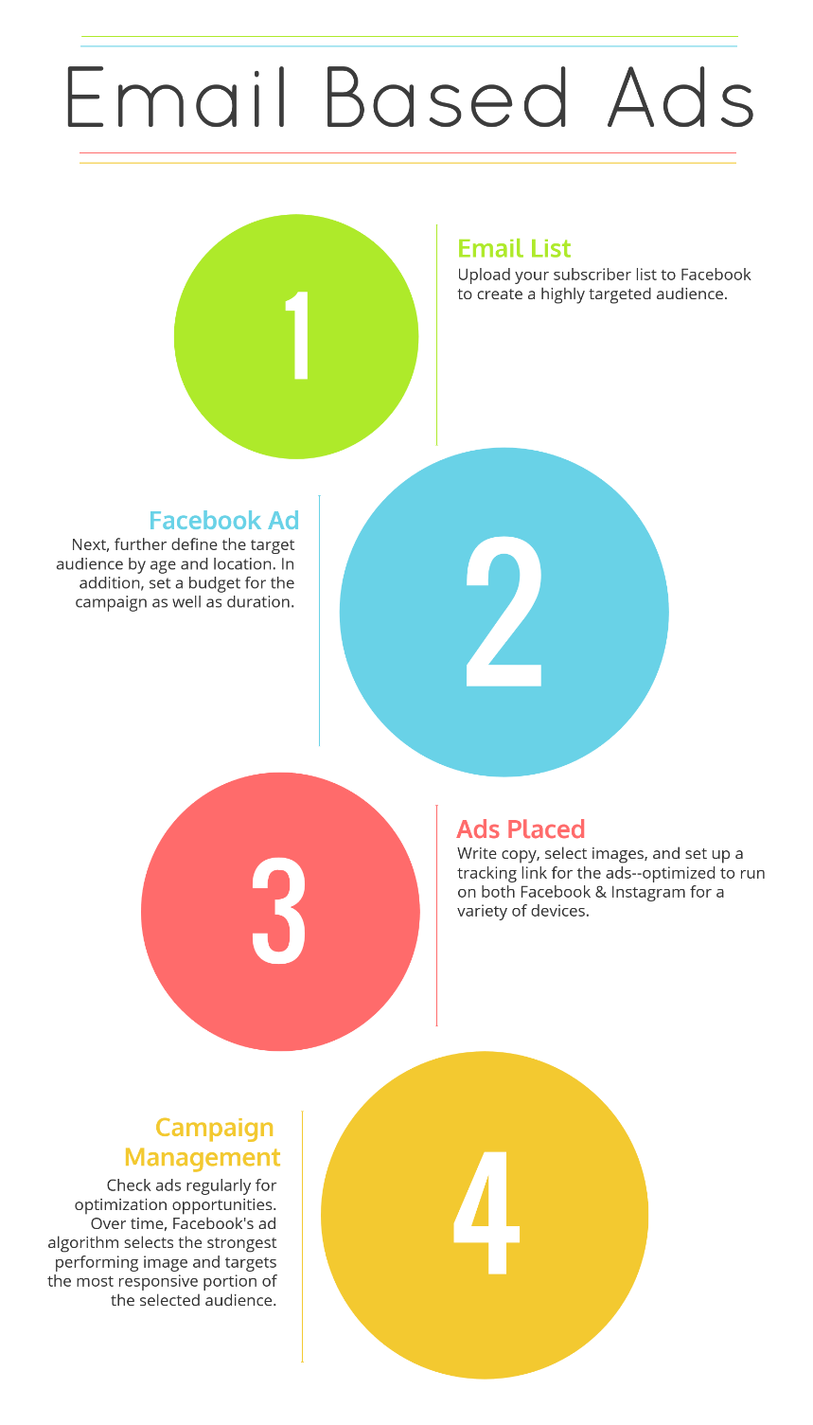
These ads serve two goals:
First, to act as reminders and to generate high awareness among an already invested audience (remember the rule of 7).
Second, to expand awareness to similar audiences through organic reach and broader engagement or by the creation of Lookalike Audiences.
Notes:
Jamie to explain that Facebook allows you to target your audience by email address. Explain process. What you can do and why? Rule of 7

Slide 48
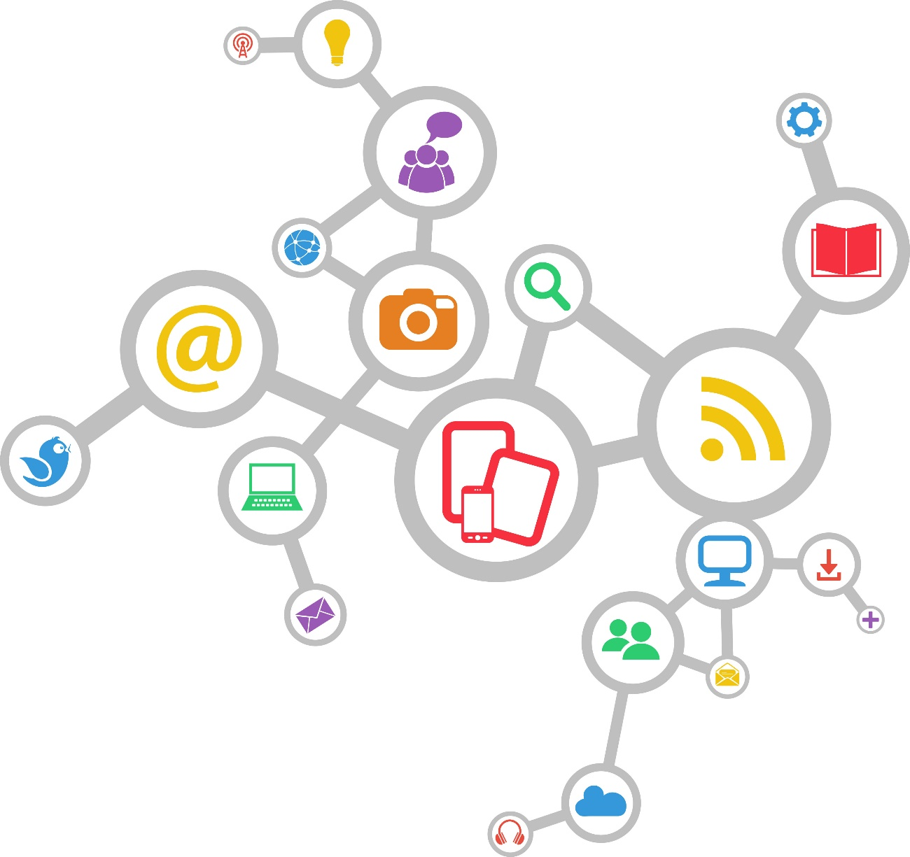
The Rule of 7 states that a person needs to be exposed to a message at least 7 times before they’ll take action.
Notes:
It may take 1,000 tries to reach an individual 7 times with a consistent message. Our goal with Washington Conference is to get them on the path to a strong integrated strategy that makes use of all their communication tools, platforms, and channels…to reach people with a consistent message and voice.

Slide 49
Facebook Budget Planning
Geotarget Audience
50 miles of Seattle
Target by interests (GC, NAD)
Impressions – Ask to follow messaging, images
“Follow for news and inspiration”
Email Append
Upload results to Mailchimp, Facebook
Target campaign by people’s emails
Request Initial Budget
$100-300
Then request more budget
Pay to play: 20% of followers will see a post
Prove concept
Notes:
March 22, 2017

Slide 50
How Far We’ve Come!
Notes:
Heidi: This is how far we’ve come this year! What started with simply asking staff to like and respond to posts on our page has now grown into two page-like ad campaigns. We had one geo-targeted campaign and one email page like campaign.

Slide 51
The Most Oversaturated Network
Notes:
Jamie: Unless you’re a celebrity or other high profile person, it’s really hard to cut through the noise. But Twitter is still a really fantastic tool for second screening and creating a collective conversation around an event or video. It’s also a very good PR mouthpiece.

Slide 52
Twitter
Outreach network
Live tweet tips
Healthy living tips/daily
Tie in with local events
Show what the church is doing
Include limited hashtags
Encourage interaction
Reward behavior with likes/retweets
Notes:
.Jamie to present

Slide 53
Extending the Coaching
Notes:
Extending the Coaching
Jamie’s example in coaching is allowing me to start coaching churches, schools, and ministries in my area. One of my churches experienced a troll recently. With Jamie’s new Assessing Your Response flow chart, the church leaders figured out how they wanted to best respond. This is a great tool that I now have posted on my desk, and shared with other key contributors. Jamie has copies of this response flowchart available and you can also find it at sdadata.org.
Additionally, the coaching is happening with my colleagues. We have monthly staff meetings, and with each meeting there is an agenda item for communication development. I typically give my colleagues a short homework assignment and a timed brainstorming session of 30-90 seconds. It makes them think fast and it’s fun. In one of these activities, my colleagues brainstormed hashtag options for their ministry area!
I am also offering coaching environments for my churches and schools. We have a targeted Facebook group with about 50 participants. Often times it is me sharing a helpful tutorial, resource, or article I found. Other times, it is questions and feedback. On Monday, we have a team coming together for a Local Communication Summit that will be focused on social media.
There have been a few instances of pushback. With any feedback or pushback, I try to thank the person for sharing (whether I agree or not), understand that feelings are not reality, and take the higher road. Sometimes this means sharing stories, numbers, or statistics. Sometimes this involves listening. One of the insights Jamie shared with me is that “Greater support requires greater communication.” This has been helpful advice not just for integrating social media plans.
Jamie: There is a lot of work to be done. I consider this partnership a success because Heidi is taking what she is learning and teaching others. I don’t want people or organizations to rely on me, my goal in this is to teach you how to fish for yourself, so that I can go on and create another digital evangelist who that then create others. It’s basically the discipleship model with fancy tools. We need 10,000 social media experts to accomplish our mission. I cannot do this alone, I require sleep.

Slide 54
Feedback & Pushback
Thank person for feedback (whether you agree or not)
With pushback, give numbers & show statistics
Feelings are not reality
Take the higher road
Don’t take it personally
Greater support requires greater communication

Slide 55
What’s Next?
Persona Development
StoryBranding
Big Data Analysis & Training
Further Implementation
Data Integration into Decision Making
More Learning & Growing!
Notes:
Heidi presents next steps.

Slide 56
Data Analysis
Notes:
Data Analysis
All of our new and renewed communication is giving us more data to analyze. The NAD’s data scientist reviewed our collected data this summer. We are anticipating more conversations soon to unpack this data and the ministry opportunities that are available. Additionally, we will likely attend a big data conference this winter to help key leaders understand how to apply big data in practical ways. For our education colleagues, one of their goals is to plant a new school. We would like to use big data to help determine where this school should be located, how much tuition should be based on household income, and the diversity makeup of staff.
Jamie: This is a long-term partnership that will continue to advance as time goes by. Data is valuable to ministry in that it’s a powerful tool to understanding your members, your community, and their unique needs. We can use data to make informed decisions on shaping ministry and service in our community. We can use to gain insights into the issues the conference is facing and ultimately find solutions that will stand the test of time.

Slide 57
Overall
We are partners for a winning team!
We work with people where they are and woo them into a shared experience
Notes:
Overall
Overall, this has been a very positive and proactive process. We are learning and growing. We are trying new approaches and finding new ways to expand our ministry toolbox to benefit God’s kingdom. Digital strategies, data services, email address integration does not need to be a daunting process. It is do-able over time. It is reassuring to not be “alone” in the process and to have the option of connecting with the experts for coaching, advice, and encouragement.
Change does take time, and a lot of education and encouragement along the way. Change is possible. And change is rewarding.
Jamie and I like to think of it as: We are partners for a winning team. We work with people where they are and woo them into a shared experience.

Slide 58
Questions & Connections
Jamie Jean Schneider Domm NAD Digital Strategist
Follow up! jamieschneider@nadadventist.org
Learn more! www.sdadata.org/resources
Social Media: @DigiEvangelism
Heidi Baumgartner Washington Conference Communication Director
Follow up! heidi.baumgartner@wc.npuc.org Learn more! www.washingtonconference.org
(See Communication > Training Modules)
Notes:
Jamie: To learn more about what we are doing and what you can do to start implementing similar advances, visit SDAdata.org for resources, case studies and blog posts on a range of topics. Got a question? You can reach out to me via email or social media @DigiEvangelism.

