Slide 1
Social Media Advertising/Analytics
A CRASH COURSE In tracking, Analytics, and Advertising
Jamie Jean Schneider Domm Digital Strategist North American Division

Slide 2
Why is tracking important?
Learning and adapting our strategies

Slide 3
If you can track it, you can measure it.
Notes:
As a result, you can better understand your audience, and their behavior in order to adapt your strategies to more effectively reach them. Saving both time and money

Slide 4
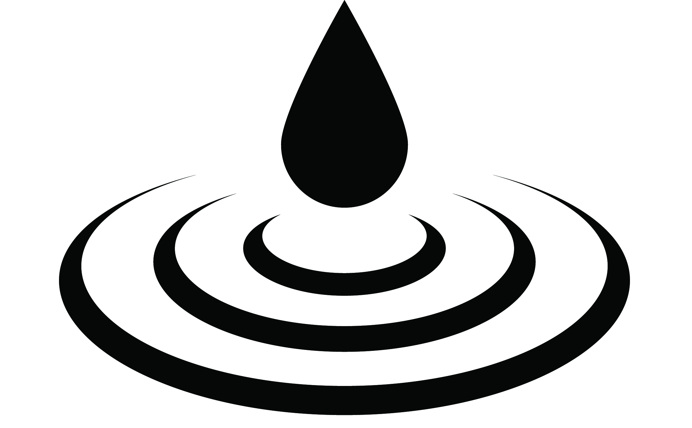
Notes:
while maximizing impact.

Slide 5
UTM Codes
A Guide to creating your own
Notes:
This is surprising very easy to do, which actually makes it difficult to teach because people feel like they are missing something. I assure you, it really is this straight forward.

Slide 6
What is a UTM code?
UTM = Urchin Tracking Module
https://www.ittoshow.com/?&utm_campaign=NADnow-2017&utm_source=Social-Media
Helps you measure & prove social media success!
Notes:
UTM = Urchin Tracking Module. UTM codes are segments appended to the end of a URL that enables data platforms like Google Analytics to record information about website visitors and traffic sources.

Slide 7
Where can they be used?
Social Media
Email
Online Ads
Website Links
In any link that drives traffic to your website

Slide 8
Creating Your Own Tracking Links
https://www.ittoshow.com/?&utm_campaign=NADnow-2017&utm_source=Social-Media
Regular link + ? + Campaign (what event, month, where, etc.) + Source (channel/platform)
Notes:
Explain the building blocks

Slide 9
Demonstration
Url = https://www.adventistlearningcommunity.com/faith-reason-earth-history
Campaign = FaithReasonEarth-2017
Source = Social-Media
Put it all together using this formula: Regular link + ? + Campaign (what event, month, where, etc.) + Source (channel/platform) https://www.adventistlearningcommunity.com/faith-reason-earth-history?&utm_campaign=FaithReasonEarth-2017&utm_source=Social-Media
More information: SDAdata.org/digital-evangelism-blog/utm-codes-a-guide-to-creating-your-own
Notes:
Talk through process & demonstrate.
For more details on how to create your own tracking codes, visit my blog: http://www.sdadata.org/blog/utm-codes-a-guide-to-creating-your-own

Slide 10
Be sure to always test your links!
Notes:
After you create your trackable link, always test your link before using it to make sure it works. There is nothing worse than sending out a bunch of digital content with a broken link.

Slide 11
URL Shorteners
Why, how, & benefits

Slide 12
Why shorten your links?
Saves valuable space in your social media posts
Hides/masks UTM codes (trackable links)
Looks cleaner for marketing messages
Easy to share
Built in tracking

Slide 13
THIS: https://www.adventistlearningcommunity.com/faith-reason-earth-history?&utm_campaign=FaithReasonEarth-2017&utm_source=Social-Media
BECOMES: bit.ly/2IBnACd
BRANDED: bit.ly/FaithReasonEarth
Notes:
URL shortening allows you to tighten up a long trackable URL to something short and easy to copy for social media posts.

Slide 14
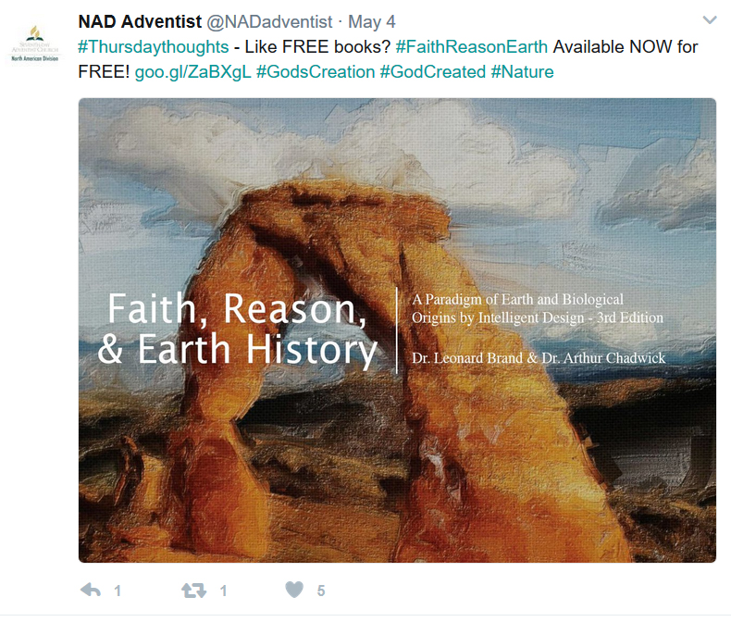
Notes:
This shortened url then fits much better in social media posts, especially Twitter.

Slide 15
They track too!
Notes:
As I mentioned before, many link shortening tools also track click-throughs. Here you can see that this particular link is actually performing quite well. Now because we used UTM codes, we can actually get more in-depth data. But more on that in a moment.

Slide 16
The Short List of URL Shorteners
Bit.ly – Shorten, brand, & optimize links while tracking individual link analytics
Goo.gl – Provided by Google with built-in individual link analytics
Rebrandly.com – Create & share short links with your domain name
Ow.ly – Provided by Hootsuite with built in analytics
Hiveam.com – Link management dashboard
Tr.im – Link management dashboard
There’s more….
Learn more at SDAdata.org: bit.ly/SMlinkShortList
Notes:
These are a few of the top options. Many are available for your phone and iPad as well.

Slide 17
Google Analytics
OVERVIEW & SET UP
Connecting the Dots
Notes:
Now we know how to append UTM codes to our links, and then shorten them. Let’s see how that information then connects to the data in Google Analytics.

Slide 18
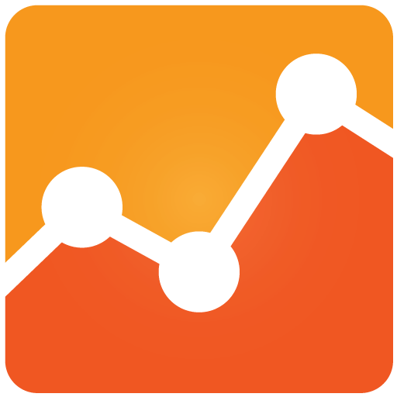
What is it & why do you need it?
Google Analytics is a free and essential tool for monitoring and understanding how visitors interact with your website and where they come from.

Slide 19
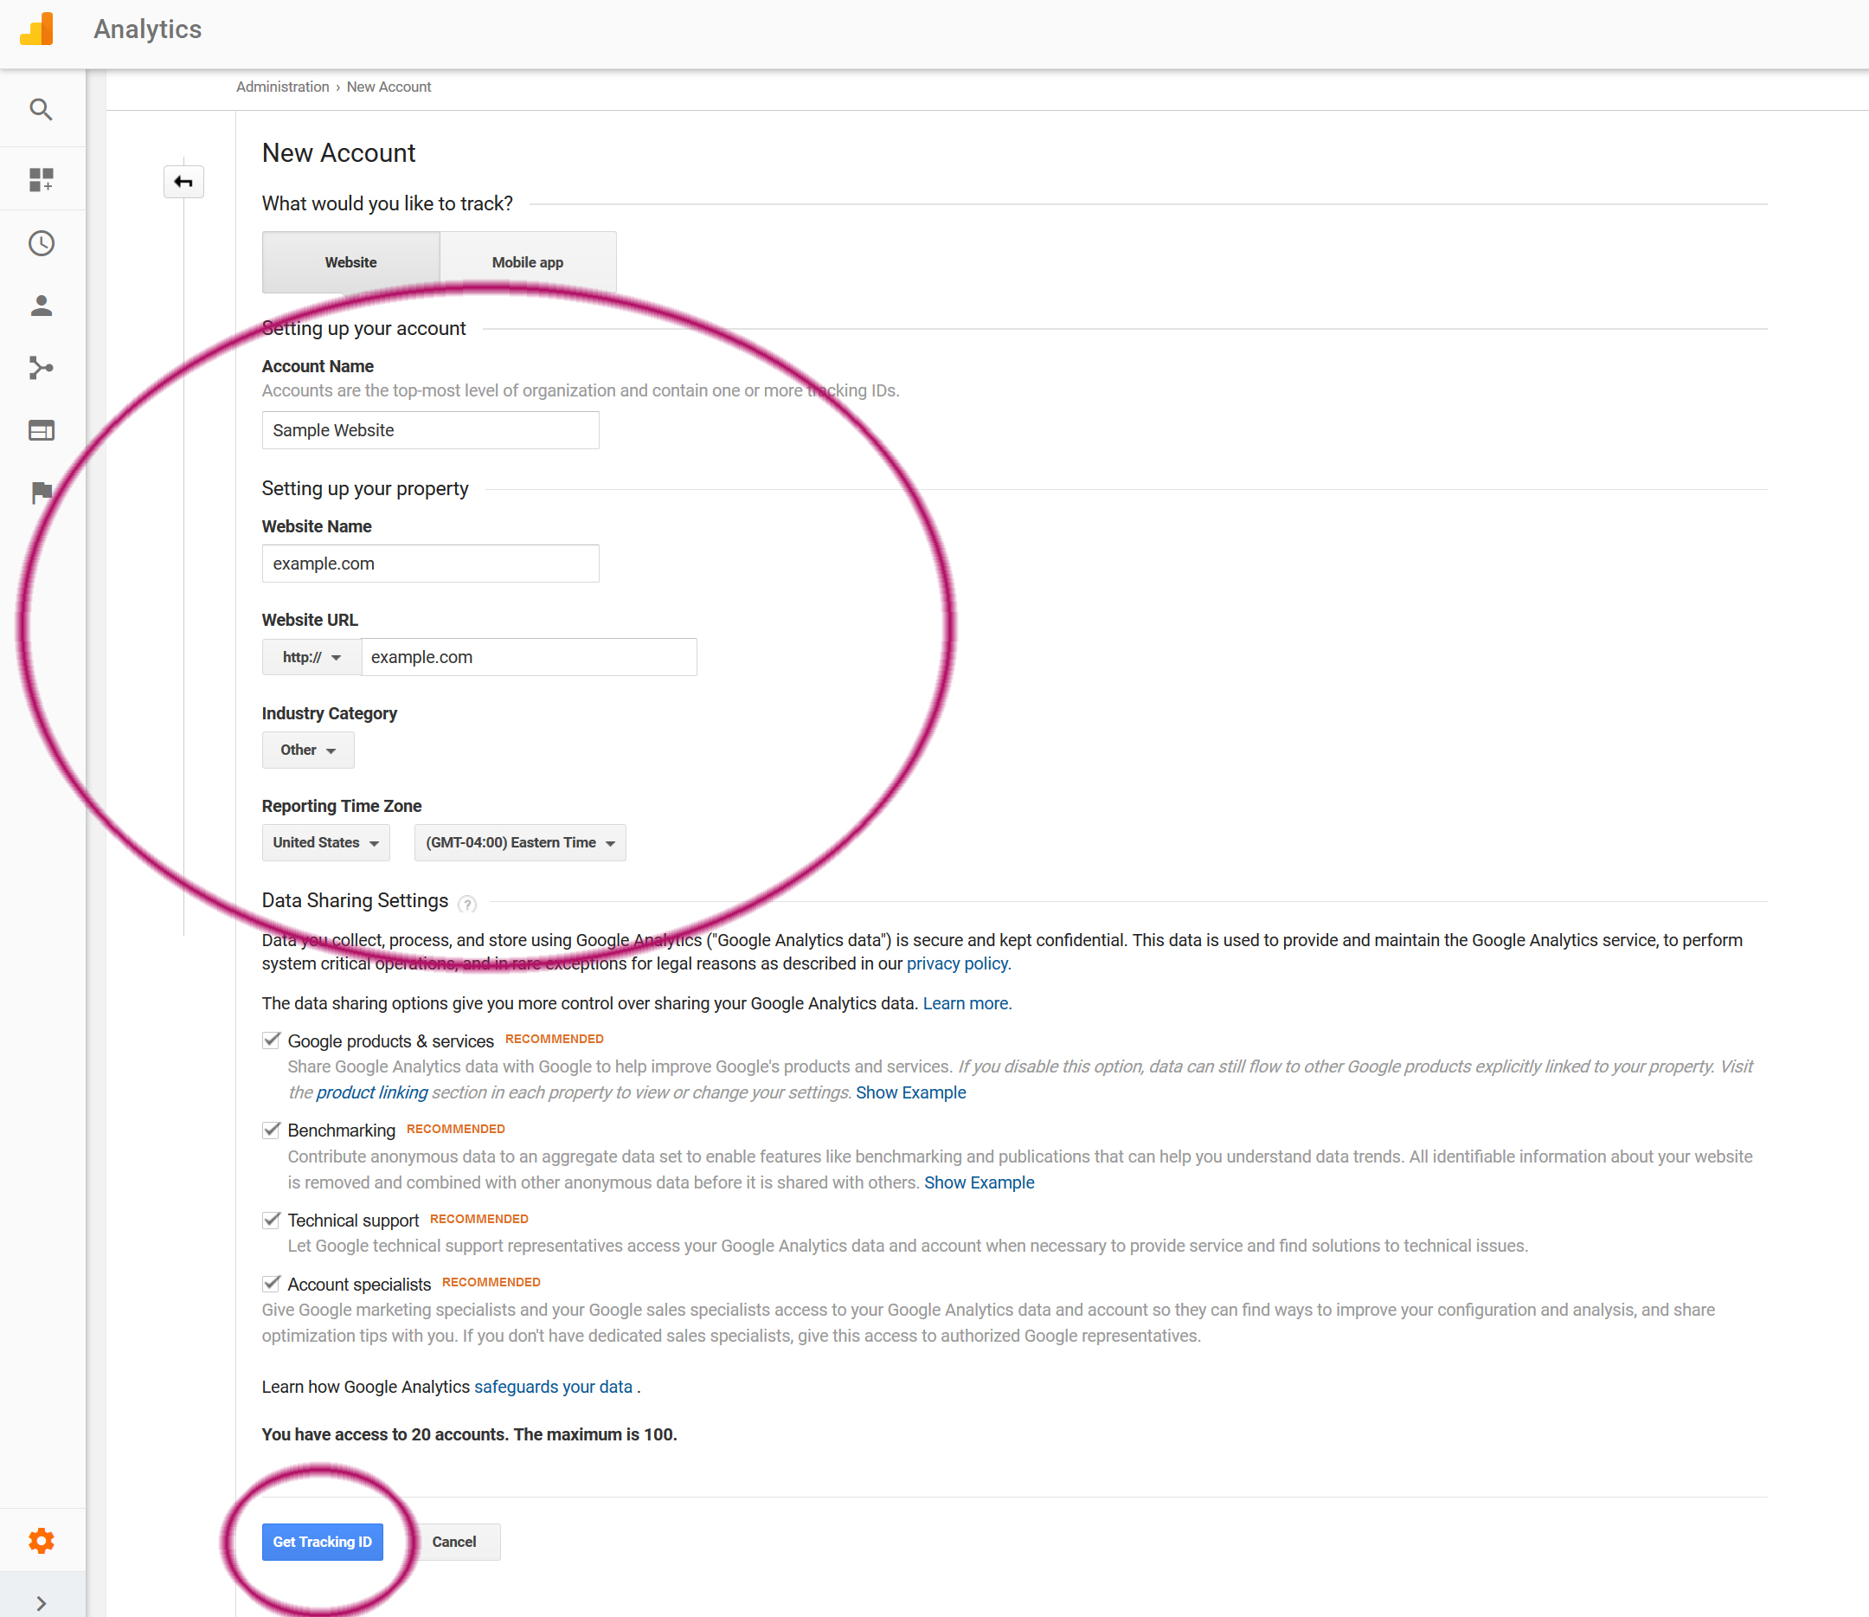
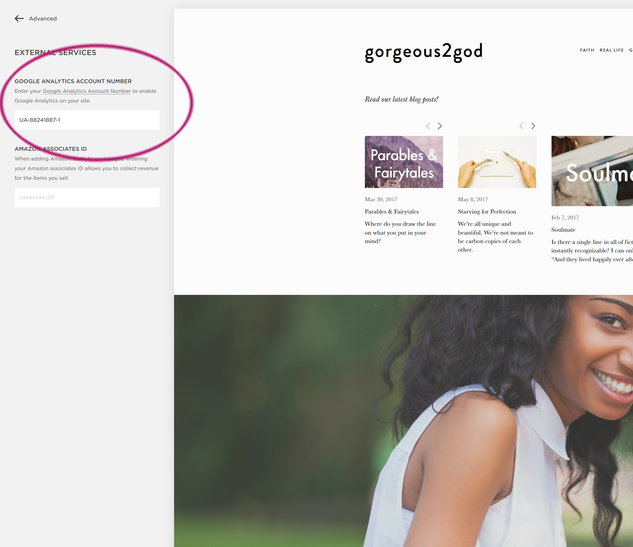
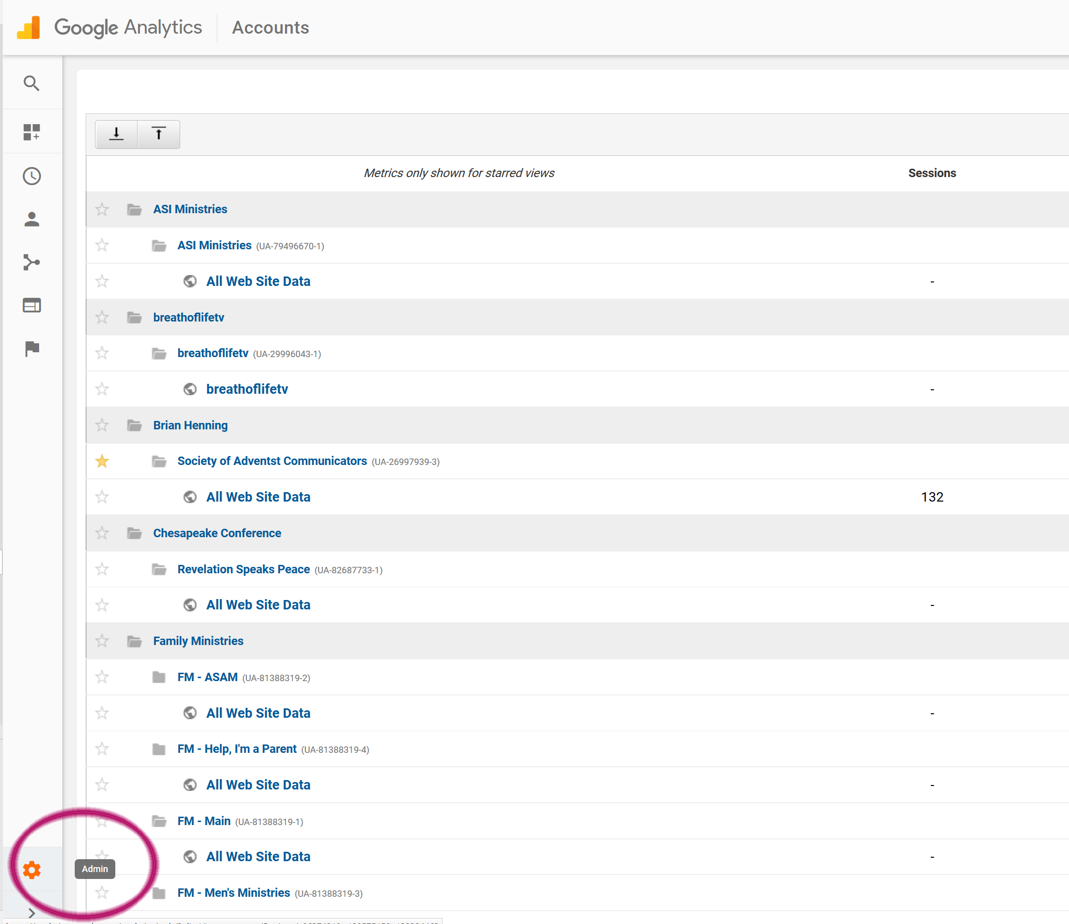
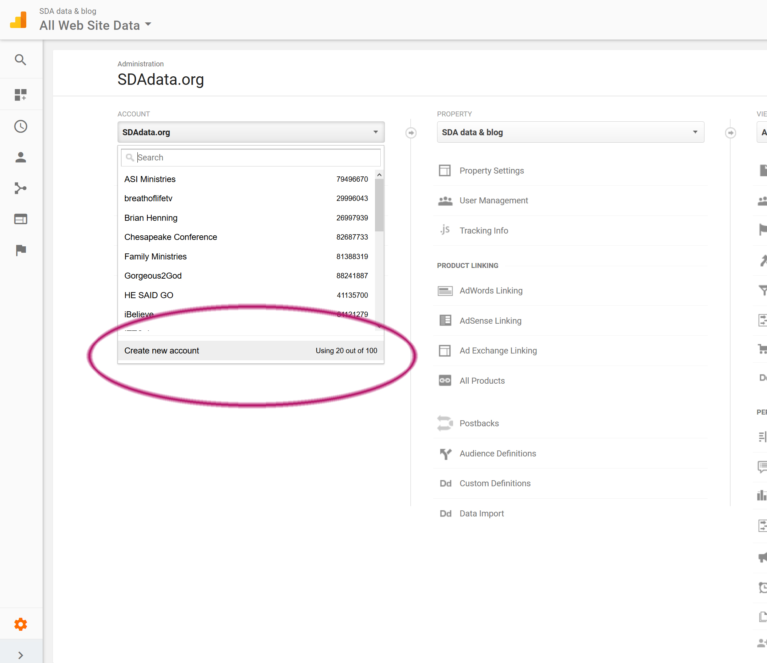
Squarespace Example
Set up:
Go to google.com/analytics
If you have a google account, sign in. If not, create an account.
Set up your website in Admin that will serve as a data collection point.
Add the Analytics tracking code to your website. Will be slightly different for each website platform.
Wait 24 hours for data to begin to appear.
Notes:
Some website platform allow you to incorporate widgets for Google Analytics. If you have trouble connecting google analytics to your website, consult your help for your hosting platform.

Slide 20
Key terms/metrics
Session: a visit to the website during which the user is active
Users: number of unique people who have visited your website during a specific timeframe
Pageviews: total number of pages viewed. Repeated views of a page by a single user are counted
Page/Session: average number of pages viewed during a session
Average Session Duration: average length of a session
Bounce Rate: the percentage of single-page sessions in which there was no interaction with the page
% New Sessions: estimated percentage of first-time visitors

Slide 21
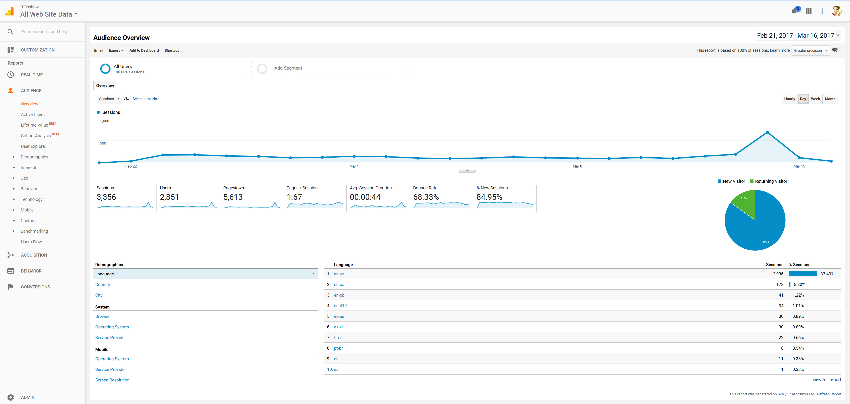
Dashboard & Navigation
Notes:
When you open your Google analytics account, you’ll see your homepage or dashboard. In the top right you can change the data range. In the center you can see the data for the various terms we just discussed. On the left-hand side is the main navigation.

Slide 22
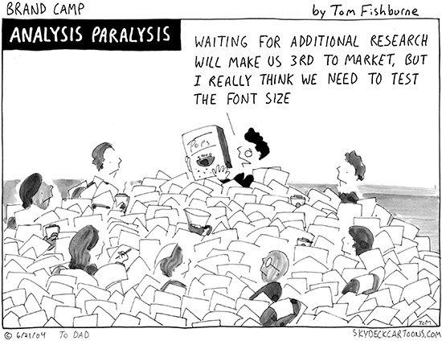
Avoid Data Paralysis
Time is valuable. Don’t get so caught in the details or data that you never move forward, or respond too late and miss an important opportunity.
Notes:
Most non-profits do not have the luxury of a dedicated analytics team. But you don’t need to dive too deep to get valuable information about how your website and campaigns are performing. I’m going to highlight the key metrics that won’t overwhelm you, but will maximize your data-driven decision making.

Slide 23
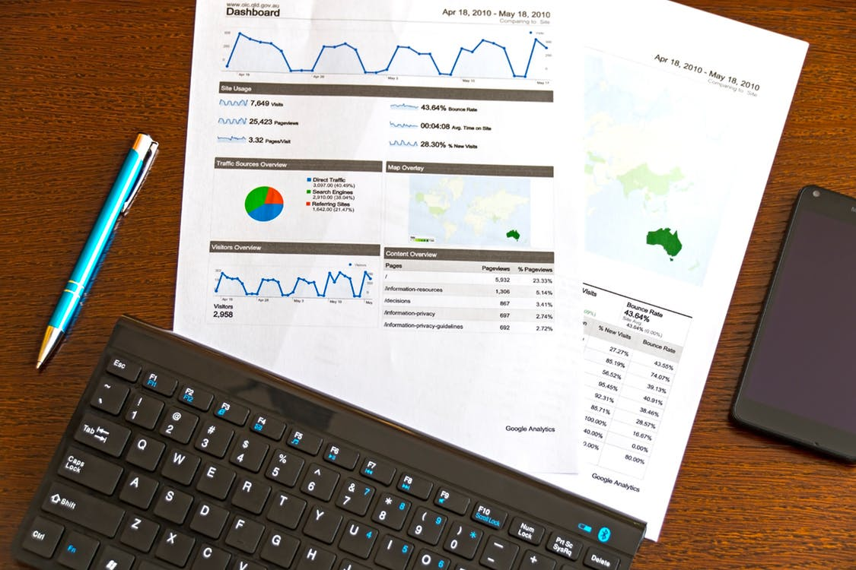
Other key metrics to monitor
Prioritize: You don’t have time to track everything!
Age & Gender
Location
Site Content – Pages
Engagement
Acquisition & Traffic Sources
Campaign Performance
Notes:
Here are some key metrics that you should consider tracking in Google Analytics

Slide 24
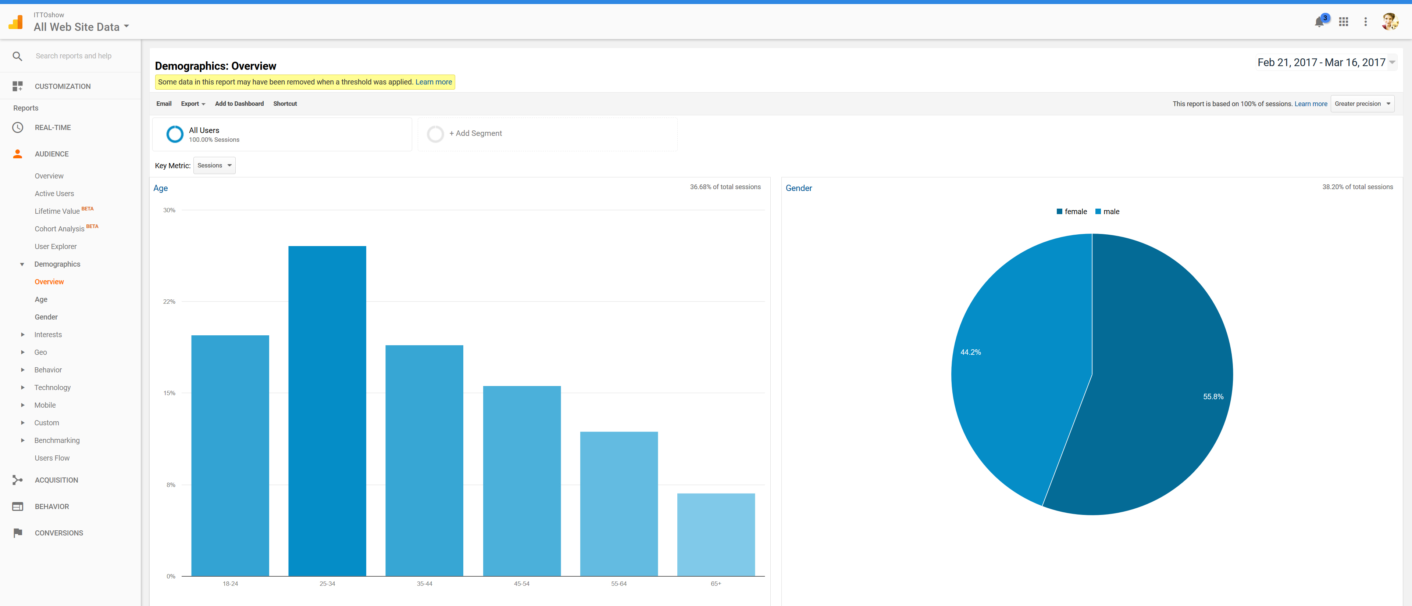
Age & Gender
Notes:
Under demographics you can view known age & gender. In this case only 36.68% of total sessions have corresponding demographic data. Even though the data is incomplete, it does give a pretty good cross-section of who is visiting your website.

Slide 25
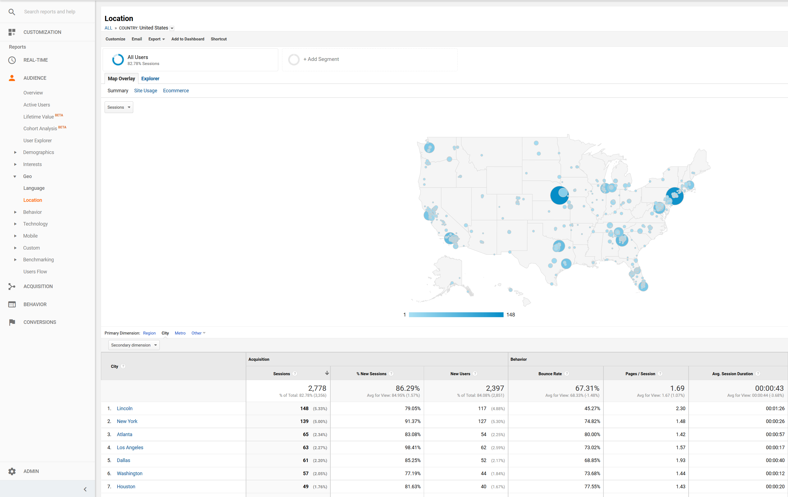
Location
Country
State
City
Metro Area
Language
Notes:
You can see location by country, city, state and metro area. You can also look at language if that is relevant to your ministry. You can look at the number of sessions and users as well as their behavior such as bounce-rate, pagers per session or depth-of-session and average session length.

Slide 26
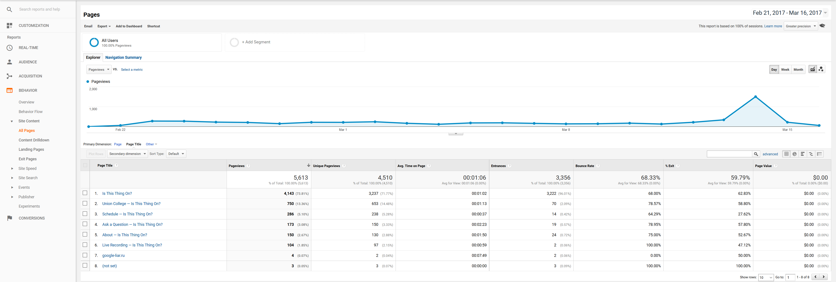
Behavior – Site Content
Here you can determine your most popular and least popular pages.

Slide 27
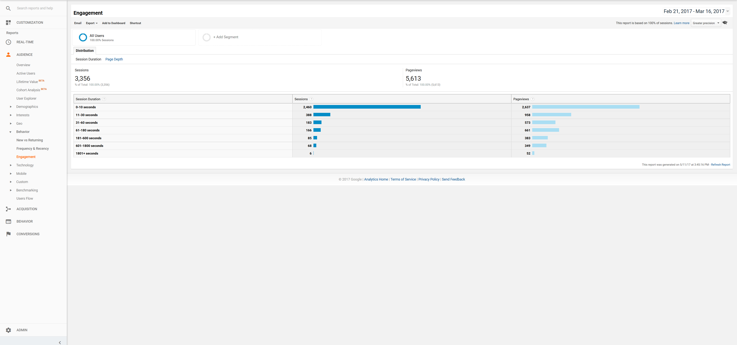
Engagement
Length of visit/depth of visit

Slide 28
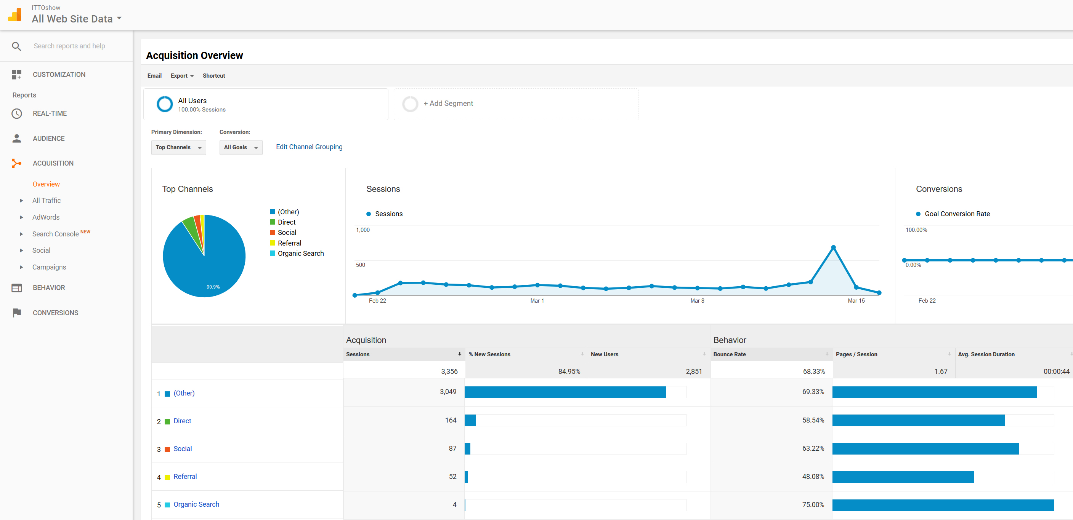
Acquisition Overview
This is where those UTM codes (trackable links) come in! Here we can see that trackable links accounted for 90.9% of the traffic to the website, meaning that our campaign was a huge driving factor behind awareness and traffic.
Other = UTM Codes or Campaigns
Direct
Social Media (no tracking code)
Referral from another website
Search engine
Notes:
As communicators, we want to know what is working and what is not working to drive people to your website. Here is where you can determine that. Keep in mind that OTHER is links with tracking codes or campaigns.

Slide 29
Campaign Performance
Google Analytics automatically picks up the campaign name and source from the links. No need to do anything in Google Analytics to make this work!
Notes:
We can then drill down deeper to learn more about what aspects of the campaign performed the best. You can create as many campaigns and sources as you want.

Slide 30
Overview of Social Media Insights
Where to find data and understanding terms
Notes:
Lets now take some time to go over your social media insights that you available to you. Again, if you can track it, you can measure it. If you can measure it, you can better understand your audience, who you are reaching, how they are engaging with your content, and as a result, you can better optimize your strategies to meet your goals.

Slide 31
47% of Americans learn about a nonprofit from the internet, specifically social media.
59% of people donate after becoming a follower of a nonprofit’s social network.
56% of people donated to an organization because they read a story via social media.
Notes:
This is important because….Therefore it’s vital that you check your social media insights regularly in order to understand your impact and adapt your strategy as needed.

Slide 32
Analytics are FREE!
Insights or analytics come free with most social media platforms. We will take a look at:
Facebook
Twitter
Instagram
Notes:
We’re going to just cover a few in this course. But if you can master these three, you can understand the terminology and data insights for just about any social media platform. Facebook currently provides the most extensive and in-depth analytics.

Slide 33
Key terms
Standard definitions:
Reach: The number of people who saw your post at least once.
Impressions: The number of times your post was viewed (one person may receive multiple impressions).
Engagements: The number of times a person has interacted with a post (reactions, pins, shares, comments, etc.)
Engagement rate: The total number of engagements divided by total impressions.
Profile/page views: The number of times people have viewed your profile and its sections.
Notes:
These definitions are pretty standard and are the same as paid advertising data reports.

Slide 34
Setting social media goals
Identify what you are trying to achieve. Your goals may include:
Sharing news
Increasing Brand recognition
Educating about a cause
Fundraising
Recruiting volunteers
Serving a specific demographic
Notes:
Before you can execute a successful social media strategy, you must clearly identify what you’re aiming to achieve.

Slide 35
Creating a baseline
You must know where you started, to properly understand the change in impact.
This requires establishing a baseline or foundation for your profile performance now.
Determine measures for success.
Keep track of these key metrics over the course of a campaign.
Evaluate success regularly; adapt as needed.
Notes:
In order to measure progress, you must have a baseline for performance.

Slide 36
Sample metrics
Increased impressions or views might reflect an increase in awareness.
Strong click-through rates mean increased traffic to your website.
Engagement rates (reactions, shares, clicks and comments) indicate interest in your cause and content.
Donations from social media reflect conversions of new “customers/supporters.”
Increased attendance at events can indicate successful social media targeting and conversion.
An increase in engagements or impressions from a specific age group, gender or demographic reflects relevancy of marketing language and graphics.
Social media should direct people to your website to encourage conversions (donations, registrations, etc.)
Notes:
Some sample metrics may include….

Slide 37
Connecting the dots
Use trackable links and Google Analytics to view sources of traffic (acquisition) to your website and other helpful information that can help you evaluate your social media campaigns.
Keep track of “sales” or registrations over time.
Learn more on our blog here: bit.ly/2keFyfh
Track and analyze trends related to your strategy, content, website visits, and conversions.
Understand how visitors from social media behave on your website.

Slide 38
Top Platforms
Facebook, Twitter & Instagram

Slide 39
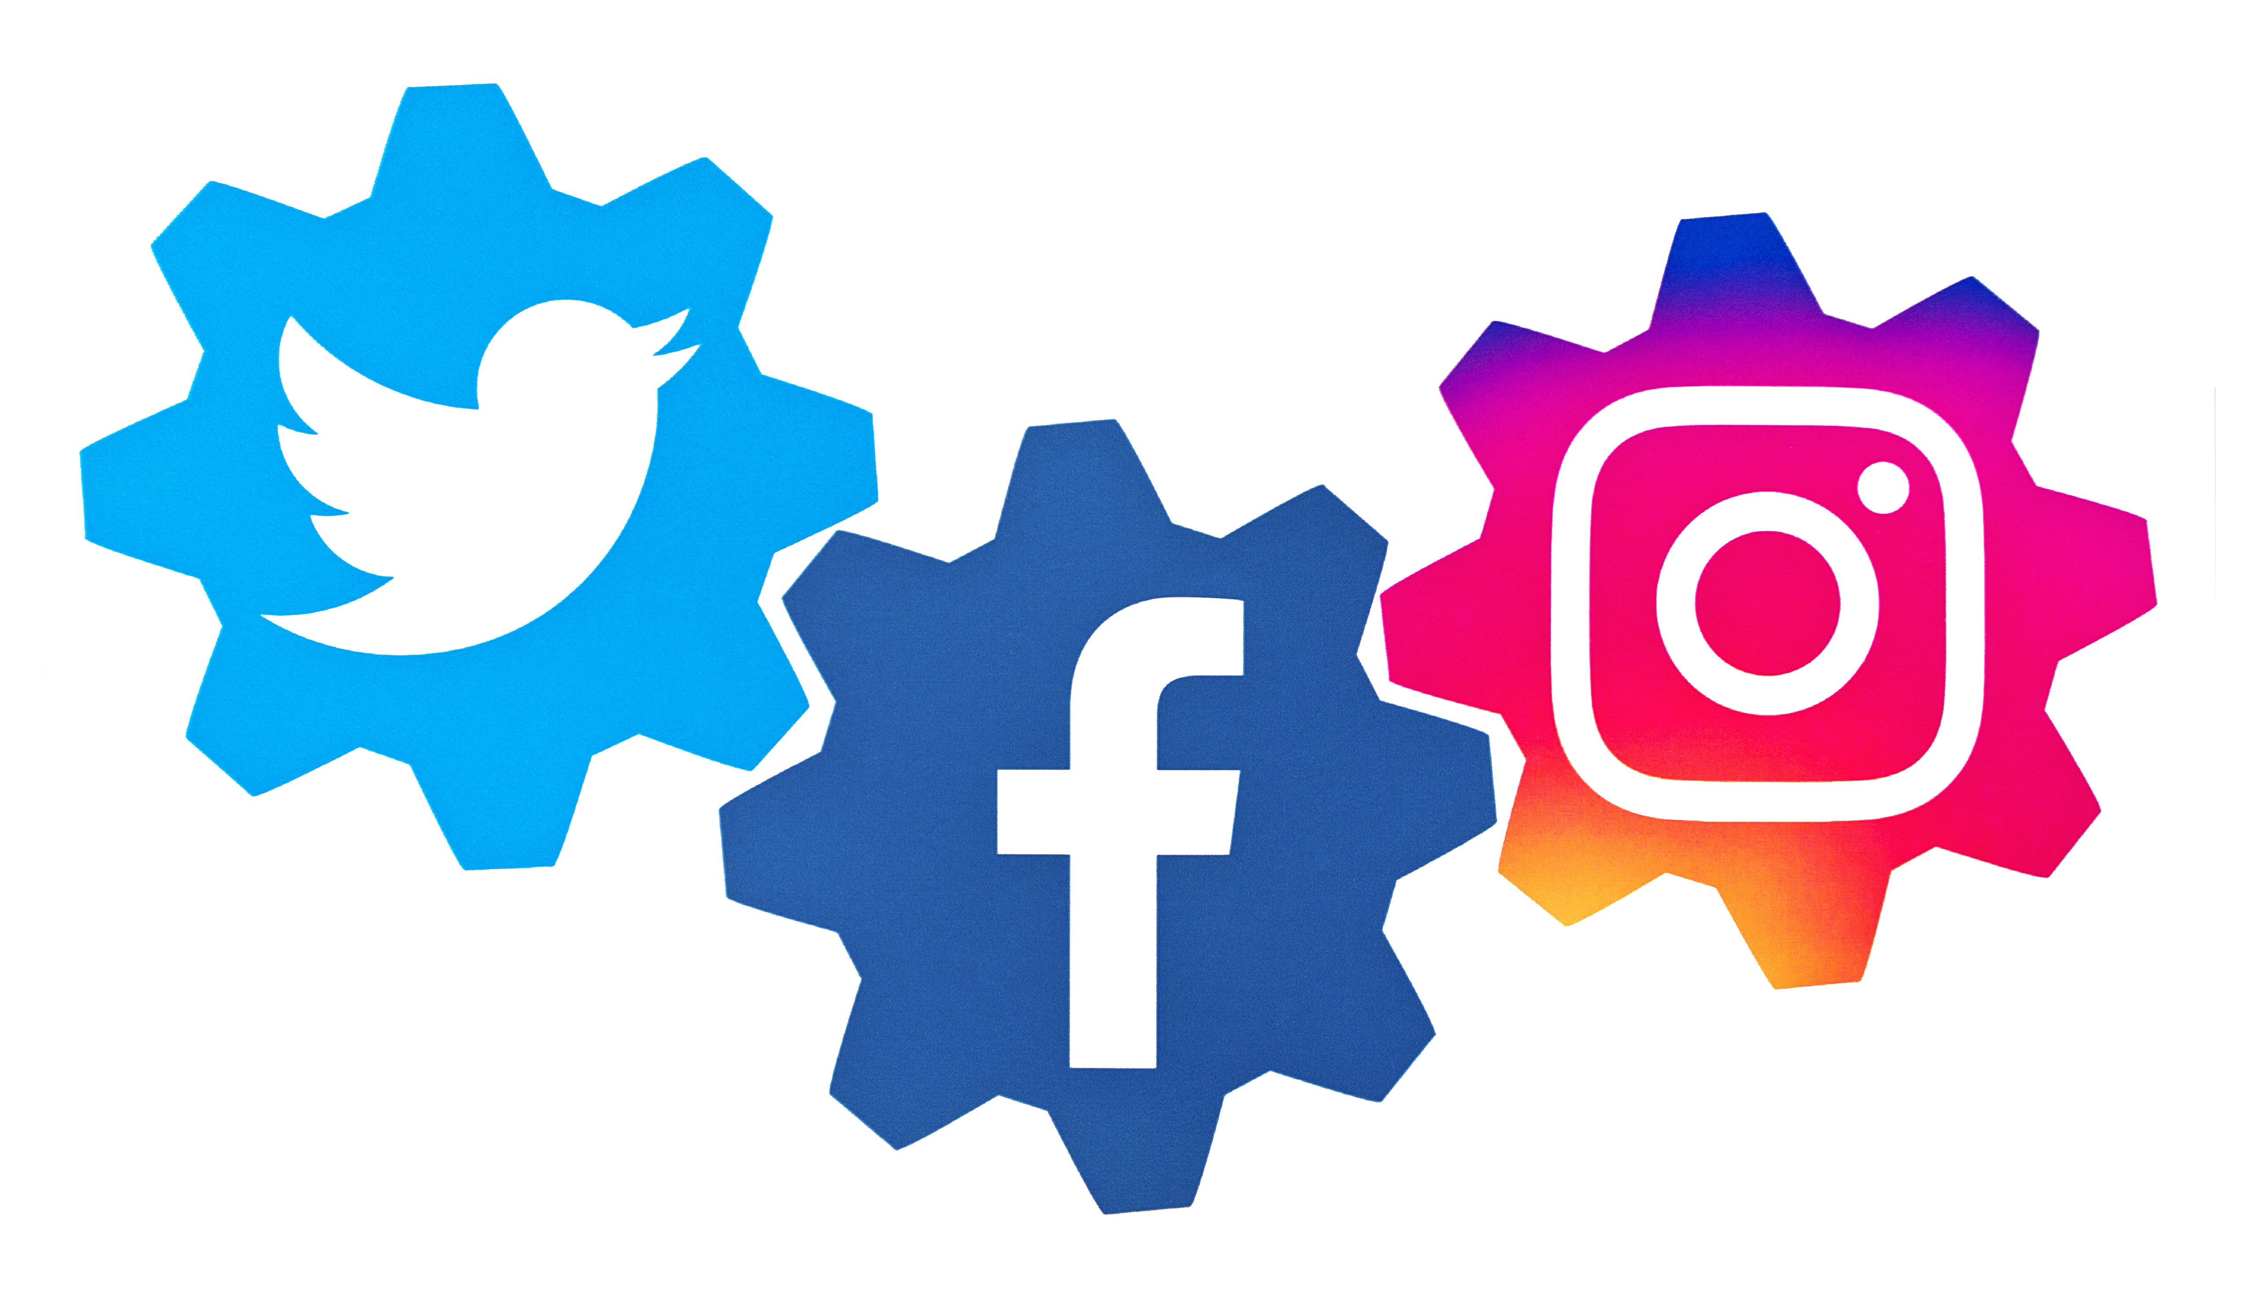
Notes:
While we may only go over these three platforms, keep in mind that all the principles are applicable to other platforms such as Snapchat and Pinterest. The data terminology is also mostly universal. But if you’re unsure, most platforms provide the definitions of the data points right in the analytics section.

Slide 40
On all platforms, check your analytics regularly so that you can become an expert on YOUR audience. Each audience is unique.
Notes:
There is no one size fits all.

Slide 41
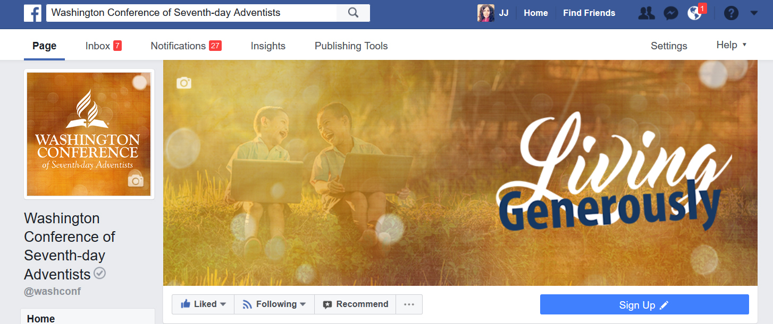
Facebook Insights Key metrics to track
Notes:
To access Facebook Insights, go to your business page and click on the insights tab.

Slide 42
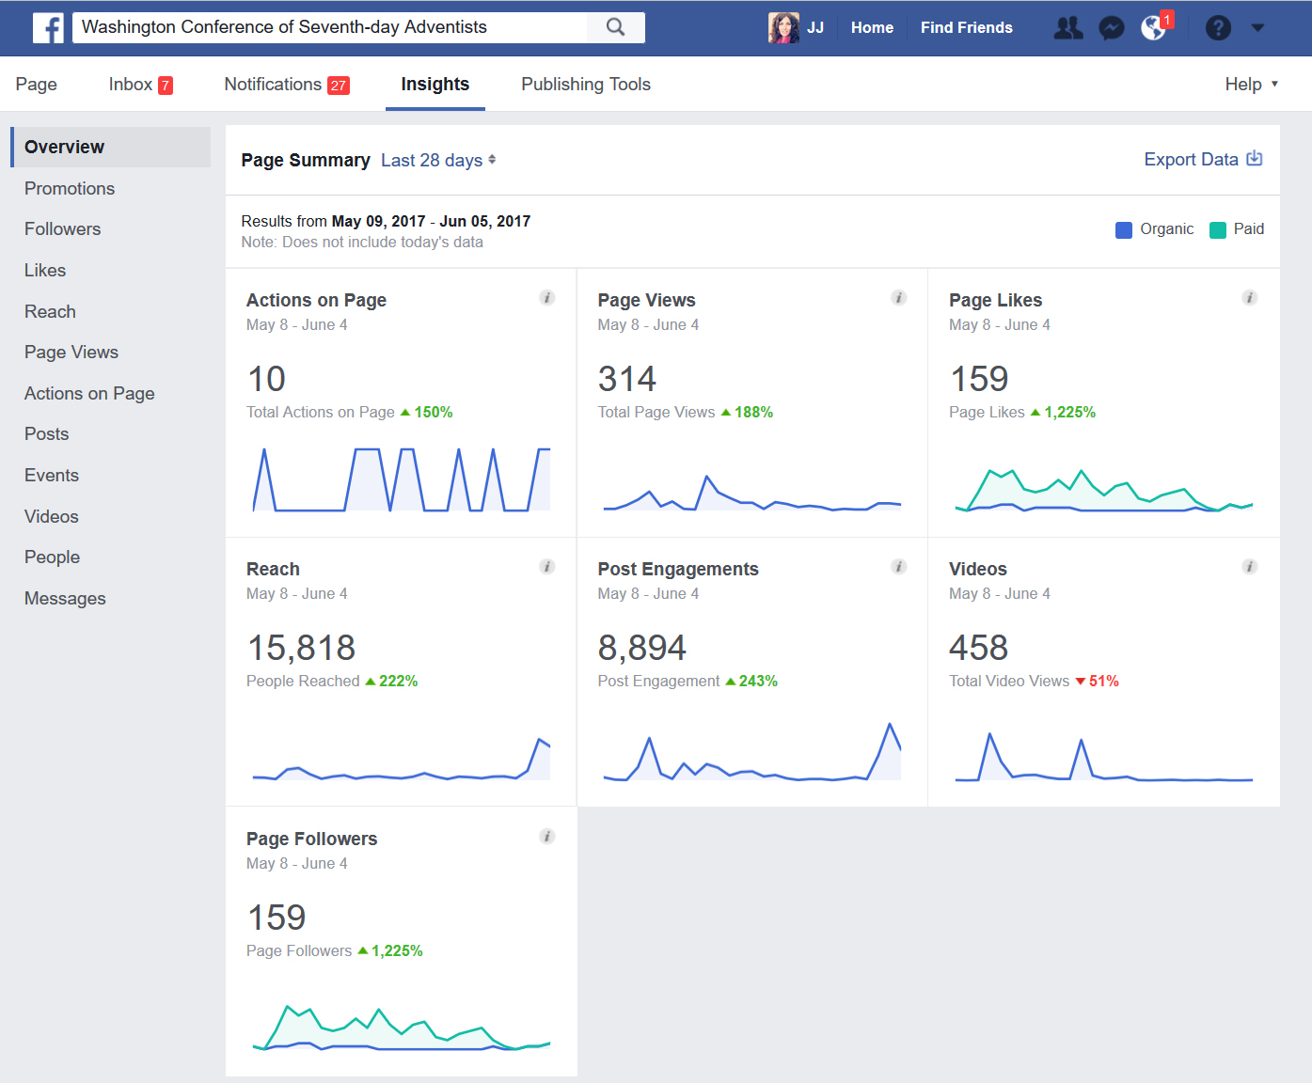
Page summary
7 day or 28 day time frame
Shows organic engagements versus paid
Change in Page Likes/Followers
Reach, Page Views, Post Engagements
Video views
Notes:
The page summary dashboard gives you a quick look at key performance metrics.

Slide 43
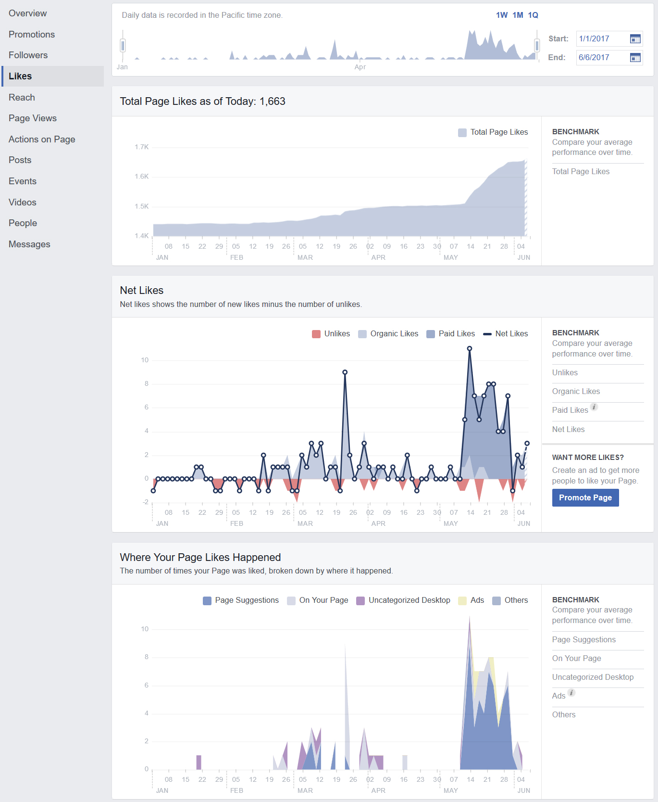
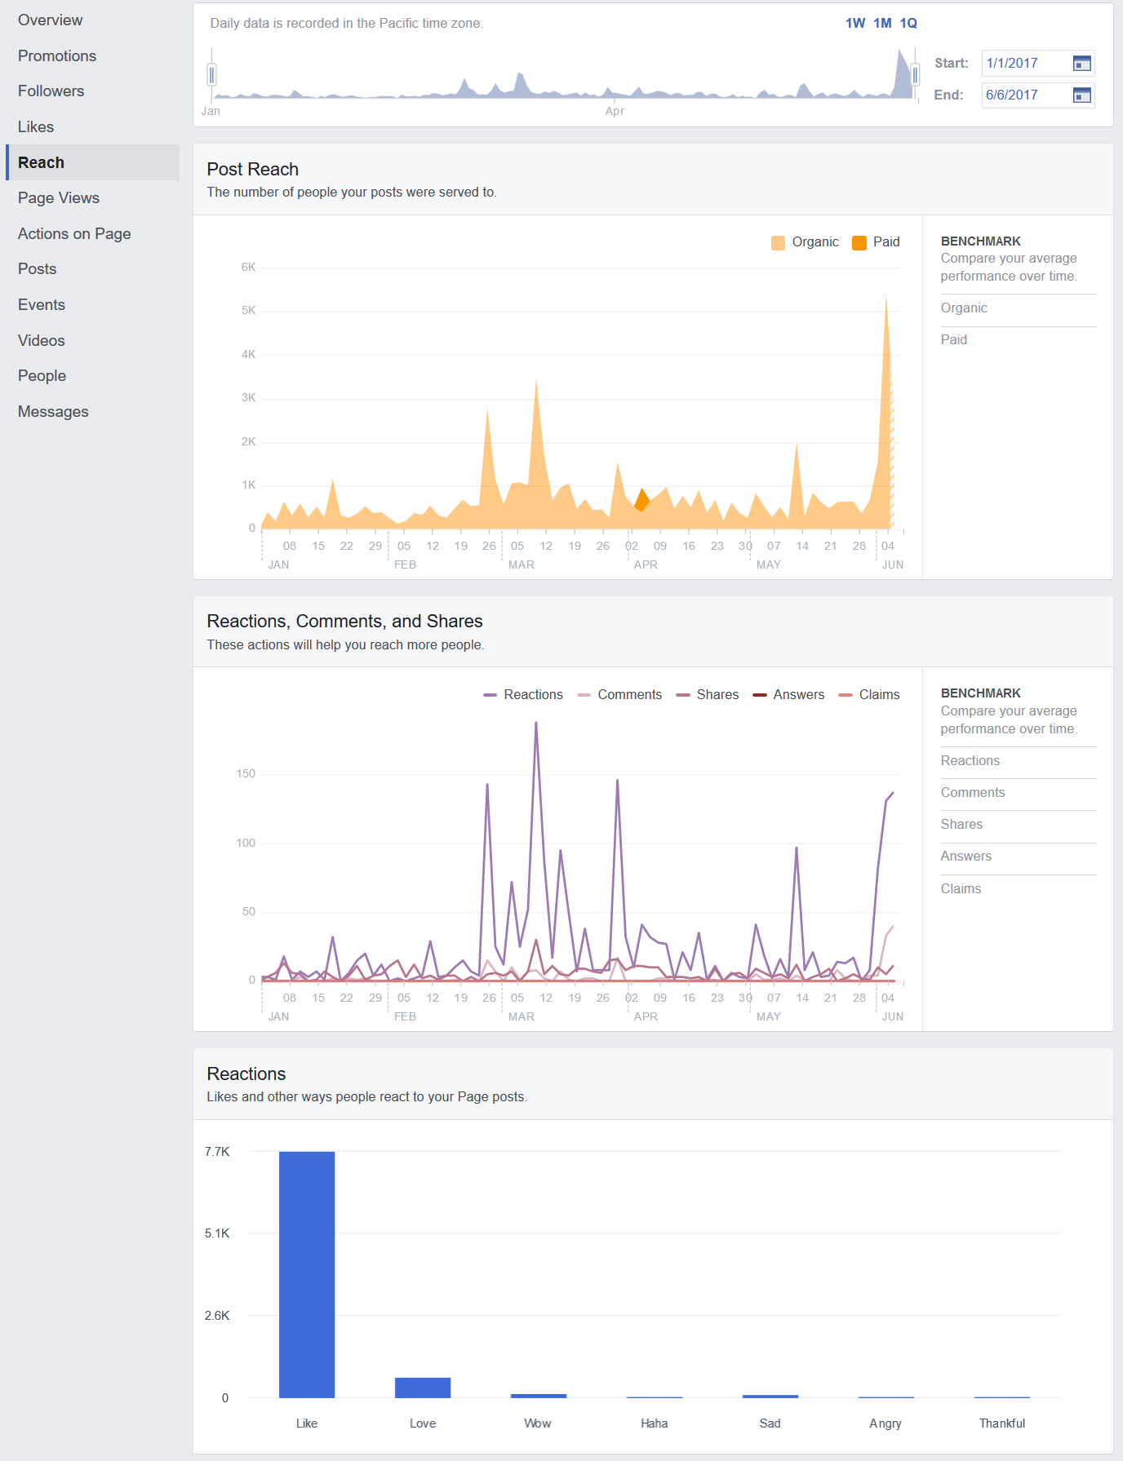
Likes & reach
Notes:
Keep an eye on Page Likes and reach over time and with regard to specific campaigns you are running. You can also see organic verses paid results as well as negative results and where your likes are coming from.

Slide 44
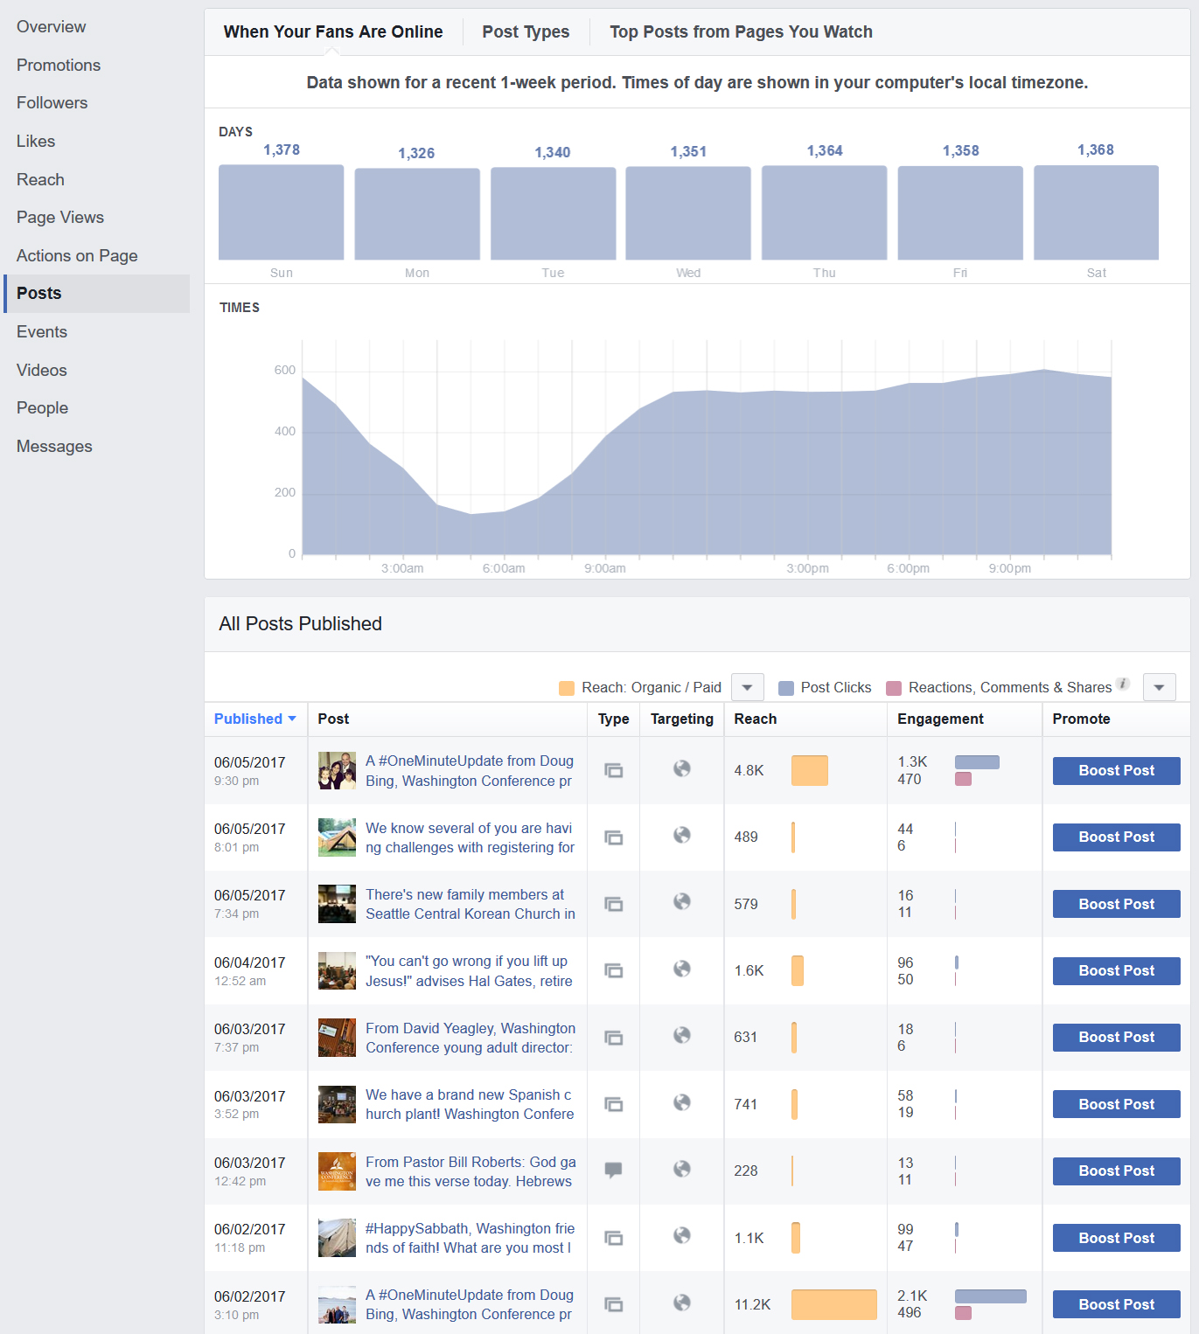
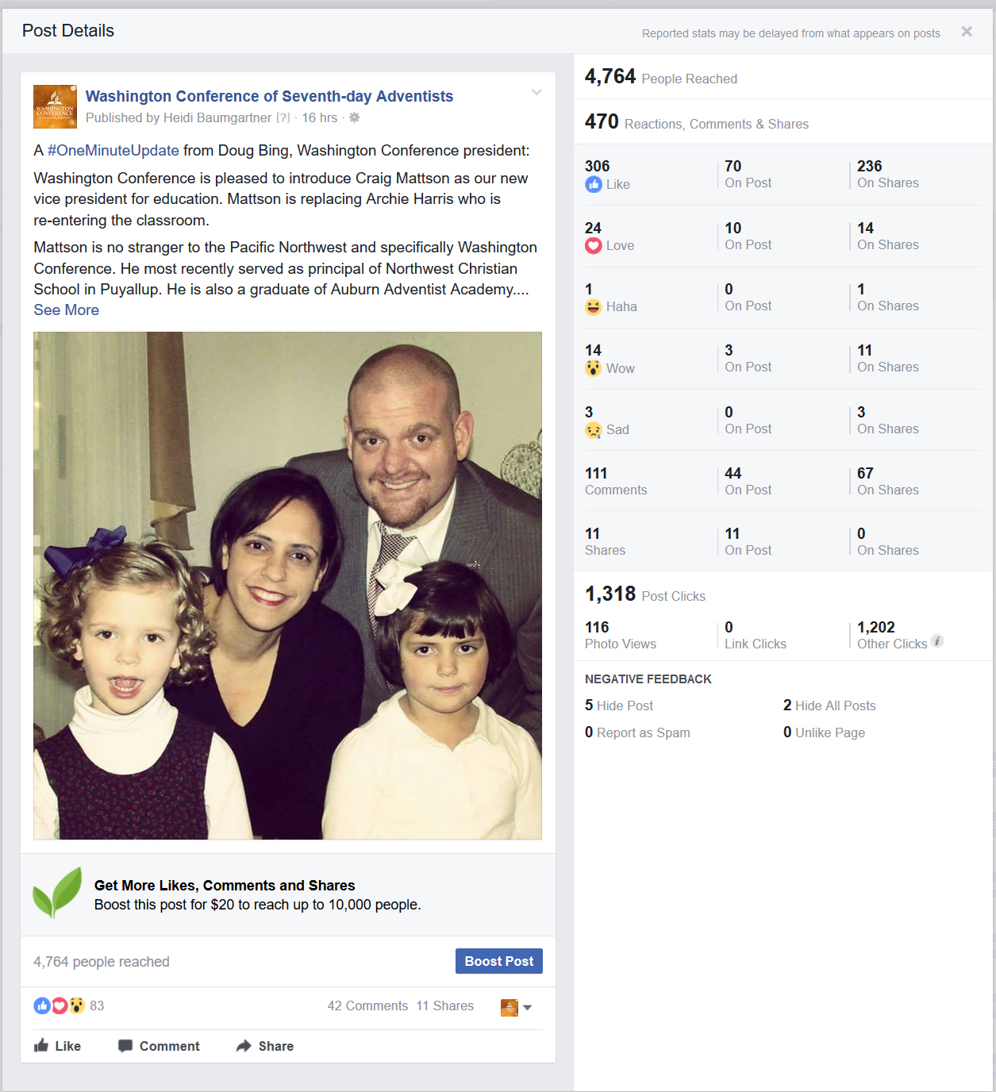
Posts
Determine when your audience is online and the best days and times to post content.
Look at the performance of individual posts to better understand how your audience is engaging with your content.
Notes:
On the posts tab, you can determine when your audience is online and the best days and times to post content. You can also look at the performance of individual posts to better understand how your audience is engaging with your content. This will help you understand what works best for your audience and plan future content accordingly.

Slide 45
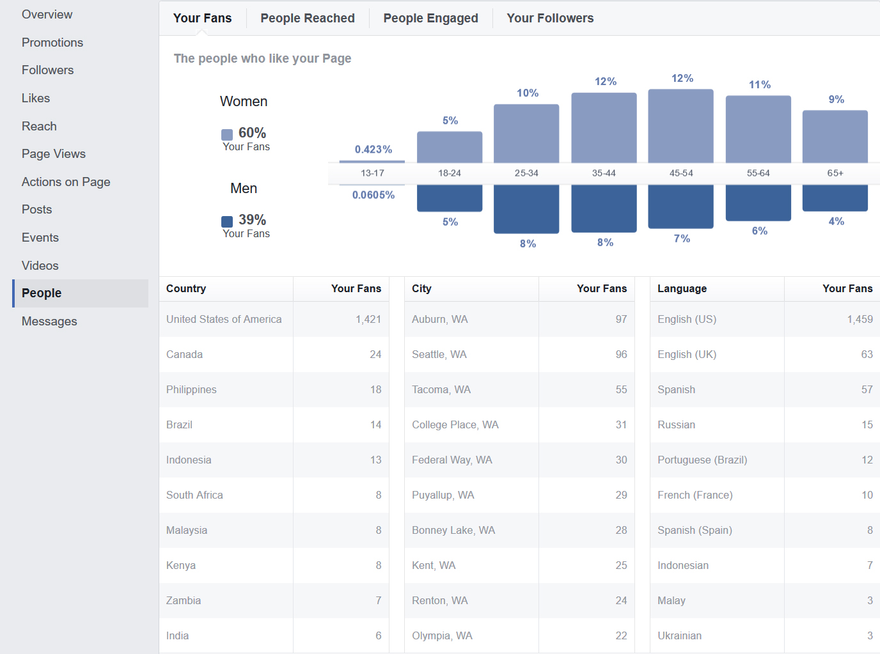
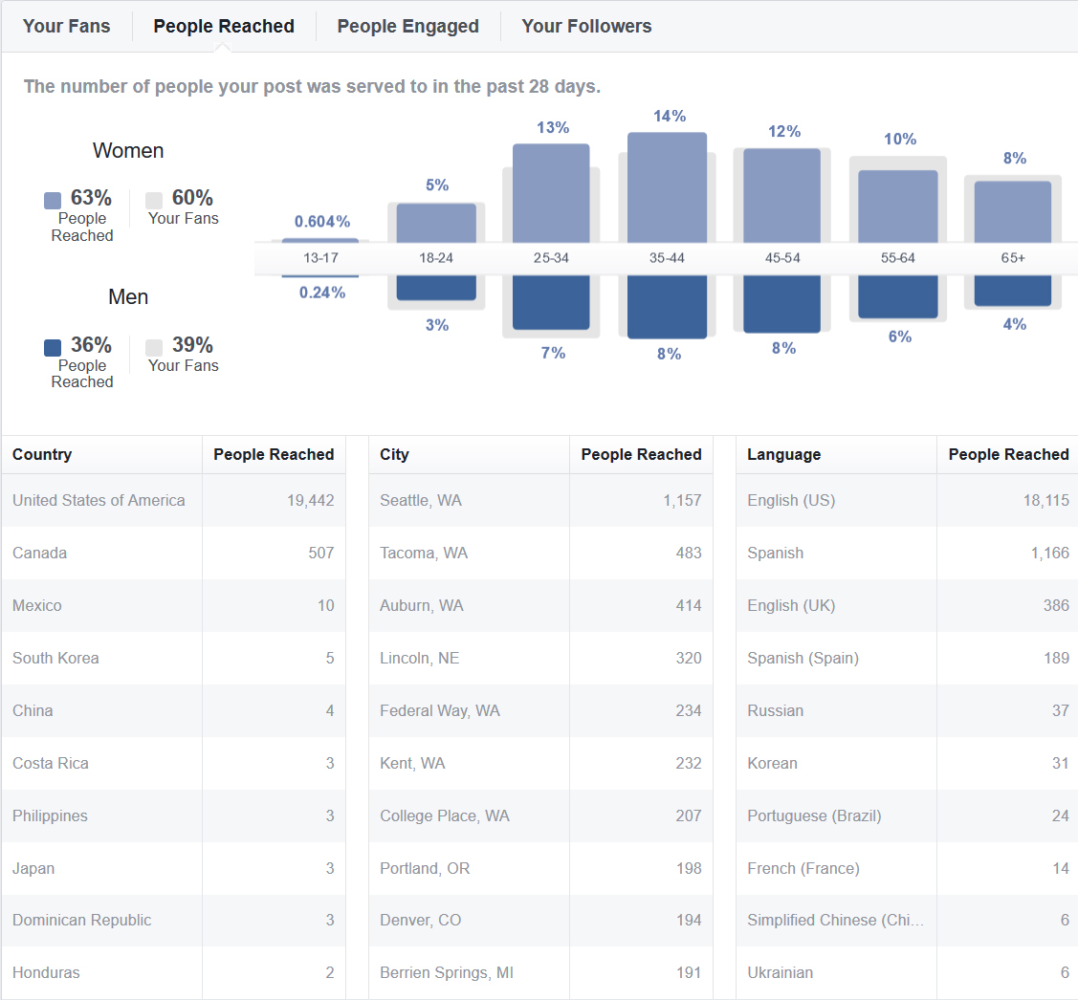
People Fans, Reached, Engaged, etc.
Notes:
This is a very valuable tab to look at if your target audience is location specific or demographic specific. Here you can view information on age, gender, location and language of your fans, followers, people reached, and those engaged. This is the Facebook data from the Washington conference of Seventh-day Adventists so we would expect to see that the vast majority of fans and people reached are in the US and more precisely, in Washington state. We would also expect to see a wide range of ages and languages spoken due to the multi-cultural nature of Seattle. Looking at the data, these assumptions are confirmed, but if they weren’t we would be able to identify a problem.

Slide 46
More advanced Insights
There’s more to explore…
And for more in-depth analysis, export the data directly from Facebook.
Notes:
Just like with Google Analytics, there’s a lot more data that can be found. The points I’ve covered are the most useful to the average person. You can export the data from Facebook for more in-depth analytics if desired.

Slide 47
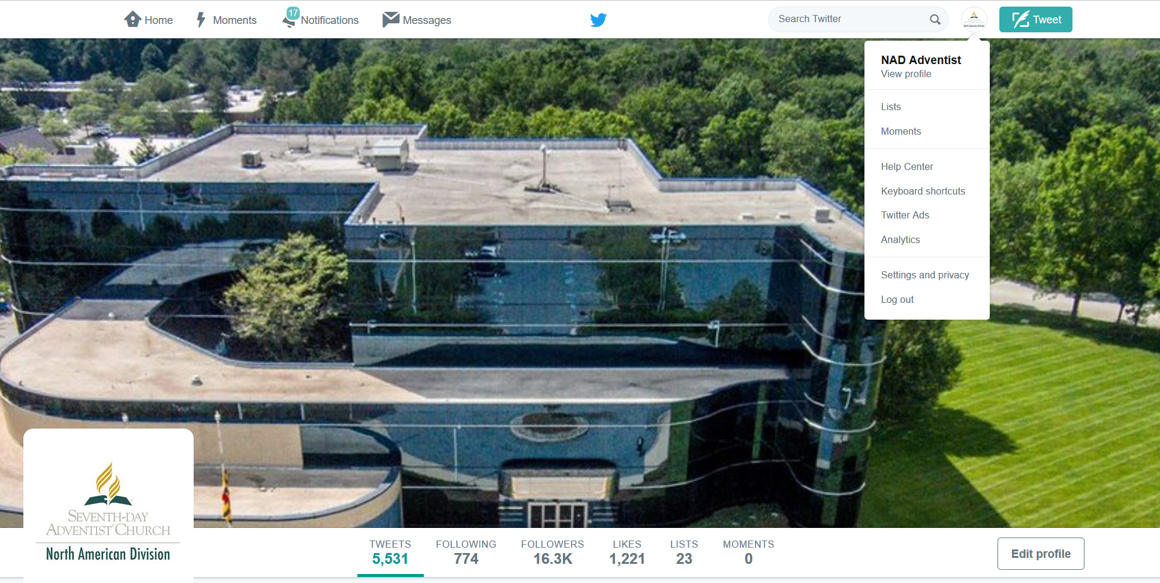
Twitter analytics
Key metrics to track
Notes:
To access Twitter Analytics, go to your profile icon and select analytics from the drop down.

Slide 48
28 day summary
Your home page starts out with a high-level overview.

Slide 49
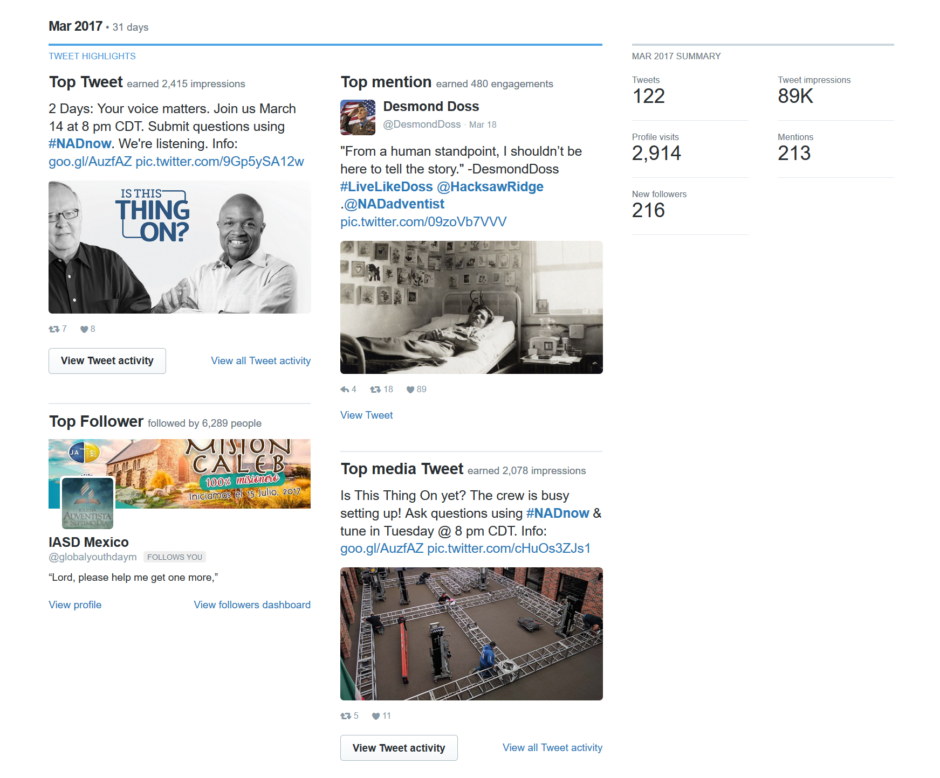
Monthly summary
Useful for keeping track of impressions and activity over time.
Notes:
Then as you scroll down, you can see monthly summaries that can be useful for keep track of impressions and activity over time. Graph it out to understand trends over time.

Slide 50
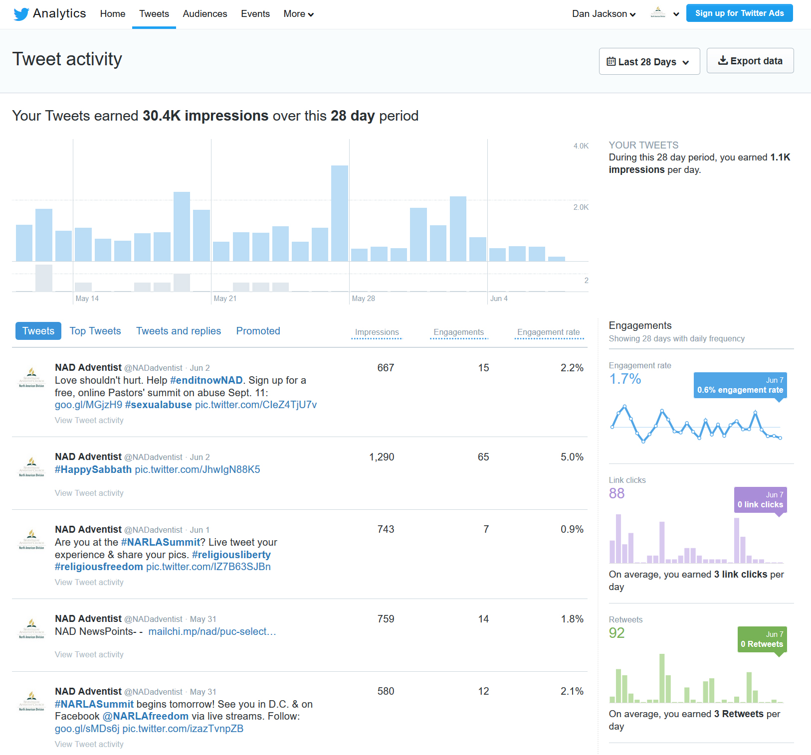
Tweet activity
Review this tab to better understand the performance of your content.
Impressions
Engagements
Engagement rate
Tends over time

Slide 51
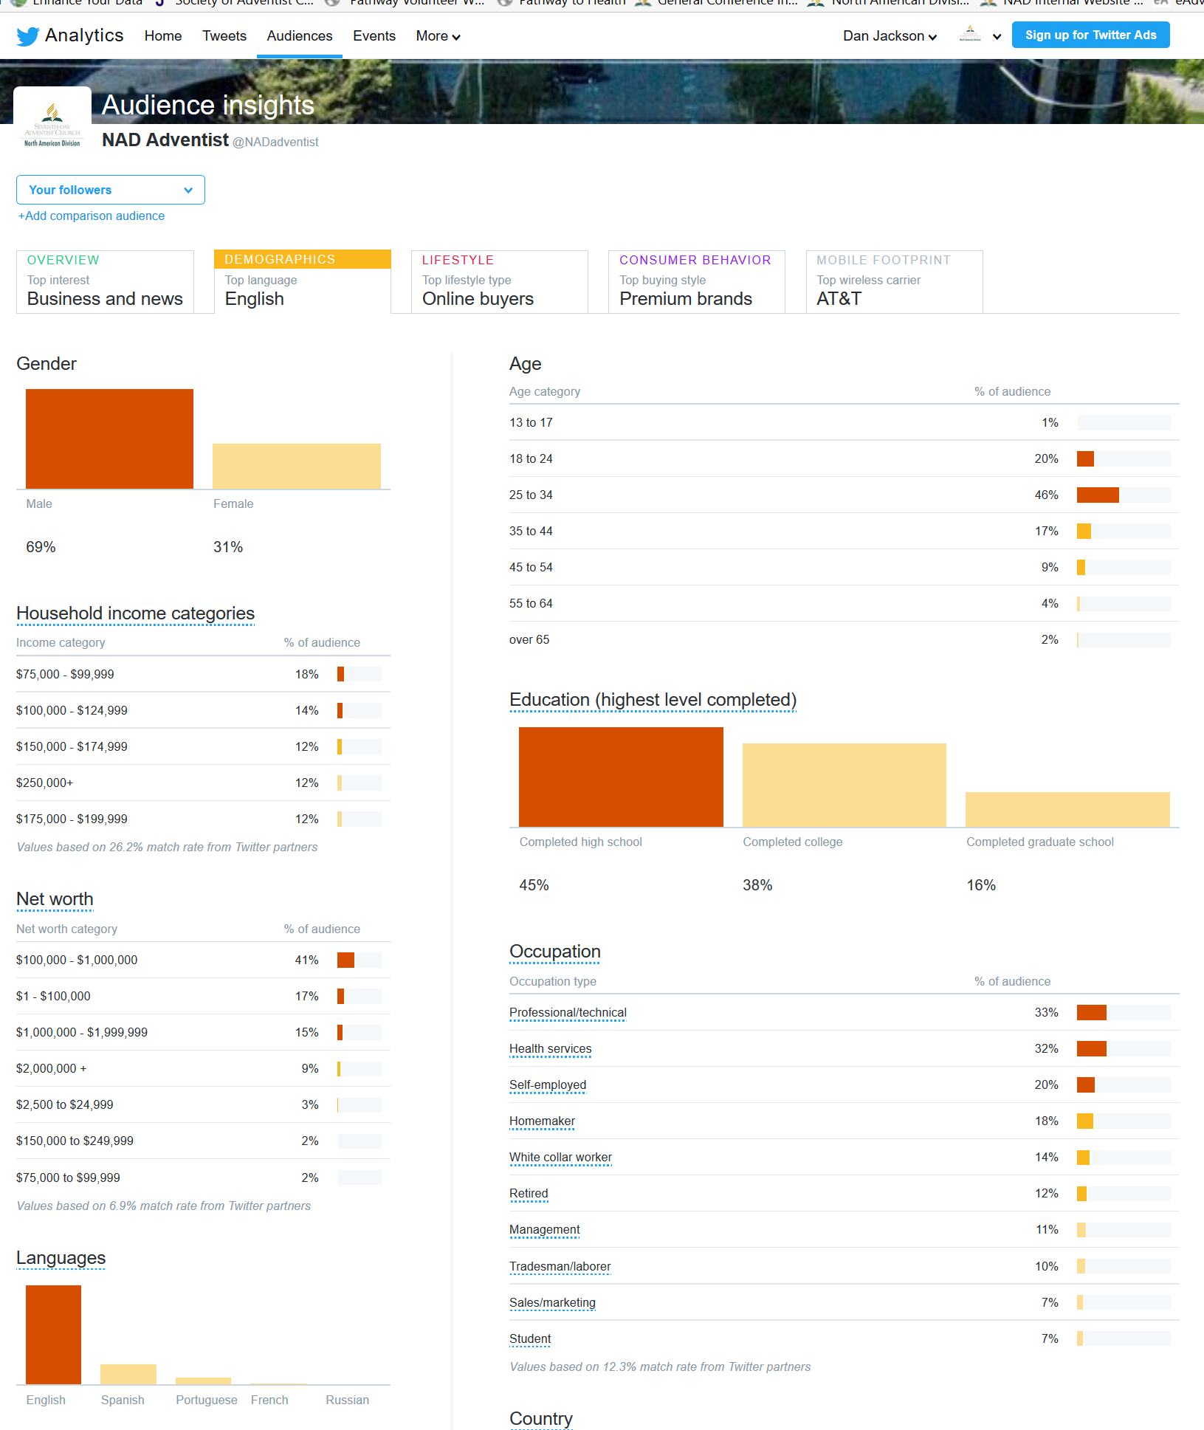
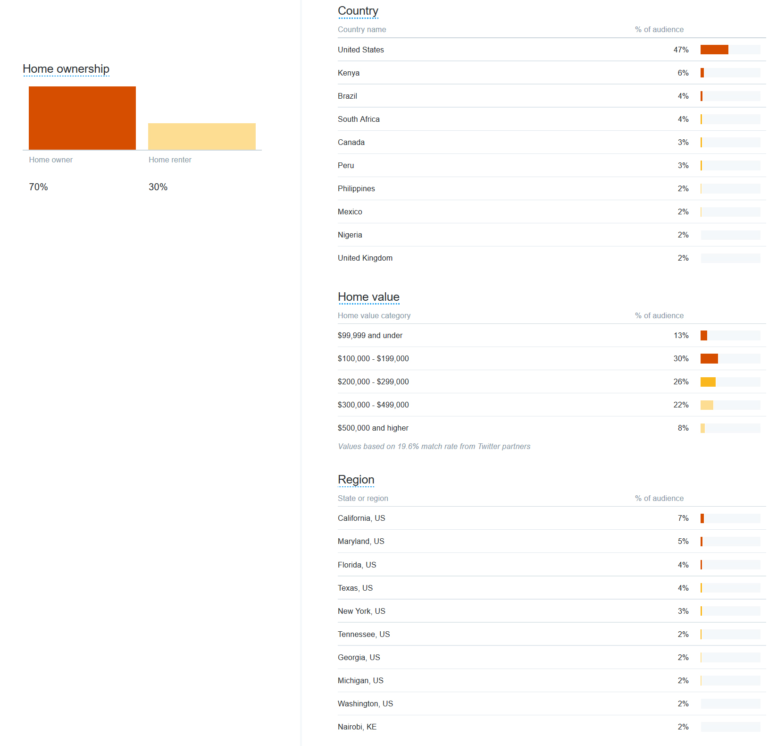
Demographics of followers
Notes:
The key data summaries to look at for demographics for your followers are: Gender, Age, Country, and Region. There’s also a ton of other information you can drill into such as wealth, education, language, lifestyle, consumer behavior, etc.

Slide 52
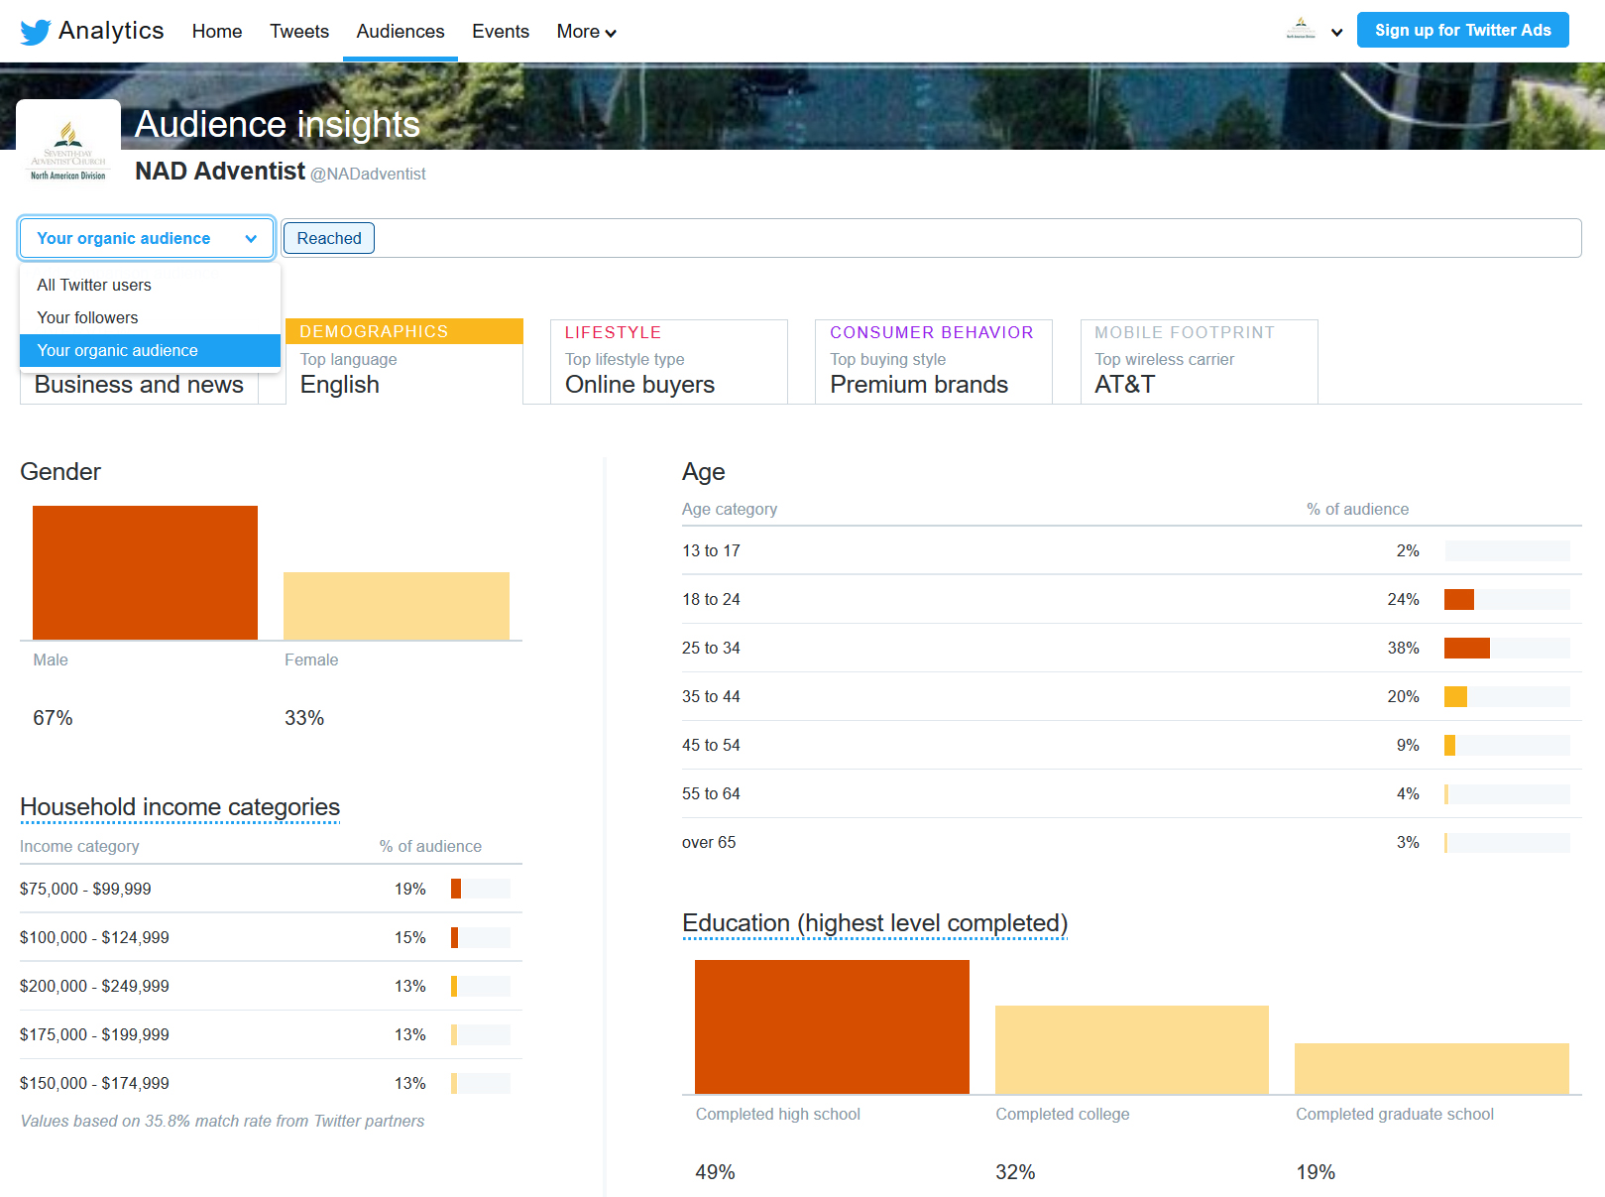
Demographics of organic audience
Your organic audience are the accounts who see your content, maybe even interact with it, but do not actually follow your profile.
Notes:
You can also look at the demographics of your organic audience.

Slide 53
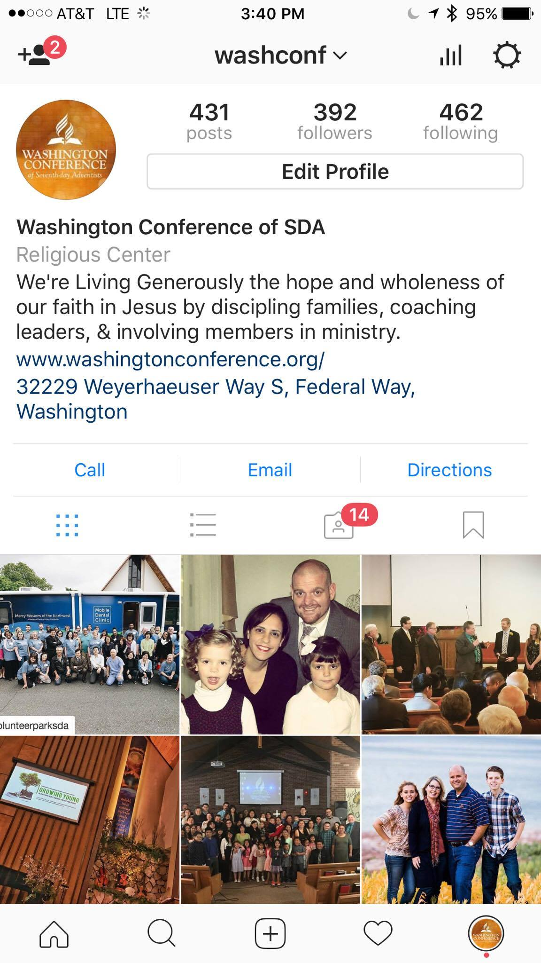
Instagram
The highlights
A picture is worth a thousand words, but only if your followers actually see it.
Check your profile’s insights regularly to determine the best hours and days to post, as well as gain general insights into your audience.
Switch your Instagram account to a “Business profile” and link it to your Facebook page.
Adds a contact button, address, and category to your profile as well as in-app analytics.
You need to have at least 100 followers.
Notes:
To access Instagram Insights, go to your profile and select the bars at the top right of the screen. Instagram insights are more limited in scope, but you get the important highlights.

Slide 54
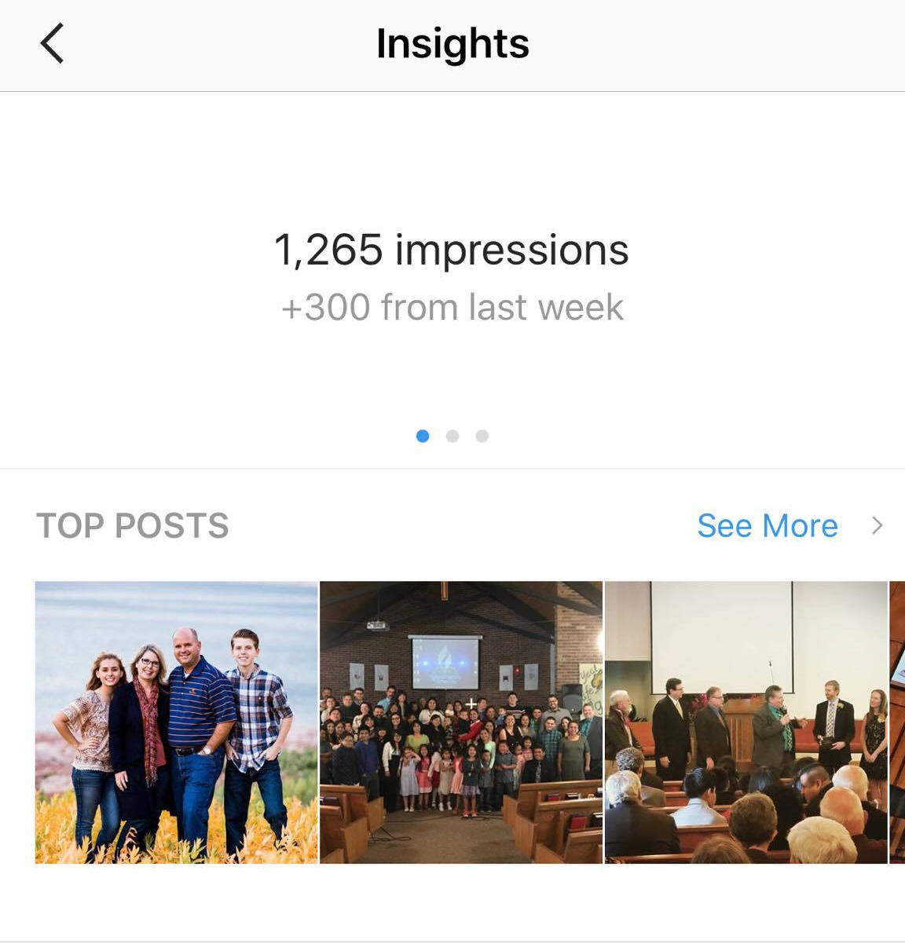
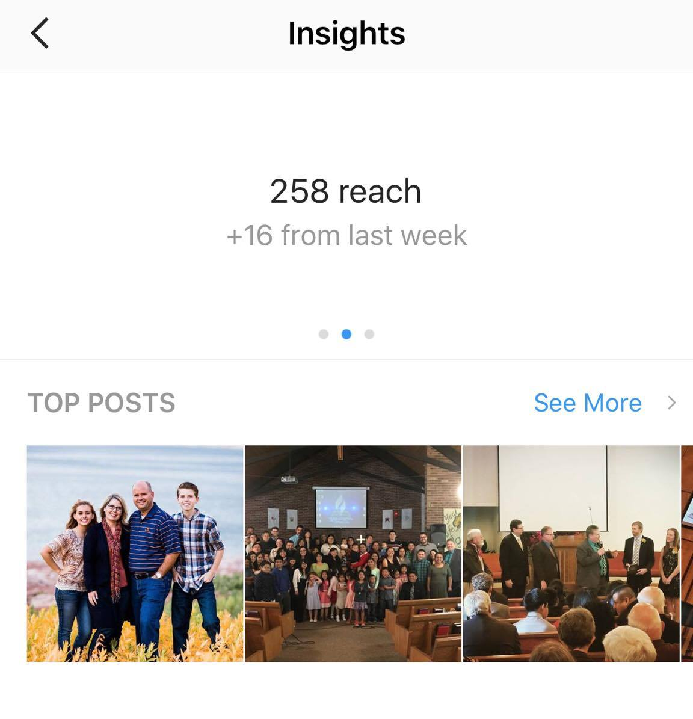
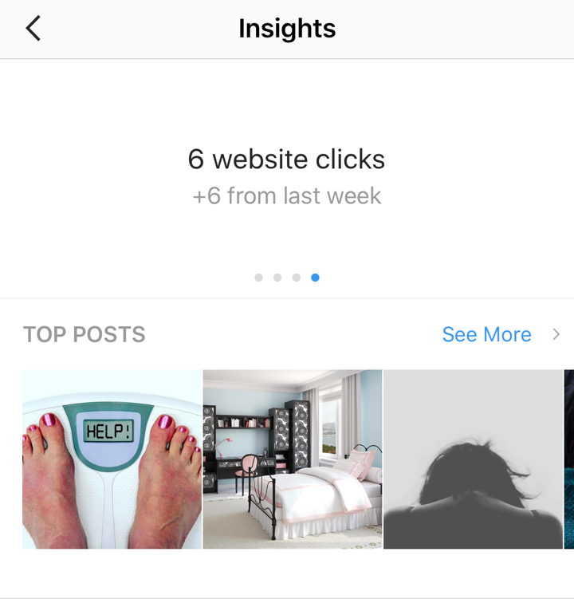
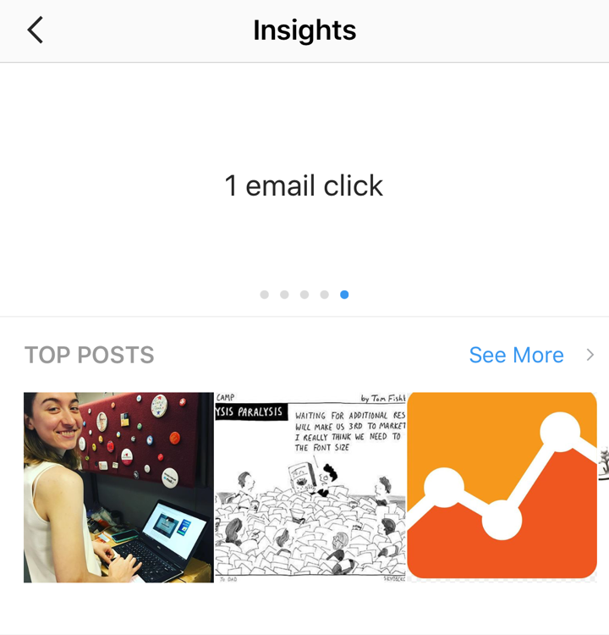
Top bar Restricted to 7 days
Notes:
The time frame for the data is currently restricted to 7 days. At the top you can view impressions, individual accounts reached, profile views, and website clicks.

Slide 55
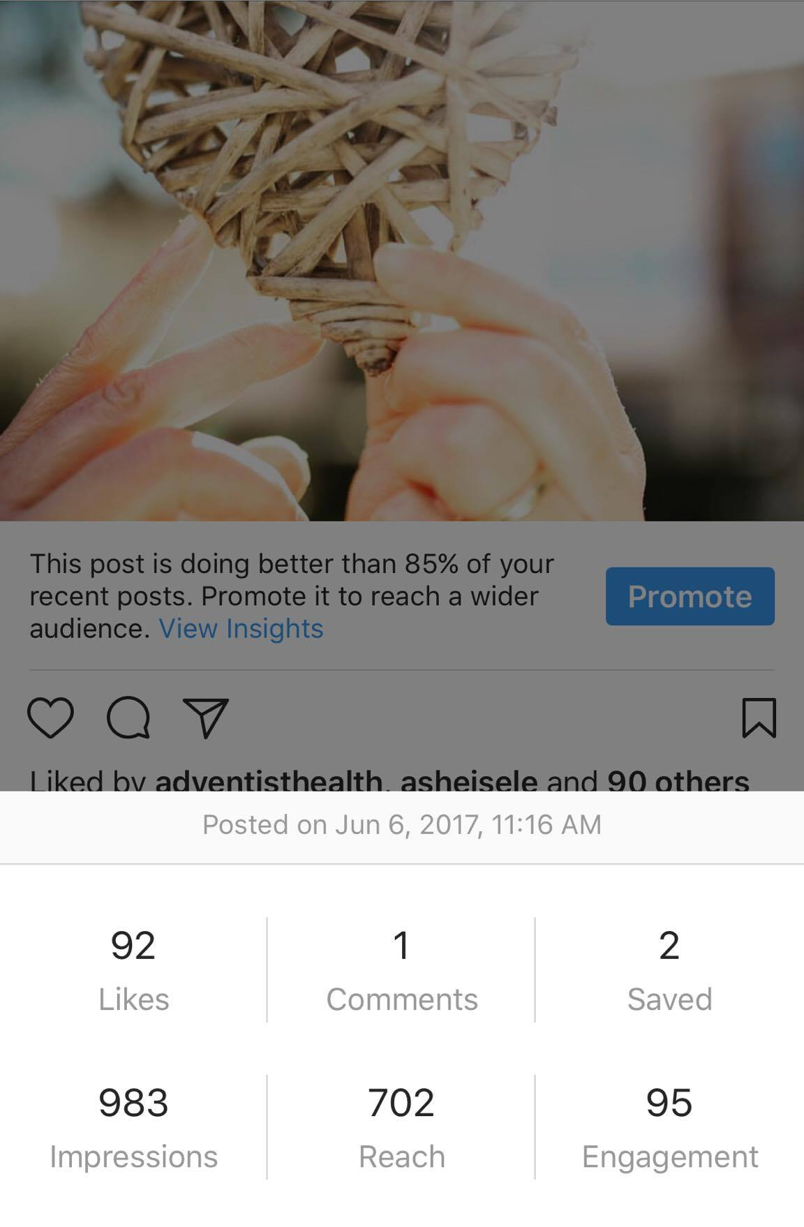
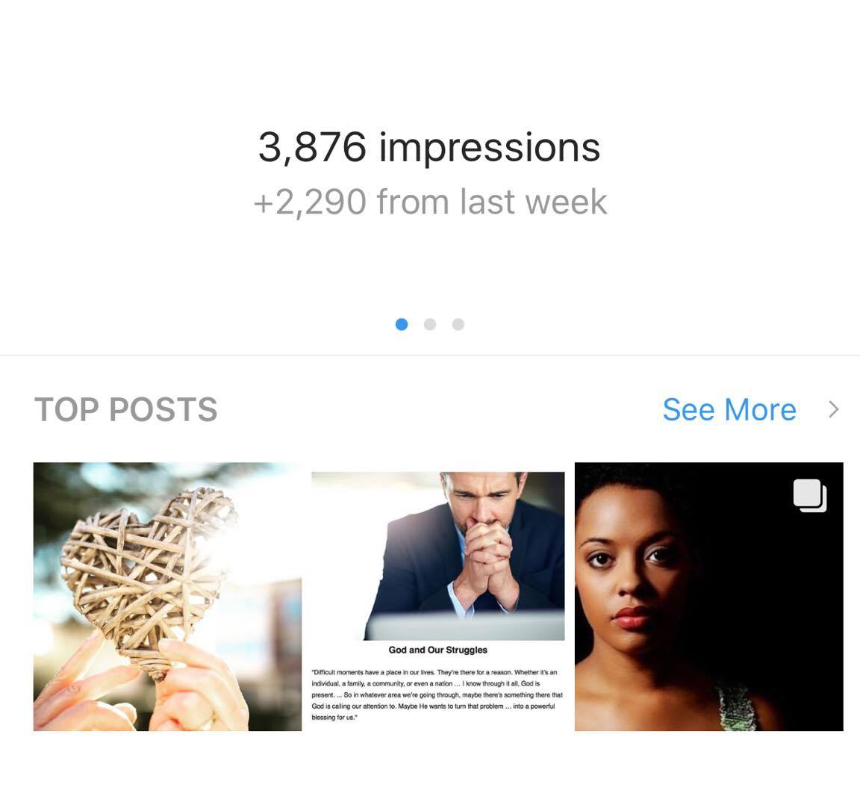
Top posts Impressions, reach, and total engagements
Notes:
Next you can see the stats on your top posts in the last 7 days. By selecting one, you can view that particular post’s impressions, reach and total engagements. This is helpful information to enable you to understand what types of content your audience responds to best.

Slide 56
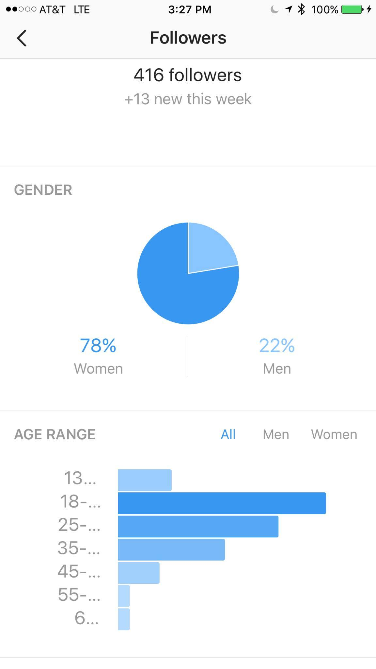
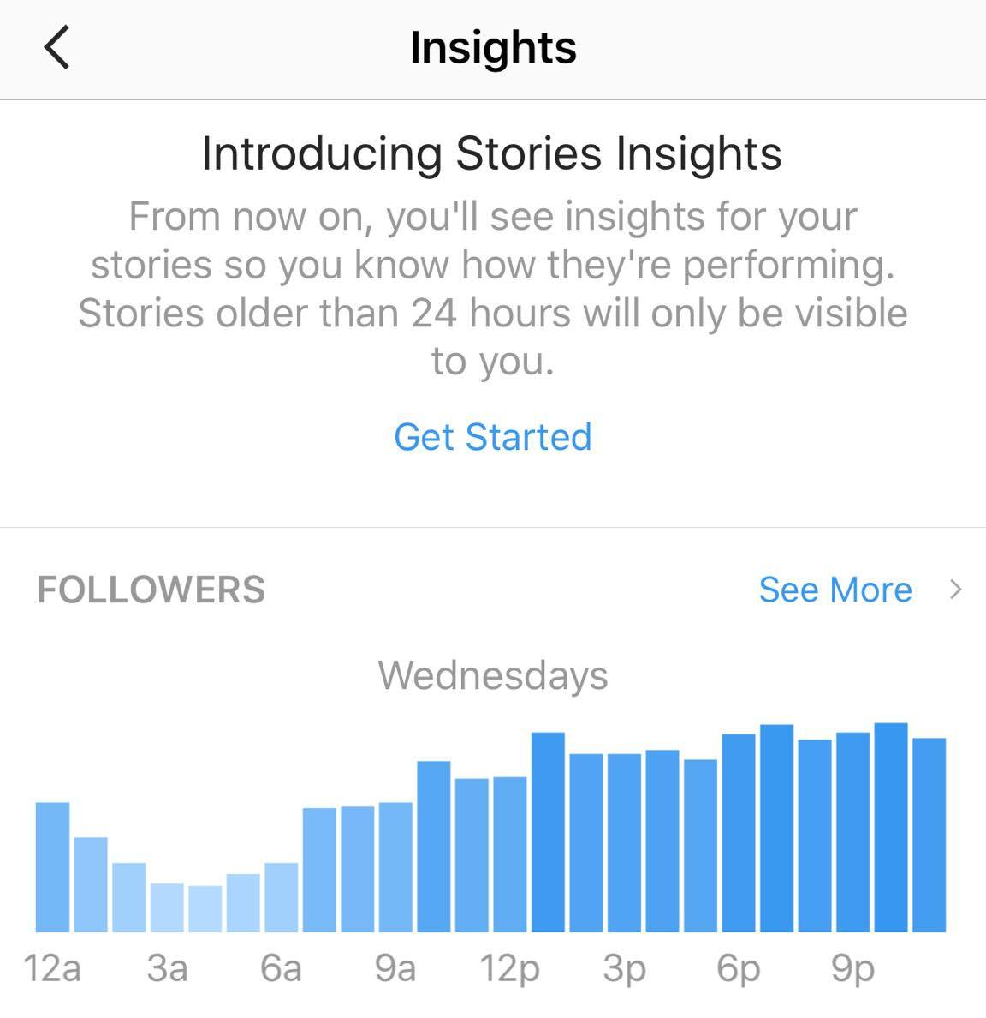
Demographic data Gender, age, and location
Notes:
If we go back to the insights home screen, and select “see more” under followers, we can view data on gender, age, and top locations by cities or country. This example is from #Gorgeous2God’s Instagram page which seeks to reach young women and teens with a Christ centered message. Luckily the data shows that we are achieving this.

Slide 57
Determine best post times By hour and day
The lighter shade of blue indicates less traffic. The darker the shade, the higher amount of traffic.
Notes:
To determine the best times to post, you’ll want to pay special attention to the hours and days section at the bottom of the screen. The darker bars show when your highest amount of traffic is by hour. To change the day, click the arrows to the right or left. To view peak traffic by day of week, select ‘days’ and here you can see that Saturday is our strongest day for the #gorgeous2god Instagram account.

Slide 58
Overview of Facebook Ads/Business Manager
How to get started and team features

Slide 59
Ads Manager basics
Create ads: design ads that appear on the Facebook family of apps and services (including Instagram and Audience Network).
Manage ads: edit your ads and update your images, audience, budget or schedule.
Measure results: view up-to-date data on the performance of your ads and schedule reports.
FREE to use.
Mobile app for working on the go!
Content is taken from the Facebook business help section that can be found here: bit.ly/FBman4Min
Notes:
Ads manager is where you can view, make changes and see results for all your Facebook campaigns (ads).

Slide 60
Business Manager basics
Business Manager is a tool for managing access to Pages and ad accounts, geared towards companies who need to give different permissions to lots of people.
Manage access to Pages and ad accounts. Clearly see who has access to your pages and ad accounts and remove or change their permissions as needed.
Keep your work separate. Get access to Pages and ad accounts without being friends with your coworkers on Facebook.
Manage multiple campaigns & credit cards. Allows you to separate the billing for multiple different ad projects.
FREE to use.
Content is taken from the Facebook business help section that can be found here: bit.ly/FBbus4Min

Slide 61
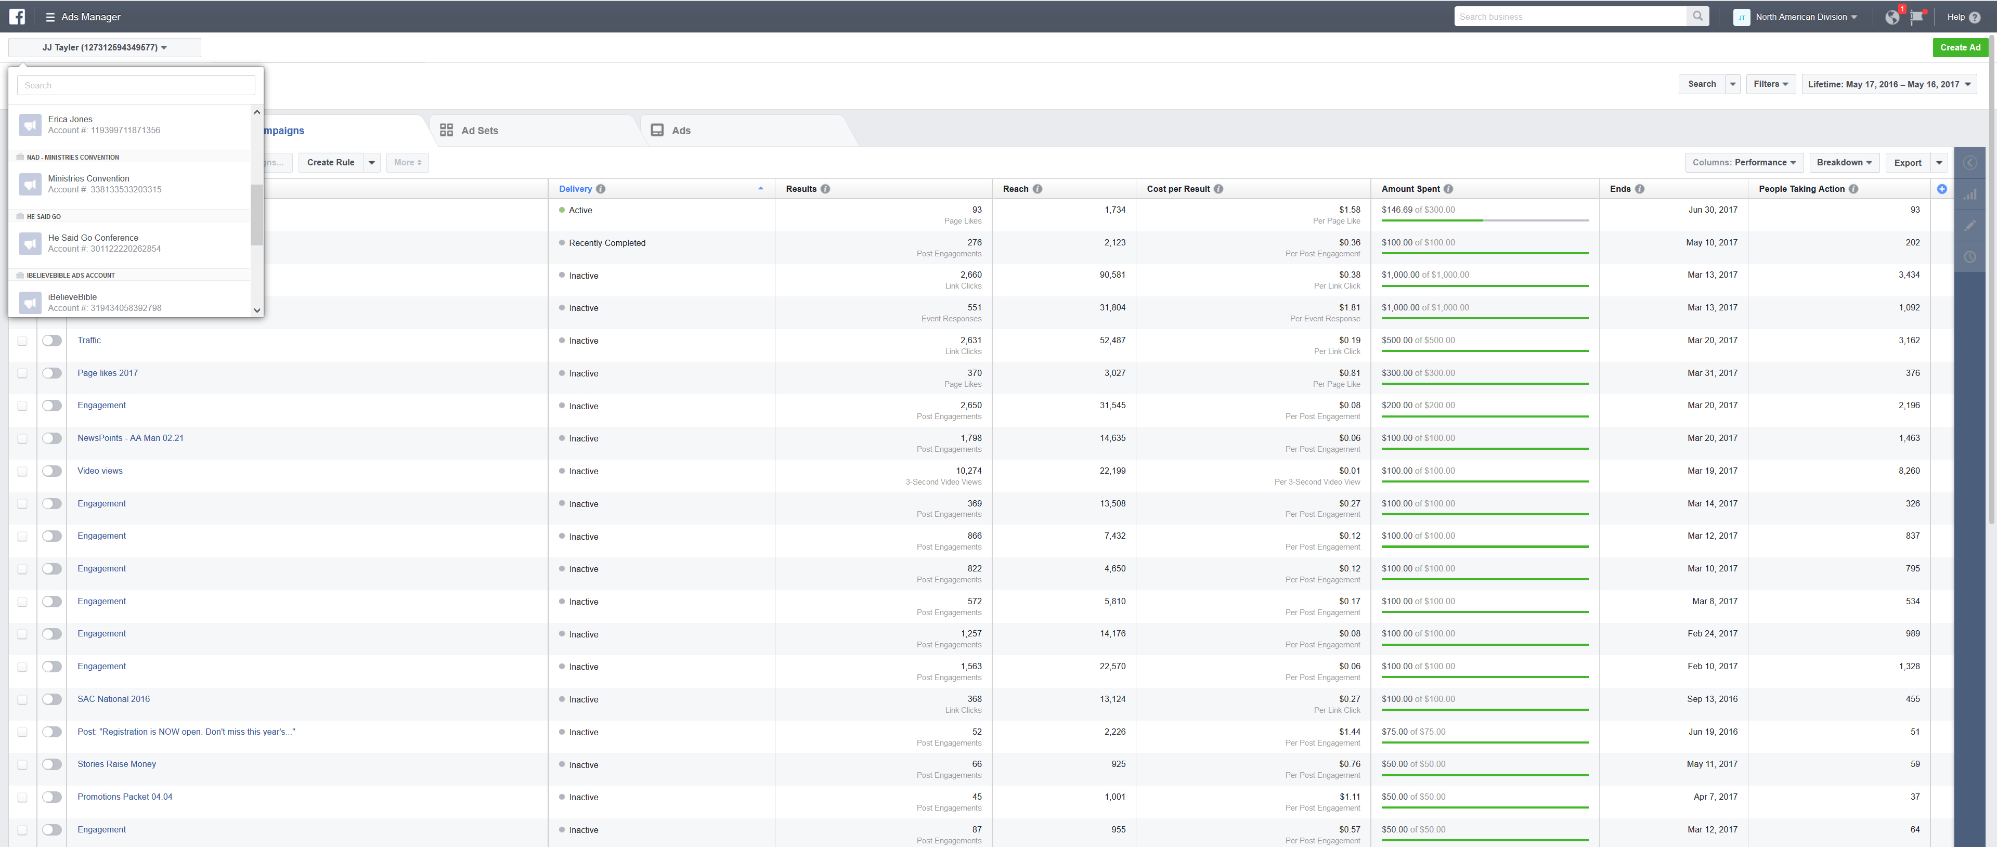
Live demonstration

Slide 62
Targeting
Reaching the right people without breaking the bank
Notes:
Facebook acquired Instagram, and so now you can run highly targeted ads on both Facebook & Instagram and take advantage of all the analytics that go with them. It’s actually very easy to do, and it’s scalable to any sized budget. Facebook’s advertising and targeting abilities are still far superior to Twitter or Pinterest advertising, so I recommend starting with Facebook ads as your money will be more effectively used.

Slide 63
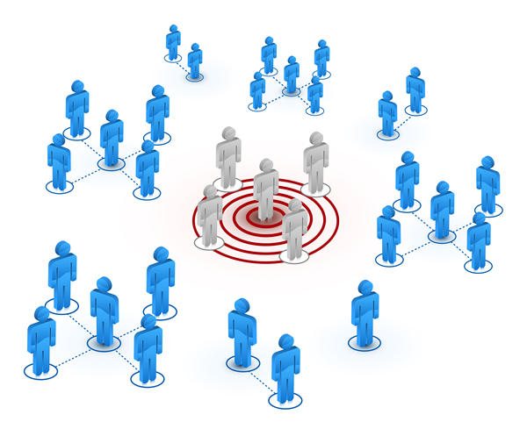
Basic ways to target
You can target by:
Location: country, state, city, or place
Age
Gender
Language
Interest: choose multiple to reach people interested in a specific topic or part of a particular group.
Connection: fans of your page and their friends

Slide 64
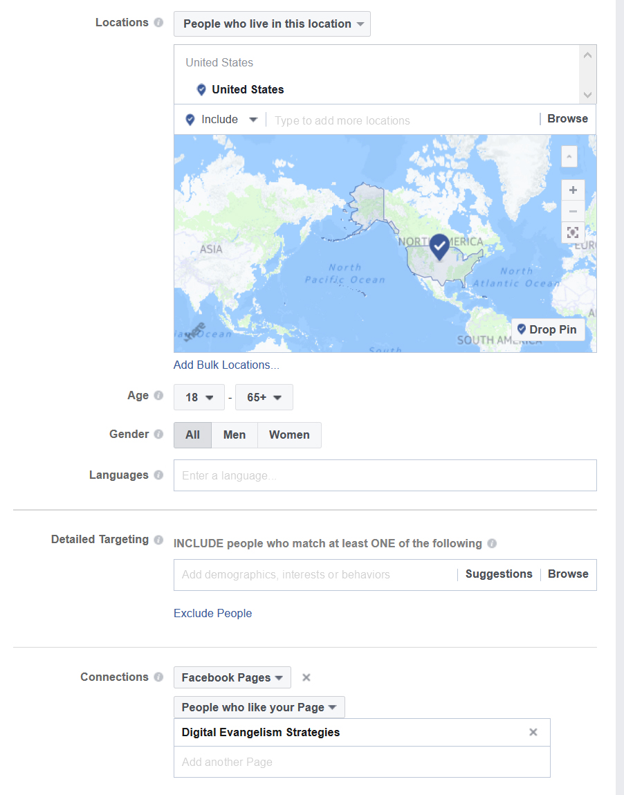
Place, Age, Language & Interest
SDAs & Religious Liberty
Fans of a Page/Connections
Notes:
Go through and explain the targeting on each one.

Slide 65
Live demonstration

Slide 66
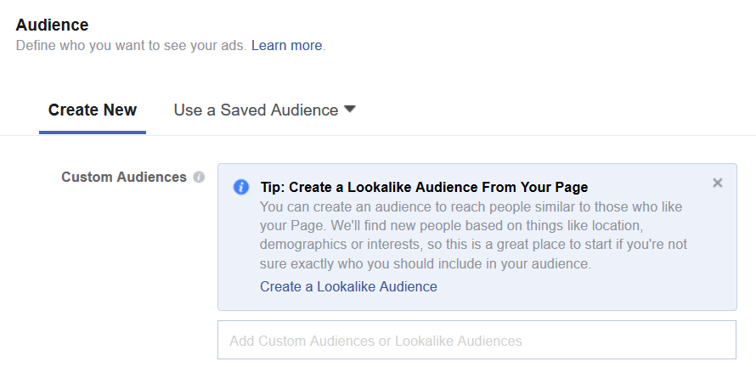
Advanced ways to target
You can also target by:
Lookalike Audience. Create an audience to reach people similar to those who like your Page based on location, demographics or interests.
Email. Use your email subscriber list to target people already connected to your ministry on social media or to create a Lookalike Audience.
Notes:
You can select a Lookalike Audience at the top of your targeting window and then you’ll be taken through a step-by-step process

Slide 67
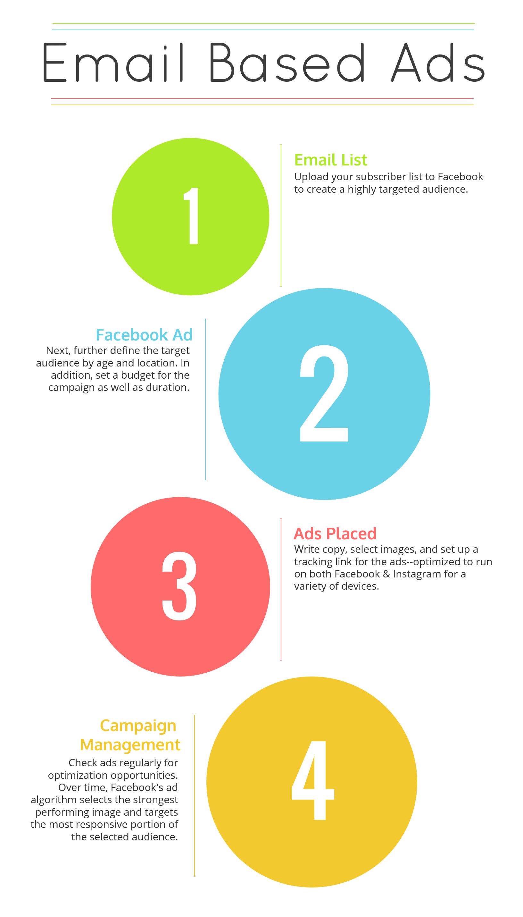
These ads serve two goals:
First, to act as reminders and to generate high awareness among an already invested audience (remember the rule of 7).
Second, to expand awareness to similar audiences through organic reach and broader engagement or by the creation of Lookalike Audiences.
Notes:
Explain process

Slide 68
Ad Placement
Show your ads to the right people, in the right place
Notes:
It’s important to understand where your ads are appearing. Facebook allows you to edit these placements if needed.

Slide 69
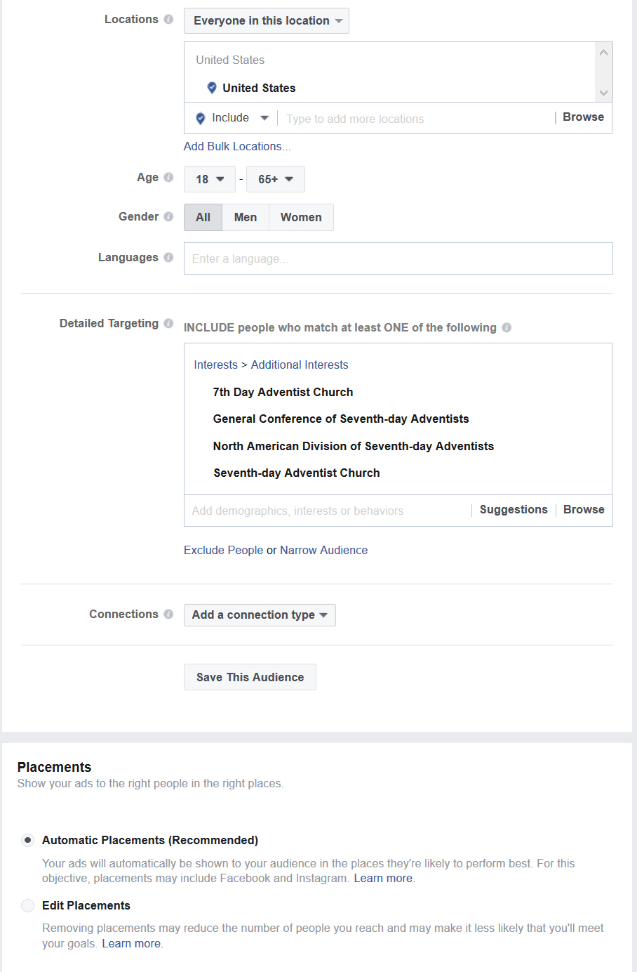
In most cases, leave the placements as automatic and Facebooks algorithm will place your ads in the locations best suited to optimize ad performance. Over time the algorithm learns and adapts as people respond to your ad. Take advantage of this feature to maximize your ad dollars.
You can, however, edit placements manually if desired or necessary.
Notes:
Placements are found under audience targeting.

Slide 70
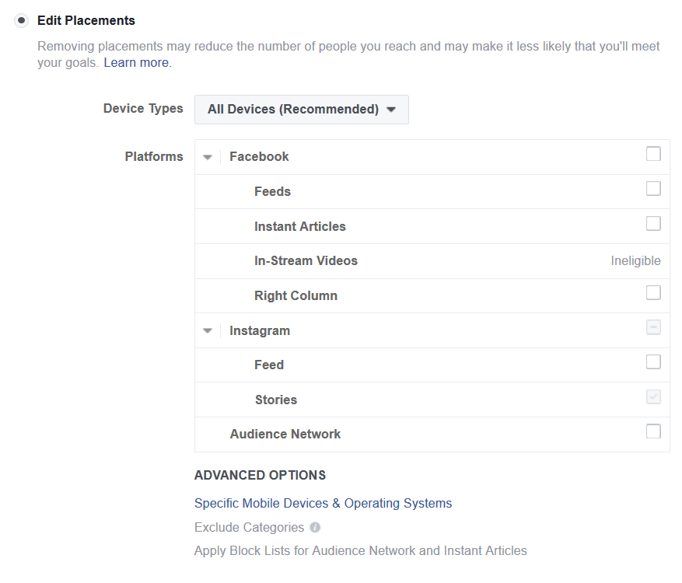
Placements
Facebook: newsfeeds, instant articles, right column
In-Stream videos offer another opportunity to reach audiences by allowing advertisers to deliver 5-15 second mid-roll video ads within live and non-live videos on Facebook.
Instant articles is a tool designed for media publishers to distribute fast, interactive articles to their readers within the Facebook mobile app and messenger.
Instagram: feeds and stories
Audience Network: extend your reach by showing ads to the same target audience on other mobile apps and websites.
Source: Facebook Business help

Slide 71
Budget & Schedule
Define how much you’d like to spend, and when you’d like your ads to appear

Slide 72
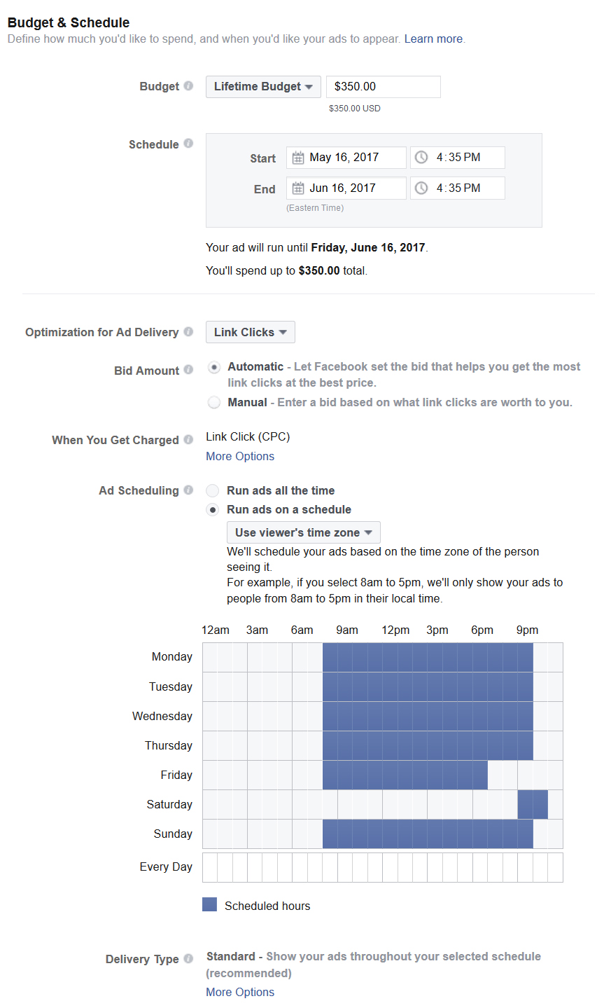
What to consider
Lifetime versus Daily Budget:
I recommend a lifetime budget to prevent you from accidentally overspending.
Timeframe: you must spend at least $5 a day.
Optimization: generally, let Facebook choose the recommended option.
Bid Amount: automatic is the best option; let Facebook’s algorithm work for you.
Scheduling: you can let Facebook decide or you can choose specific days and times to run ads.
Example: you can set it up so ads don’t run on the Sabbath in the time zone of the person seeing them.
Live Demonstration>>

Slide 73
Types of Ads
Determining purpose

Slide 74
Promote your page
Page like ads:
Increase your Facebook following.
Create or increase brand awareness among a targeted audience.

Slide 75
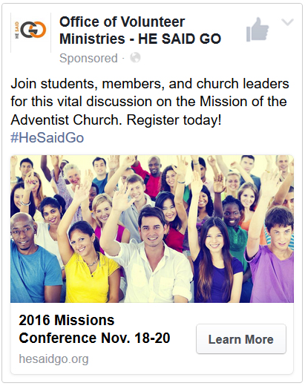
Website ads
Send people to your website to:
Increase attendance at an event.
Increase traffic to your website.
Promote content or a product.
Increase brand awareness.
Claim an offer.

Slide 76
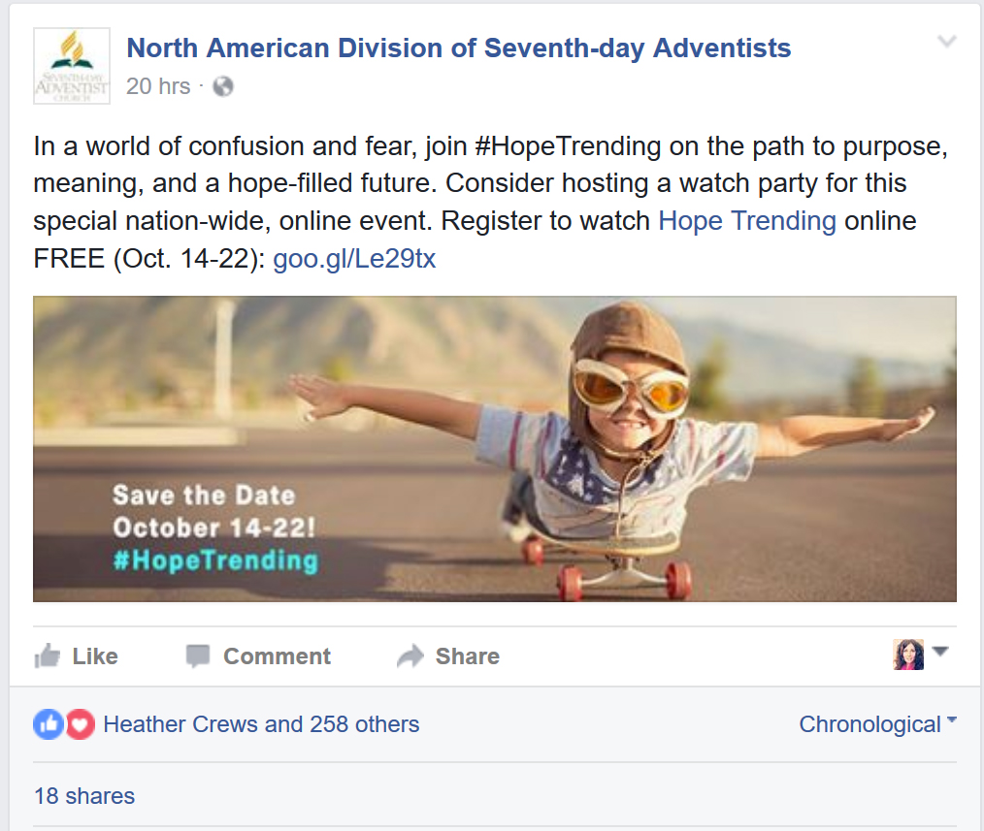
Boosted posts
Boost your posts in order to:
Ensure your content reaches more of your fans.
Expand the reach of your content.
Facebook is a business that needs to make money, therefore it limits unpaid reach. This means less than 10% of your fan base will actually see your posts in their news feed. You can counteract this by boosting key posts to reach more of your fan base.

Slide 77
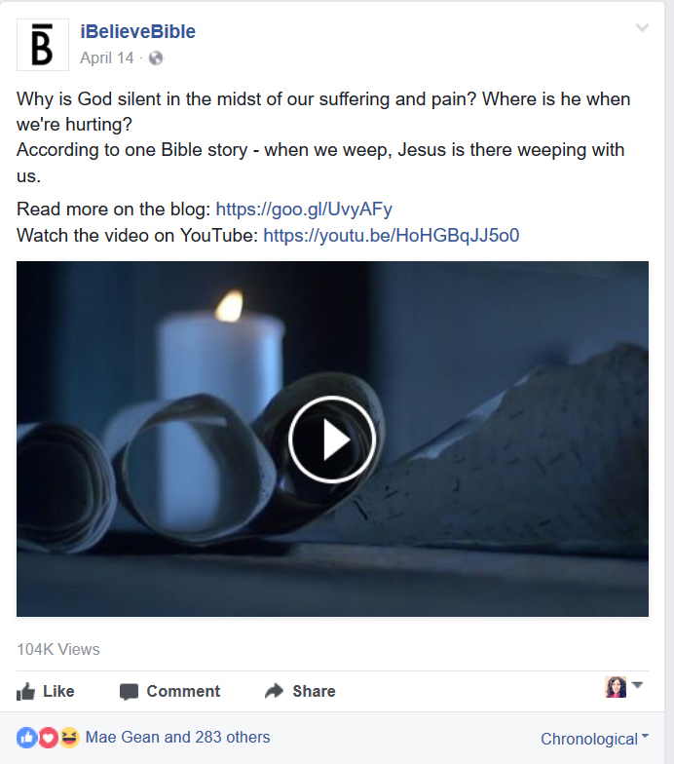
Video views
Get video views:
Increase video reach to a targeted audience.
Increase video engagements & views.
Tell your story to a wider audience (video is king).

Slide 78
Event response ads
Promote a Facebook Event to:
Enable fans to easily share about the event and invite their friends.
Increase attendance and awareness.
Take advantage of crowd mentality (I can see that my friend is going so I want to go too).

Slide 79
Live demonstration

Slide 80
General tips
To optimize the effectiveness of your ads:
Limit text in images & use high quality images.
Facebook has free stock imagery you can use in the images section of the ad creation tab.
Keep text brief but provide context.
Always target your audience.
Include a clear call-to-action.
Be honest; no bait-and-switch marketing.
Include captioning on videos.
Down a comprehensive guide to writing for social media: bit.ly/SMwritingGuide

Slide 81
Guidelines for choosing good photos
High quality
Take your own or use stock images.
Limit text on images, especially for ads.
Invoke an emotional response/tell a story.
People are attracted to bright colors and group shots.
Use contrast to help your image stand out.
Visit bit.ly/SelectingImages for more information on choosing images for social media.

Slide 82
Ad images
You can test up to 6 different images on an ad. I recommend a mix of your own high quality images and stock images. You may also want to consider a slideshow or carousel if that would make sense for what you are promoting.

Slide 83
Analysis
Making sense of the results

Slide 84
Facebook ads insights
Check your ad performance regularly to make changes and optimize as needed.
Understand where your ads are appearing and who you are actually reaching.
Understand what the numbers mean.
Monitor engagement/response.
Test images and audiences (A/B Testing).
Connect performance to Google Analytics and visitor behavior using trackable links.

Slide 85
Key terms
Highlights: as defined by Facebook Business manager
Results: The number of times your ad achieved an outcome, based on the objective you selected.
Reach: The number of people who saw your ads at least once. Reach is different from impressions, which may include multiple views of your ads by the same people.
Impressions: The number of times your ads were viewed
Frequency: The average number of times each person saw your ad.
Cost per Result: The average cost per result from your ads.
Aim to keep this below $0.50

Slide 86
Key terms continued
Relevance: A rating from 1 to 10 that estimates how well your target audience is responding to your ad.
Aim for at least a 6, but an 8-9 rating is preferred.
CTR (Click-through rate): The percentage of times people saw your ad and performed a click (all).
Aim to keep this above 2.5%
CPM: The average cost per 1,000 impressions
CPC (All): The average cost for each click
Aim to keep this below $0.50

Slide 87
Example & live demonstration
Check regularly during the course of a campaign as results will shift over time as the algorithm adapts.
Notes:
Explain sections

Slide 88
In summary:
If you can track it, you can measure it.
Use data to make better strategic decisions—saving both time and money.
Use UTM codes to track the performance of digital campaigns.
Always test your links before you post.
Use a url shortener to mask tracking codes and to track clicks.
Set up a free Google Analytics account for your website to better understand your visitors.
Avoid data paralysis, pick a few metrics to keep track of and determine goals.
Monitor the performance of your UTM codes in Google Analytics and optimize accordingly.

Slide 89
Summary continued:
Social media is a powerful tool for non-profits.
Analytics can help you develop a stronger digital communications strategy.
Set clear social media goals that are measurable, and look at old data to create a baseline for comparison.
Use trackable links and Google Analytics to help you connect the dots between actions and results, enabling you to more accurately evaluate your social media campaigns.
Use social media insights to determine when your audience is online and the best days and times to post content.
Look at the performance of individual posts to better understand how your audience is engaging with your content and what types of content produce the desired results.
Use social media analytics to determine who you are reaching and the effectiveness of your messaging.
Check regularly and become an expert on your audience.

Slide 90
Summary continued:
Set up a free Facebook Ads Manager or Business Manager account to get started.
Facebook Business Manager is ideal for team work.
Always target your ads to stretch your advertising dollars.
Allow Facebook’s algorithm to work for you, optimizing placements, bid amount and results.
Choose a lifetime budget to prevent overspending and schedule your ads.
Choose the ad time that best fits your goals.
Learn to write for social media and choose strong images without text.
Familiarize yourself with ad terminology and monitor your campaigns closely.
Use trackable links in ads that direct traffic to your website to monitor performance in Google Analytics.

Slide 91
Questions?
Follow @DigiEvangelism on Facebook, Twitter, and Instagram for more digital marketing tips and tricks.
Visit SDAdata.org for more resources, blogs, and videos or sign up for our eNewsletter at SDAdata.org/subscribe.

