Slide 1
Social media 101
Session 1 – Overview of Platforms, terms & demographics
Notes:
Thank you for coming to the first session of our Social Media 101 Course.

Slide 2
Four sessions
Session 1: Overview of Platforms, Terms, and Demographics
Session 2: Tips for Getting Started – Strategy, Goals, Branding, Hashtags, and more
Session 3: Basics of How to Write for Social Media & Engagements Best Practices
Session 4: Designing and Selecting Images for Social Media
Notes:
Feel free to grab an outline to follow along with for this series.

Slide 3
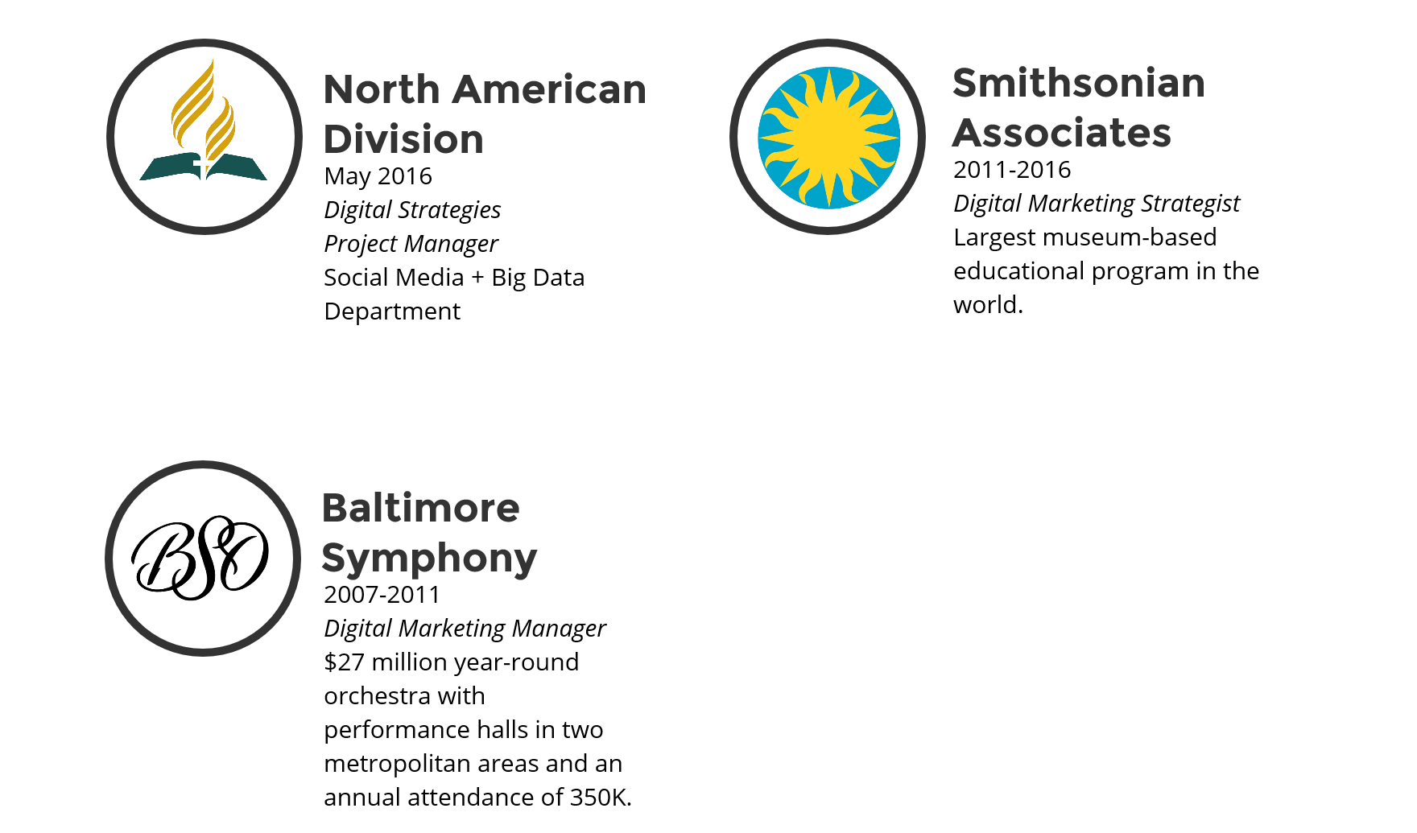
Who am I?
Notes:
Some of you I don’t know, so a little bit about who I am. With nearly 10 years experience, my specialty is building multi-channel, multi-platform digital strategies from the ground up with limited budget and resources. I am part of a new department at NAD called Social Media & Big Data that serves to connect members & mission through technology.

Slide 4
Why is social media important for the church??
This gospel of the kingdom shall be preached in the whole world as a testimony to all the nations, and then the end will come. (Matthew 24:14)
Notes:
We live at a unique time. For the first time in human history, every one of us has the potential to witness to the world via the power of social media. As disciples, I believe each of us has an obligation to be social media ambassadors for Christ within our own sphere of influence. If we work together, we can easily spread the gospel to the ends of the earth in just a few short years. My goal is to provide resources and tools to better equip you for this work.

Slide 5
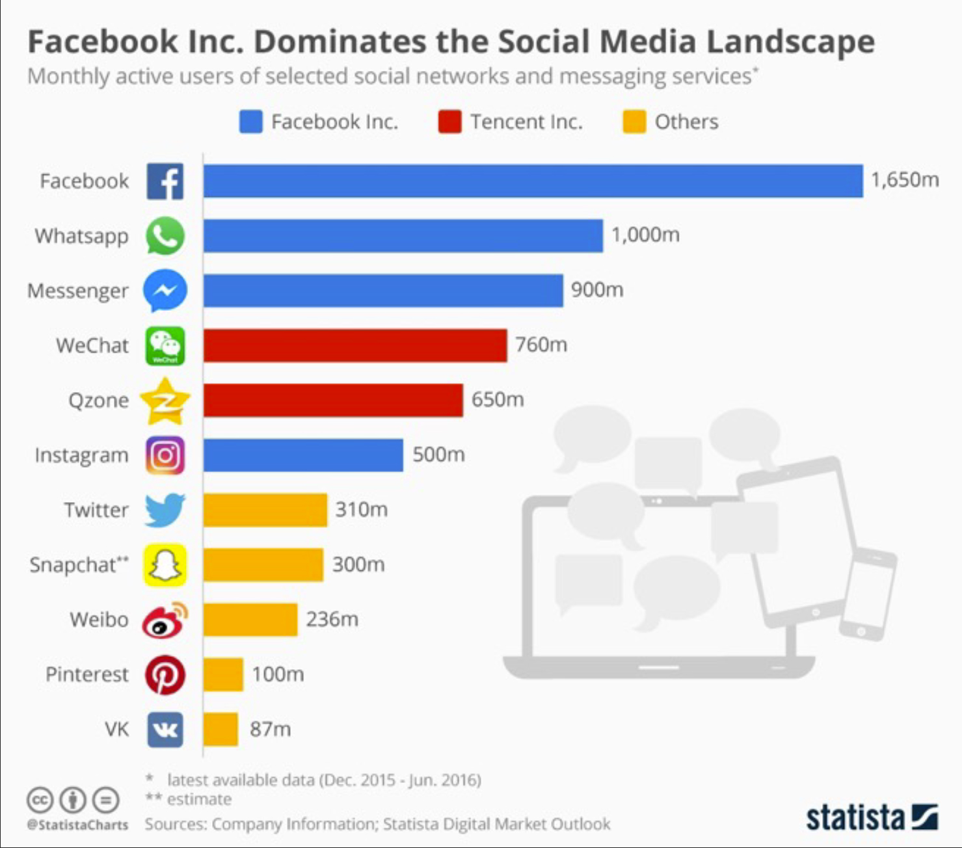
New frontier for mission
“Time is rapidly passing, and there is much to be done. Every agency must be set in operation…” —EGW, Acts of the Apostles, p. 158 (1911)
Notes:
Social media represents a bold new frontier for mission. The numbers are simply staggering.

Slide 6
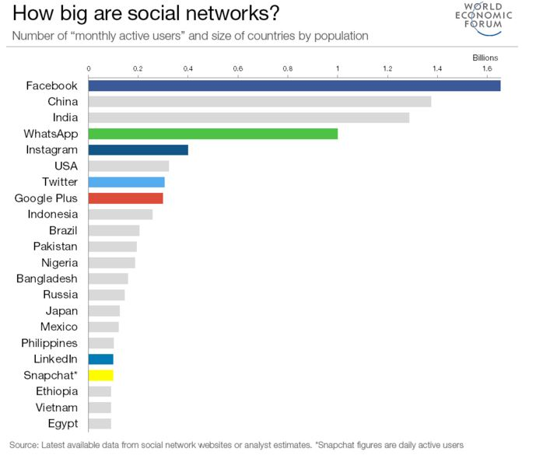
Data as of May 24, 2016
Notes:
I would also like to point out that if Facebook were a country, it would be the largest country in the world. Data as of May 24, 2016

Slide 7
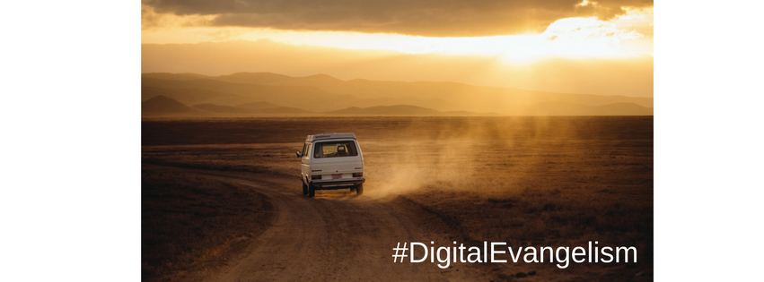
Why are we not sending missionaries?
Notes:
We will physically send people halfway around the world. And that IS a very important part of our mission. But not everyone can do that. So my challenge to you and the community is this: Why are we not spending time and effort sending missionaries to the digital countries? In other words, why are we not ALSO trying to reach souls for the kingdom on platforms that are already designed for engagement and relationship building? And for those who are called to the field, social media can plant valuable seeds in the community before the evangelist arrives and can continue the relationship after they leave.

Slide 8
But what would ellen white say?
Notes:
An integrated, multi-channel, multi-platform approach must become part of our outreach strategy, because we are seeking to reach souls in a digitally focused environment. We need to combine traditional means with new technologies to magnify our impact. Can you imagine if William Miller or James and Ellen White had the technologies we have today?

Slide 9
Cut through the noise
The average adult is exposed to over 3,000 marketing messages a day.
Notes:
Reaching souls in the digital realm means cutting through the noise. We are being bombarded daily with news, social issues, product ads, mixed messages, and so much more from countless sources. It is estimated that the average adult is now exposed to over 3,000 marketing messages a day. Therefore, it’s important to develop the tools necessary to navigate a dynamic and complex digital environment to enable your message to reach people and stand out as relevant.

Slide 10
It’s all about the mix
We now have more resources to reach audiences how they want to be reached.
Effective marketing/communication campaigns work together across all channels, platforms and partners.
Digital media is a vital tool for understanding your audience and building relationships.
Notes:
To stand out, you then need to determine the right communications mix. The average person has to see something at least 7 times before they are motivated to action.
I do want to be very clear about something. At this time, digital communications is a way of magnifying the impact of traditional means, not replacing it.

Slide 11
Platform breakdown
Audience, key terms, and use

Slide 12
Facebook: More than just the largest country
Used by 64% percent of Americans 12+
It spans all generations
Nearly 85% of daily active users are outside of the U.S. and Canada.
Accounts for 1 in every 6 minutes spent online and 1 in every 5 minutes spent on mobile.
The most-used app
Skews a little older and female
Notes:
Facebook is still No. 1. Despite what you may have heard, everyone uses Facebook. Everyone. It is the new website. For example, how many of you have a Facebook account? I usually recommend that a brand start with a strong Facebook presence. Data as of May 2016

Slide 13
Facebook: Terms & Use
Friends & Fans
Posts
Share
Like & Reactions
Check-in
Events
Stories
Pages & Groups
Facebook LIVE
Live Demo>>

Slide 14
Twitter
Every second, 6,000 Tweets are sent.
79% of accounts are outside the U.S.
86% of Twitter users use the site for news (real-time & breaking)
28% use it to second-screen with live events
53% users never post any updates
Skews younger & male (25-40)
Notes:
The majority of Twitter users are news junkies who use the network to seek out information about what’s happening in the world. The micro-blogging platform is also a place for people to connect with brands, and have a conversation.

Slide 15
Twitter: Terms & Use
Tweet
Handle & mentions
Follows
Live-Tweeting
Hashtags
Live-broadcasting with Periscope
Live Demo>>

Slide 16
Instagram
27% of teens ranked Instagram as the second most important social network
Skews under 25
75% of users are outside the U.S.
80 million photos shared per day
The highest per follower engagement rate
Notes:
If you are trying to reach a younger demographic, make sure you’re on Instagram. We now live in a highly visual society and most young people are more interested in pictures and stories than reading articles.

Slide 17
Instagram: Terms & Uses
Posts
Stories
Likes
Followers
Hashtag
Filter
Regram or Repost
Instagram Live
Live Demo>>
Notes:
It’s a relatively simple application that you can only use on your phone to share pictures and videos less than 60 secs in length. You can have a personal account or a business account. I you are an official ministry, you should have a business account.

Slide 18
SnapChat
Second most-used social network after Facebook.
18 to 24-year-olds are the largest user base at 37%; 25 to 34-year-olds (26%); 13 to 17-year-olds (23%)
60% of U.S. 13 to 34-year-old smartphone users are Snapchatters.
28% of teens ranked Snapchat as the most important social network.
25 to 30 minutes on the app each day.
Over 1/3 of Snapchat’s daily users create Stories.
Notes:
Just an FYI, I’m not promoting spiritualism, this is the actual logo for snapchat. It reflects the fact that your posts disappear after a certain amount of time. This creates a sense of a safe place for young people to openly express themselves.
Snapchat’s users may skew younger, but they’re not the only ones who use the app. Increasingly, older users and brands are jumping on the bandwagon. But if you want to reach teens, this is the platform along with Instagram.

Slide 19
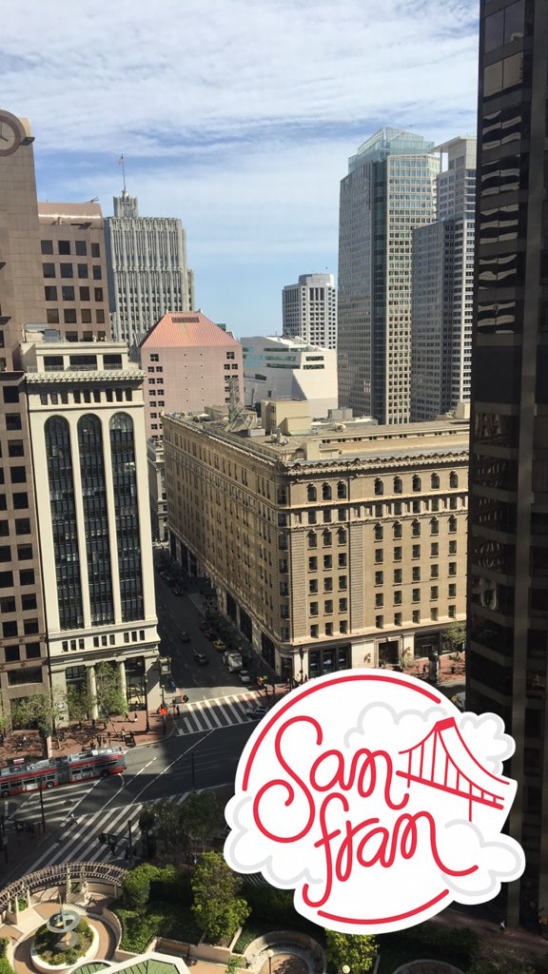
Snapchat: Terms & Uses
Content disappears after 24 hours & usually only 1 replay is permitted
Chat privately
Send images or videos (Snaps) and stickers
Add to your ‘Story’
Use filters (time, temperature, speed & geofilter) or lenses for selfies
Screenshot snaps
Add friends by Snapcode
Live stories (community curated)
Discover stories from brands
Live Demo>>
Notes:
Lenses are like filters but specifically for selfies. Your Snapcode is a code that can be scanned by anyone who wants to be your friend. Live Stories are a fun way Snapchat combines Snaps from either a specific location or event. Discover allows you to find content from different publishers.

Slide 20
Pinterest
Predominantly used by women, but 1/3 of users are now male
Network of choice for planners
75% of Pinterest usage taking place on phones & tablets.
Pinners are 2x more likely to celebrate events & holidays
Planning on Pinterest begins 2 to 4 months in advance
14 million articles are Pinned daily
Compared to the average online consumer, Pinterest users are 9x more likely to plan to get pregnant or have a child in the next 6 months
75% of Pins saved come from businesses and 2/3 of all Pins are from a business’ website.
Notes:
Pinterest remains one of the most fundamentally useful social networks. It’s the network of choice for planners—pinners use it to plan for holidays, travel, and special events like weddings. It’s primarily popular with female users (but men are catching on).

Slide 21
Pinterest: Terms & Uses
It’s a digital bulletin board
Catalog of ideas
Categorize & organize content by interest or topic
Pin & Repin
Board
Follow other boards
Live Demo>>
Notes:
It’s a digital bulletin board used to categorize and organize content by interest or topic.
A pin is an image added to Pinterest. You can link to an image from a Web site or upload an image from your computer. Once something is pinned, it can then be repinned (aka shared) by other Pinterest users. This is how content spreads virally.
Boards are where your pins live. You can have separate boards for subjects such as a wedding, inspirational quotes, fashion or healthy recipes.

Slide 22
Additional terms
Learning the lingo

Slide 23
Additional Terms: MEMES
A 'meme' is a virally-transmitted cultural symbol or social idea.
Usually a picture with text
Typically includes an element of humor
Very popular and often go ‘viral’
Hashtags do not work when posted on images
Avoid on serious posts and events
Create your own on memegenerator.net
To learn more, visit Behind the Meme on YouTube
Notes:
Meme pictures generally belong to a canon of existing popular memes (you can’t make a meme with any random picture). Meme images convey specific emotion (Win Kid) and text must match, i.e. (Pathway to Health was a WIN, so it fits with Win Kid). Memes are tricky to get right if you don’t know the culture and what is currently popular. The easiest way to look out of touch is misuse of memes, often appears as “trying too hard."

Slide 24
Additional Terms: Viral
To ‘go viral’ simply means that something (image, video, news, etc.) spreads very quickly and broadly throughout social media and/or the internet.

Slide 25
Additional Terms: GIF
Stands for ‘Graphics Interchange Format’
Short and sweet video clips that convey a message, often with humor and easily shared
Do not have audio
Auto-replay an infinite number of times
Grainy video is standard and expected
iMessage & Facebook messenger now have built in gif library
Live Demo>>
Nailed It!

Slide 26
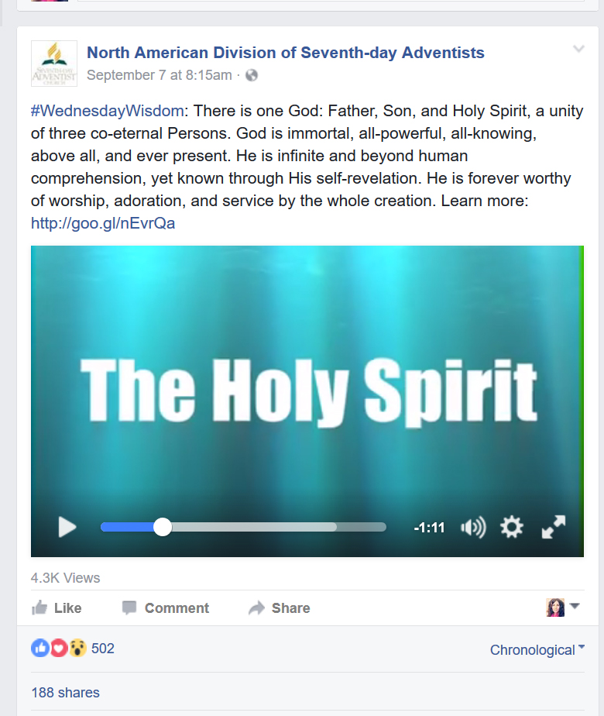
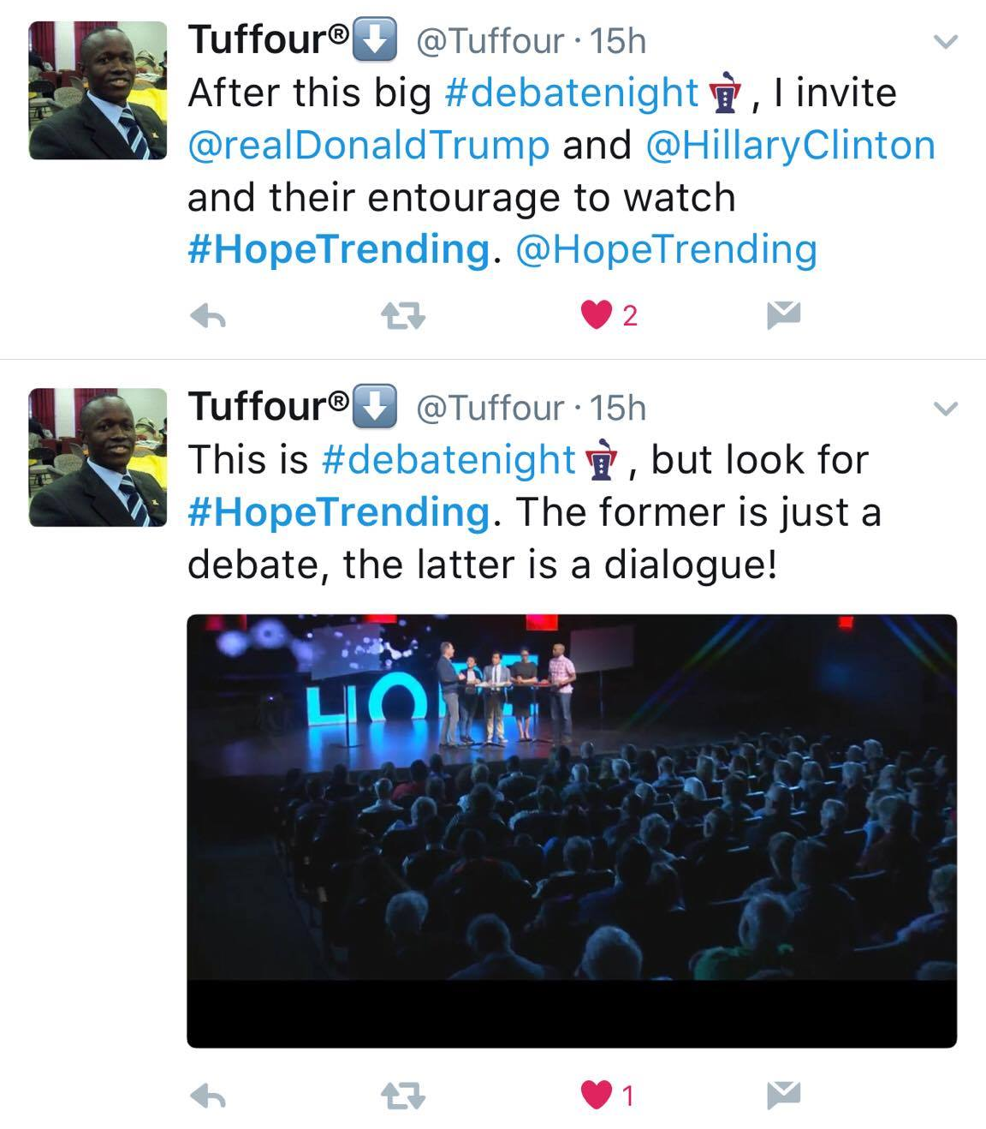
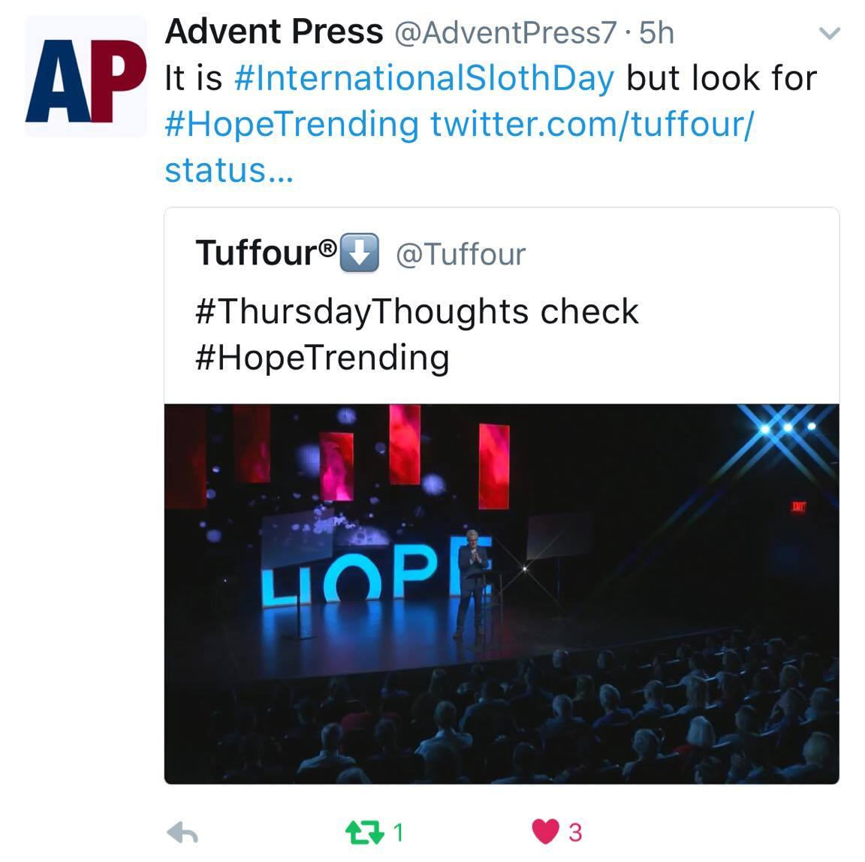
Additional Terms: Common Hashtag Themes
Collective conversation around reoccurring themes
Popular hashtags & trending hashtags are sometimes used in unrelated posts to get more views.
#FF (Follow Friday)
#TBT (Throw Back Thursday)
#TT (Trivia Tuesday)
#MondayMotivation
#WednesdayWidsom

Slide 27
In summary
Social media represents a bold new frontier for mission.
Reaching souls in the digital realm means cutting through the noise with an integrated communications strategy.
Digital communications is a way of magnifying the impact of traditional means, not replacing it.
Everyone is on Facebook. It is the new website.
Twitter skews younger and male. A place for news junkies and conversation.
Instagram targets under 25 and is highly visual.
Snapchat is the second most used platform and skews very young.
Pinterest is for woman of all ages and planners.

Slide 28
Questions?
Follow @DigiEvangelism on Facebook, Twitter, and Instagram for more digital marketing tips and tricks.
Visit SDAdata.org for more resources, blogs, and upcoming videos.
The next class will focus on: Tips for Getting Started – Strategy, Goals, Branding, Hashtags and more
Notes:
I know this is a lot of information. So I wanted to allow for plenty of question and answer time. I’m also happy to live-demo anything else you want to see.
For those of you who want to receive a copy of this presentation, see me afterwards to give me your email address.

